Slide 1
CVPR19

Slide 2
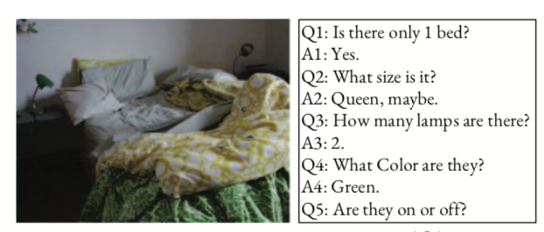
Visual Dialog
Two major Problem:
How to answer visually-grounded questions, which is the core challenge in VQA
How to infer the co-reference between questions and the dialog history
example: pronouns (e.g., “they”) in the question (e.g., “Are they on or off?”) are linked with nouns (e.g., “lamps”) appearing in the dialog history (e.g., “How many lamps are there?”) and the object grounded in the image.
An unmade bed with side table and lamps.

Slide 3
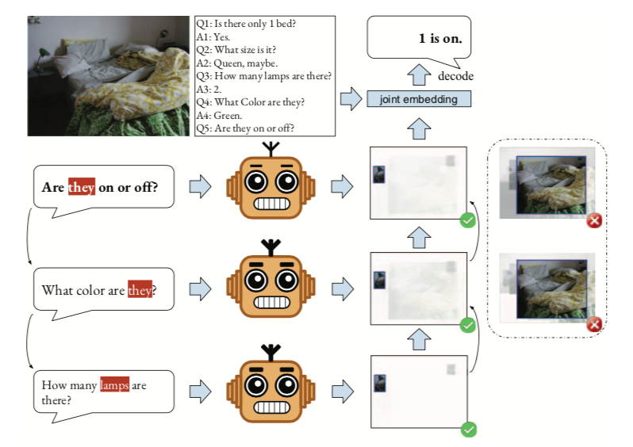
Intuition
Previous work: apply a soft attention over all the stored visual attentions for refinement
Human rarely remember all their previous visual attentions, and only review the topic-related dialog history when confused with ambiguous question
expect our dialog agent to selectively review the dialog history.

Slide 4
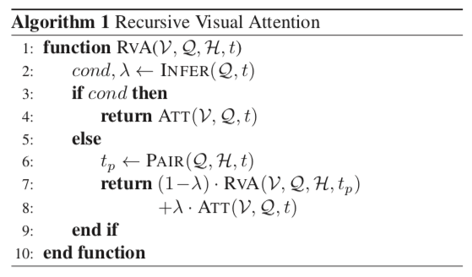
Approach
INFER module: assert the recursion termination condition and compute visual feature fusion weight
PAIR module: return the paired round
ATT module: calculate question-guided visual attention

Slide 5
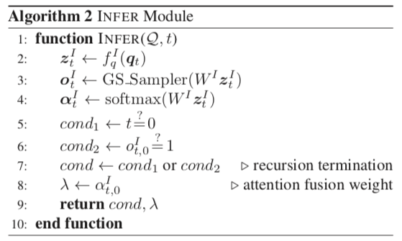
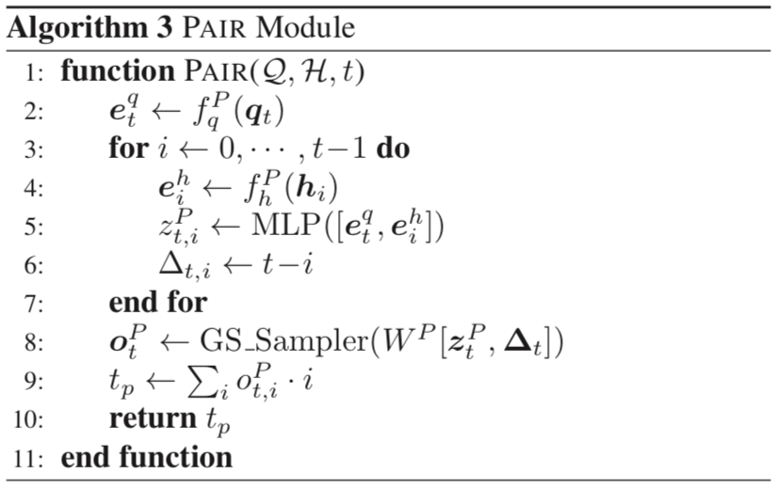
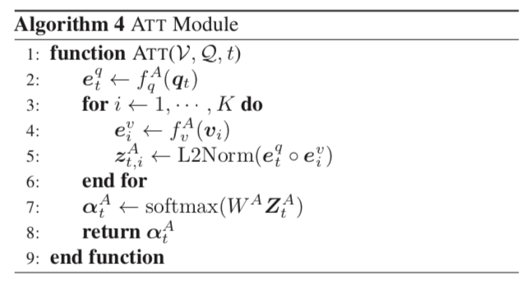

Slide 6
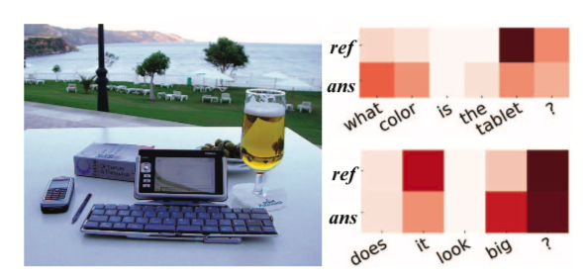
Feature Representation
filtered visual feature +
answering-aware question feature +
fact embedding

Slide 7
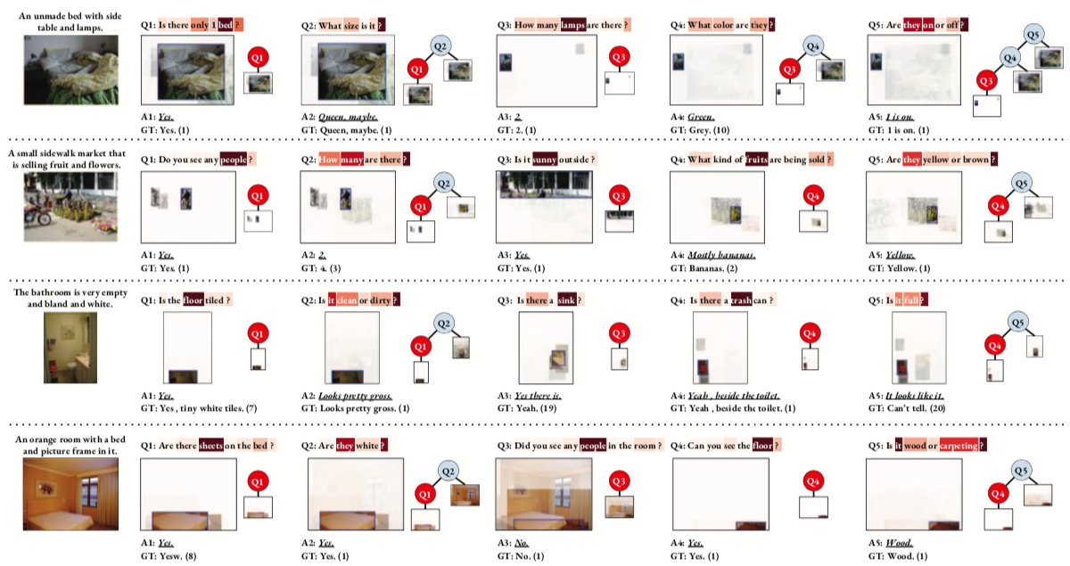

Slide 8
