Slide 1
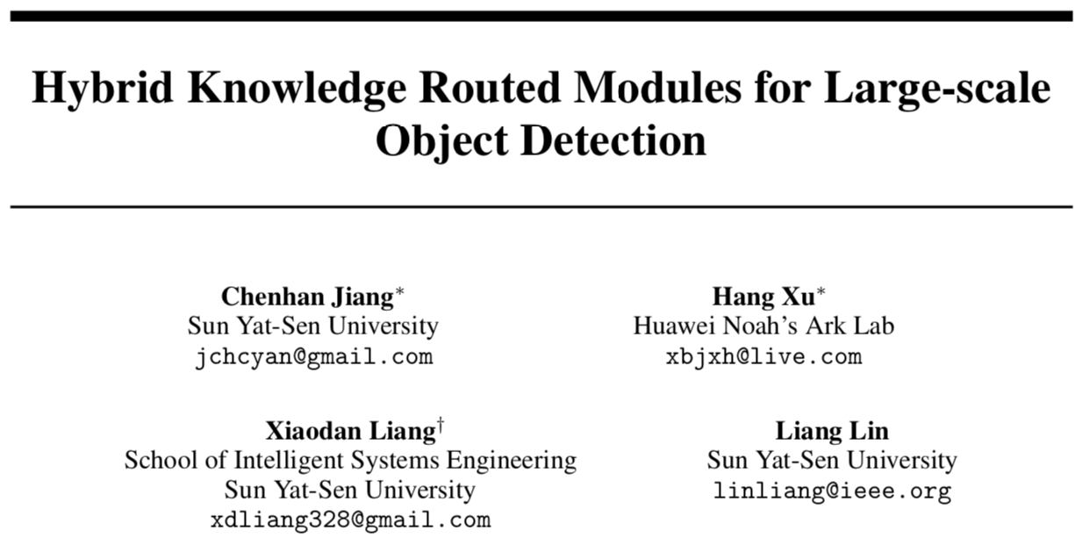
NIPS 2018

Slide 3
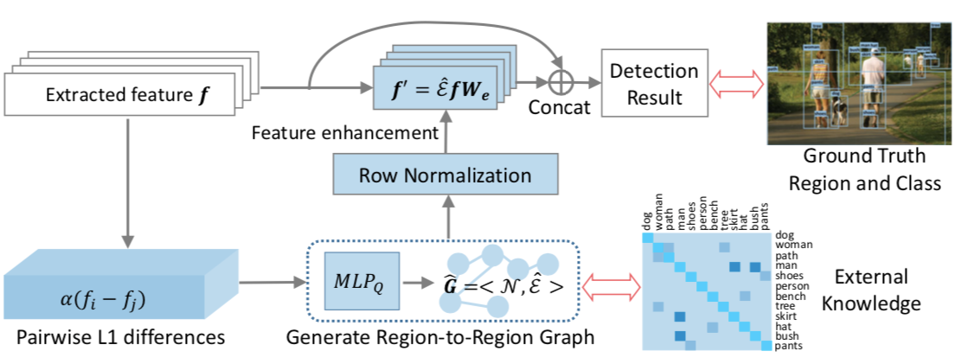

Slide 4
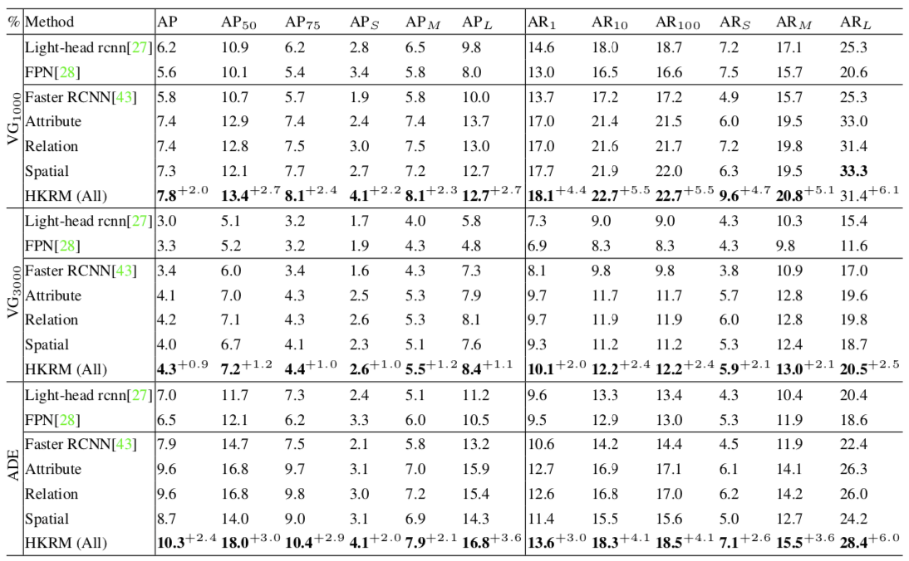

Slide 5
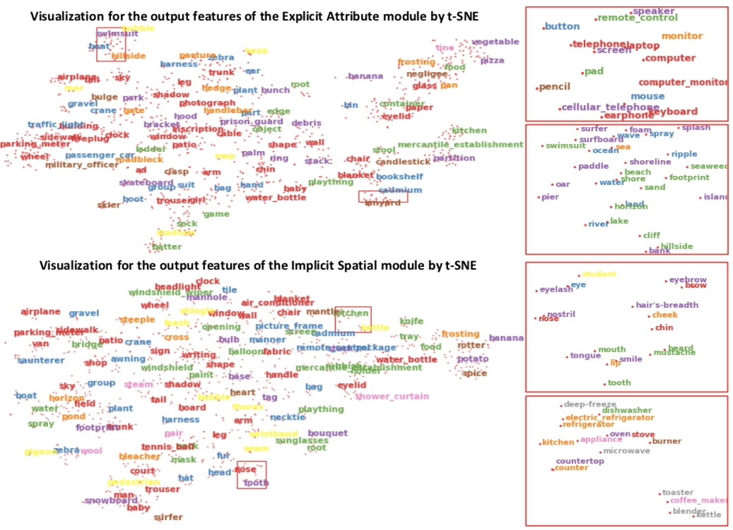

Slide 6
CVPR19 Oral

Slide 7
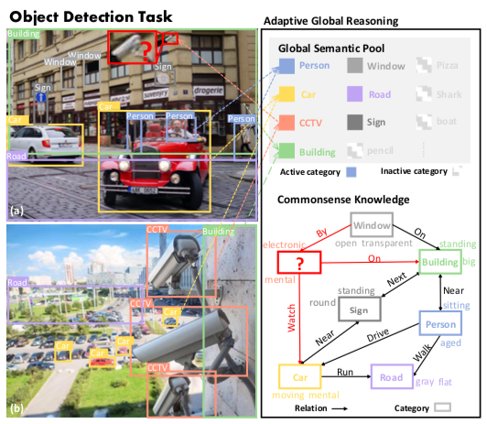
Motivation
Treat the recognition of each region separately -> require high-quality feature representations and sufficient labeled data.
Current detection systems lack the ability to reason with the help of commonsense knowledge
Recent work:
model spatial relationship -> implicit and uncontrollable
propagate region-wise feature locally -> fail to reason through a bad feature representation
Notes:
人类的推理经验：会全局地搜寻相似外观的物体（利用全局的关联性）；利用位置的常识，比如安装在墙上。

Slide 8
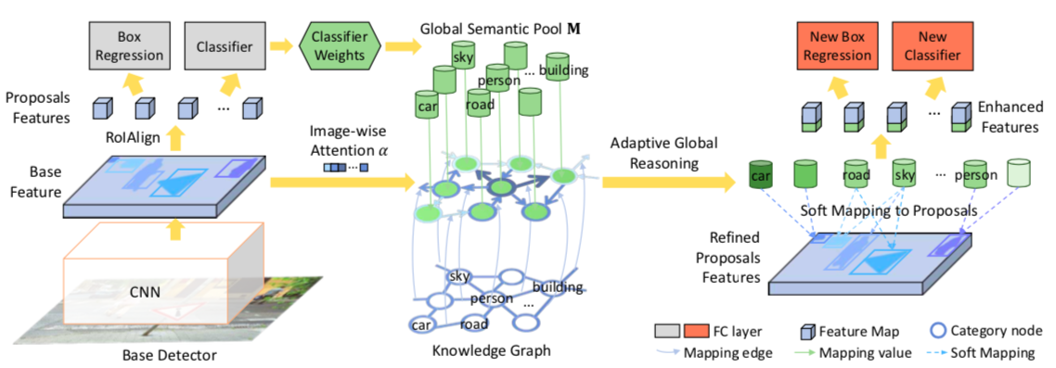
Framework

Slide 9
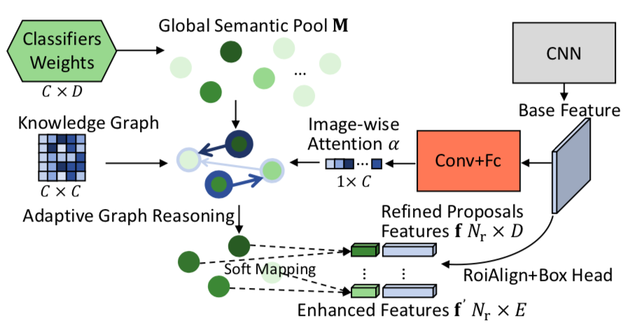
Adaptive Global Graph Reasoning Module
Global Semantic pool M
inspired by zero/few shot learning
weights of the classifier constrains high-level semantic information since they record the feature activation trained from all images.
Notes:
现有方法使用某一个类别的全局性的特征是如何处理的？使用平均或聚类的方法找到特征的中心，作为参考的类别
zero/few shot中训练模型去拟合出没有见过的类别的分类器权重，分类器权重包含丰富的语义信息（需要探究）
将分类器权重作为了全局的encode了类间关联性的特征
必须pretrain，然后才能其作用。

Slide 10
Adaptive Global Graph Reasoning Module
2. Feature Enhanced via Graph Reasoning
propagate the connected categories of M by the edges in the prior knowledge graph
soft-mapping
Notes:
soft mapping避免了直接分配结果带来的风险
边的权重硬编码，不够灵活不能调整，容易带来些噪声

Slide 11
Adaptive Global Graph Reasoning Module
3. Adaptive Attention
Squeeze-and-Excitation to further rescale the categories being considered.
Notes:
主要意义是利用图片的视觉特征和构建graph连通方式来引导了全局特征的组合分配。

Slide 12
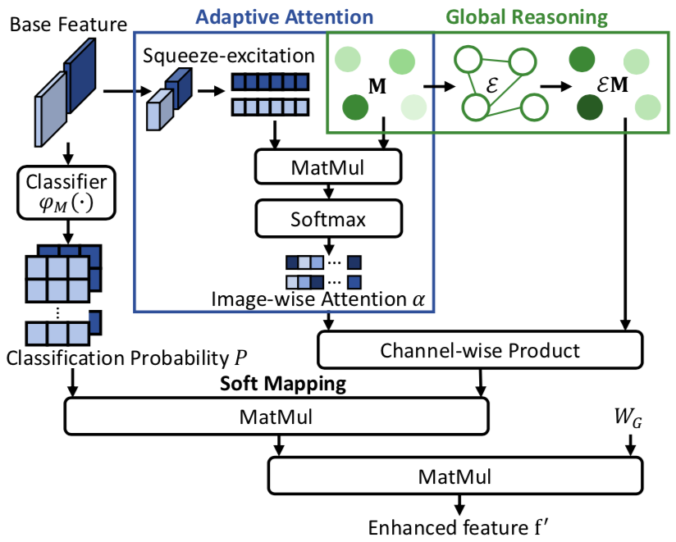
Adaptive Global Graph Reasoning Module

Slide 13
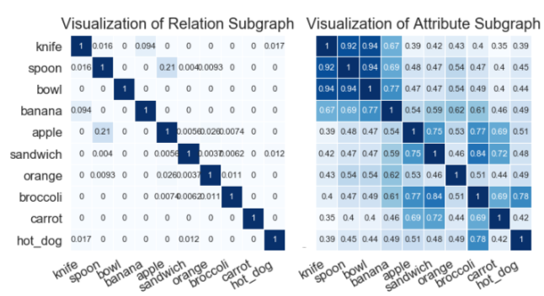
Model Specification with Relation Knowledge
Relationship knowledge graph
Attribute knowledge graph

Slide 14
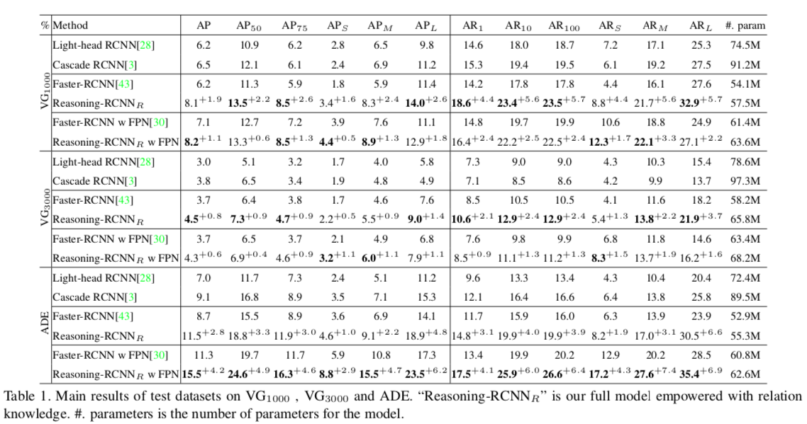
Experiments

Slide 15
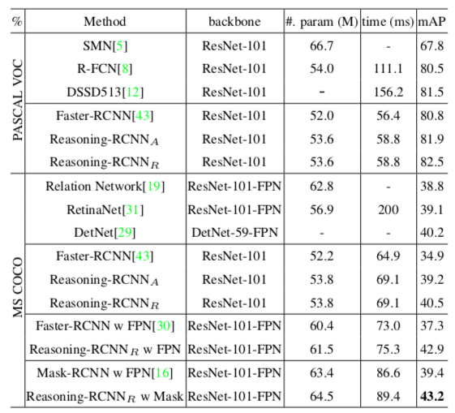
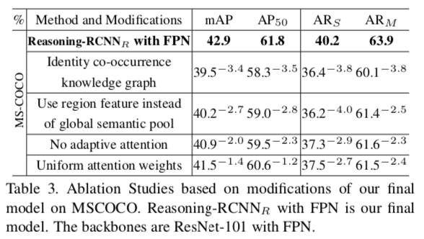
Experiments

Slide 16
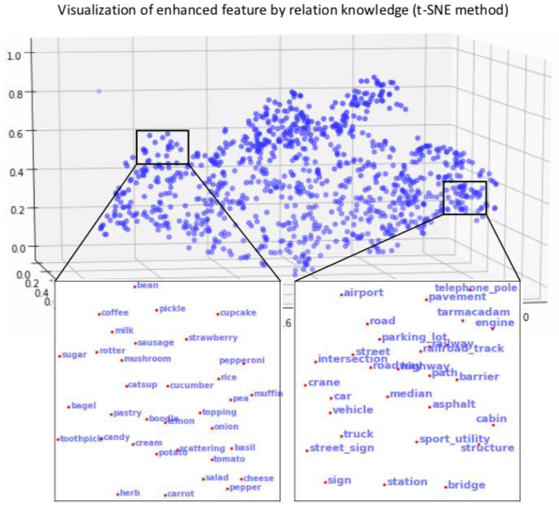
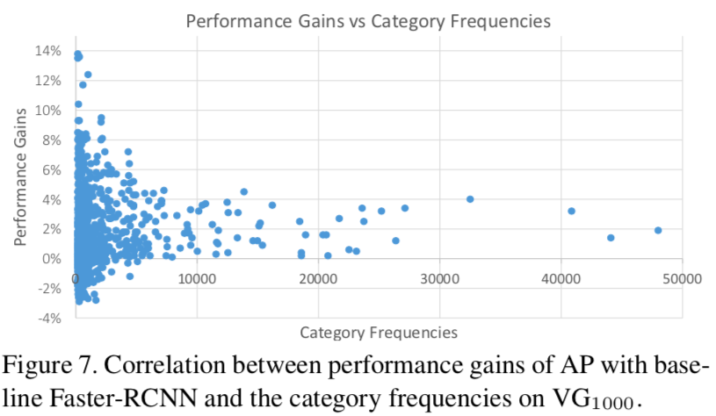

Slide 17
Thanks

