Slide 2
deep-RL-from-pixels problems
It can learn arbitrary policies in an elegant and end-to-end fashion , but:
1.requires massive amounts of data (large sample complexity)
2. results policies do not transfer well across environments
Notes:
Recent researches shows that RL could be used to train policies directly on raw images.
But this kind of method have many problems such as :
requires massive amounts of data which means large sample complexity, and the resulting policies do not transfer well across environments. It is shown in the experiment that learning from raw images is not better than a blind agent

Slide 3
Illustration
Notes:
So to solve these problem, This paper suggest to use mid-level visual representations for RL.
One of the goals of computer vision is formulating useful visual priors about the world and developing methods for extracting them. Conventionally, this is done by defining a set of problems, like object detection, depth estimation.
In this paper， It study how such standard vision objectives can be used within RL frameworks as mid-level visual representations.
Look at the left picture. The mid-level representations come from a set of neural networks that were each trained, offline, for a specific vision objective.
In this way ,it can warp the input distribution between the training set and test set. And then use the mid-level represents to train the agent to learn the downstream policies.
In this work they test a lot of mid-level representations in different tasks and get some interesting results.

Slide 4
Experiments
Environments:
1.Habitat platform with the Gibson dataset
2. Gibson Environments
3. ViZDoom
Downstream Navigation Tasks
1.Local Planning
2. Visual Exploration
3. Navigation to a Visual Target
State-Representation Baselines
Tabula Rasa (Scratch) Learning (trained on raw RGB image )
Blind Intelligent Actor (input a fix image)
3.Representation Learning: dynamics-modeling,
curiosity, ImageNet pretraining, etc.
4. Non-Learning : SLAM , hand-engineered systems
Mid-Level Representations:
1.24 different computer vision objectives
e. g: Texture Edges, plane normals
2. Trained on a dataset of 4million indoor scenes
3.Do not change when training policy
Notes:
These are some experiment settings:
There are three downstream navigation tasks:
the first one : Local Planning: The agent must direct itself to a given nonvisual target destination and the destination is specified using coordinates.
The second one :Visual Exploration: The agent must visit as many new parts of the space as quickly as possible
And the third one: Navigation to a Visual Target: In this scenario the agent must locate a specific target object as fast as possible
The train and test platform are Habitat, Gibson, and ViZDoom
And the mid-level Representations are trained on a dataset of 4 million indoor scenes for a vision objectives offline, which means it doesn’t change during training the agent to learn policy . In this paper it test 24 different computer version representations.
And there are four different baselines: the first is RL mathod trained on raw picture. The second is a blind agent. It’s input image is always the same one.

Slide 5
Core Analysis
Final Performance
Generalization
Sample Complexity:
Notes:
There are three core analysis .
The final performance of the model , they evaluate agents in a test space distinct from where the agents were trained.
Generalization, How the agent work in a different environments or longer distance
And Sample Complexity, the number of frames for training
Here are some results

Slide 6
Final Performance
Desirable emergent behavior
Notes:
The picture above shows the models use mid level-representations works better then the others in test set.
Also, Using use mid level-representations show higher success rate, fewer collisions and less jerk also more robust to noisy sensors

Slide 7
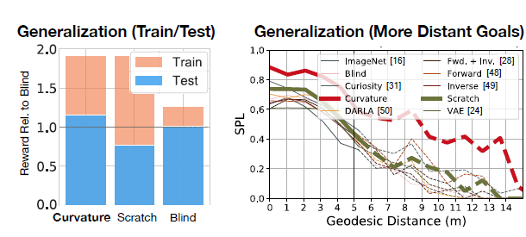
Generalization
Notes:
There are two different metrics, the first is how well agent generalizes to the test set of different environments. We can see from the first picture that the scratch is overfit to the training data set, even worse than a blind agent. And using mid-level representations is better.
And the second metric is how well the agent works on long distance navigation. It can be seen in the left images, using mid-level representations (the red line) is much better.

Slide 8
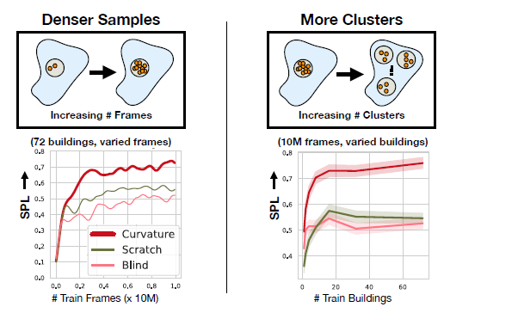
Sample complexity
Performance by Number of Training Frames
Performance by Number of Sample Clusters
Notes:
There are two different ways to increase the samples the first one is increase the number of training frames. The other one is let the agent to see different buildings.
models Using mid-level representations use less data and performs better in both ways.

Slide 9
Rank Reversal: Which Mid-Level Feature to Use?
no feature is universally useful for all downstream tasks e. g.:
feature rankings uncorrelated among three tasks
within-task ranks were consistent between environments
Notes:
There are not one or two canonical representations that consistently outperform all else. In different downstream task ,different represents works better.
For example, the top-performing exploration agent used representations for Distance Estimation, perhaps because an effective explorer needs to identify large open spaces.
And as the table shows, the feature rankings uncorrelated among three tasks but within tasks ranks are highly consistent between environments

Slide 10
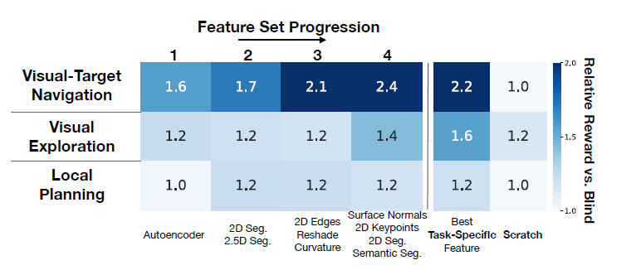
When the Downstream Task is Unknown or Changing
Use a Set of Feature performs better：
Notes:
They evaluated the Max-Coverage feature set for this purpose. The Max Max-Coverage set is that different version representations concatenate together . It works almost same well as the best represents.

