Slide 2
Task
an agent is given a natural language instruction referring to a remote object.
The agent must navigate to an appropriate location and identify the object from multiple distracting candidates.
a high-level natural language instruction
surrounding panoramic images
output a bounding box or choose from several
candidates provided by the simulator.

Slide 3
Matterport3D Simulator
Anderson P , Wu Q , Teney D , et al. Vision-and-Language Navigation: Interpreting visually-grounded navigation instructions in real environments[J]. 2017.
Simulator for embodied visual agents, based on Matterport3D dataset (Chang et. al. 2017)
Contains 10,800 panoramic images / 90 buildings
High visual diversity
Notes:
This task build based on a matterport simulator…

Slide 4
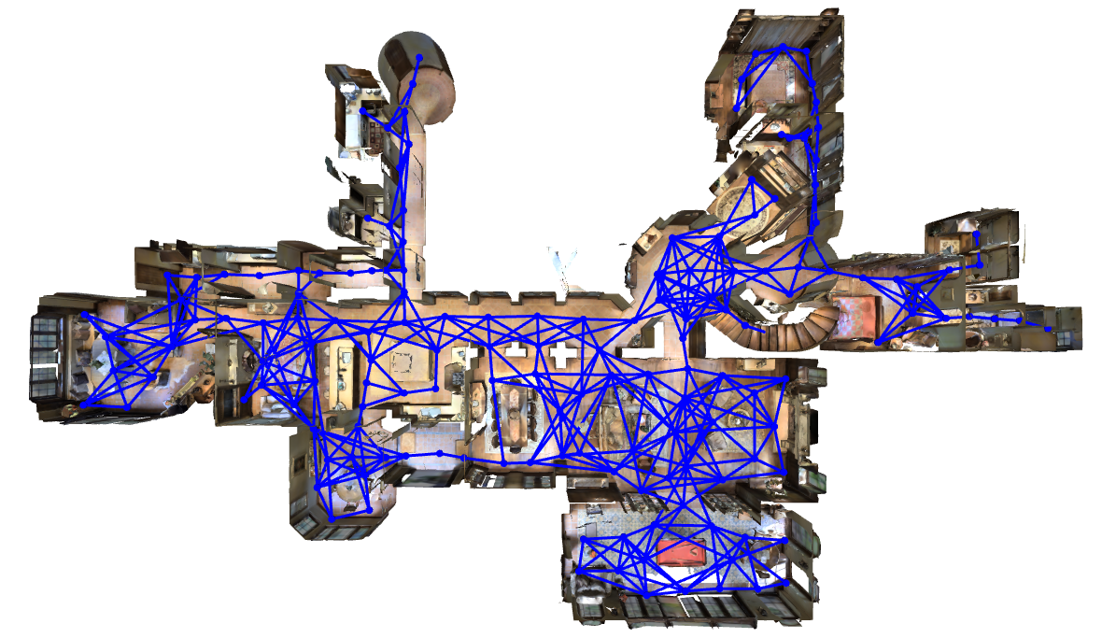
Feasible trajectories determined by navigation graph

Slide 5
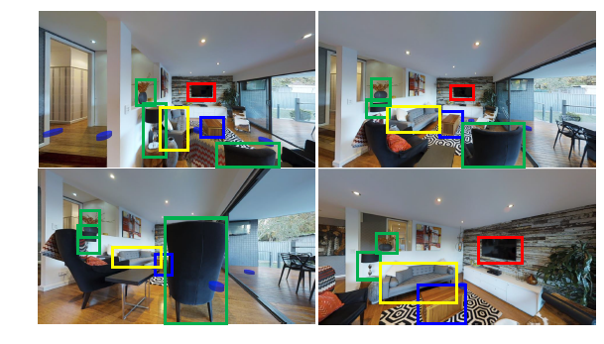

Slide 6
MAttNet

