Slide 1
Multi-label classification
包仁达 2020.06.06

Slide 2
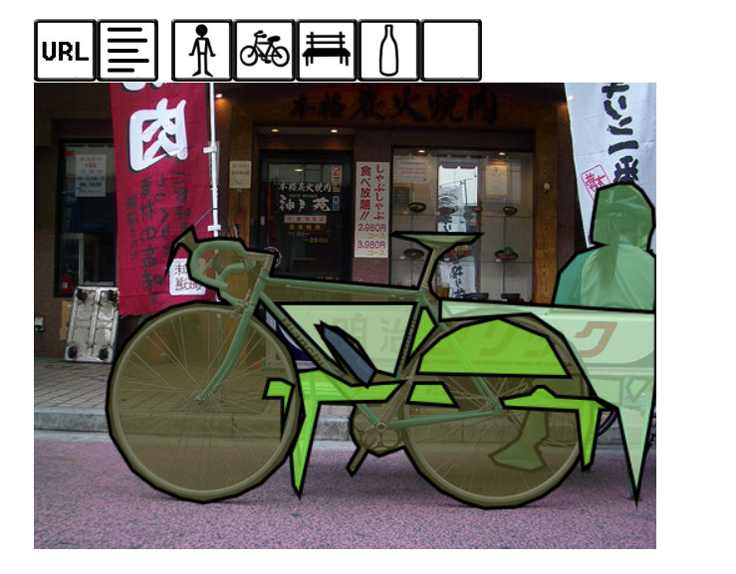
Introduction
Multi-class Classification
最常规的N类分类问题
Softmax + cross entropy loss
Multi-label Classification
Label之间不是互斥的，可以共存
Aka：Image Tagging / Image Annotation
相近的任务
Tag based image retrieval
Weakly supervise object detection → COCO
Multi-label learning with missing label
……

Slide 3
Methods
最朴素的方法
CNN + sigmoid + binary cross entropy loss
转换成了“N个2分类”问题
局限
未考虑label间的关系
当label很多时（>1k），很可能较难收敛[1]
分类空间 N -> 2^{N}
实践上，很容易输出全0，recall极低
[1] Mahajan D, Girshick R, Ramanathan V, et al. Exploring the limits of weakly supervised pretraining[C]//Proceedings of the European Conference on Computer Vision (ECCV). 2018: 181-196.

Slide 4
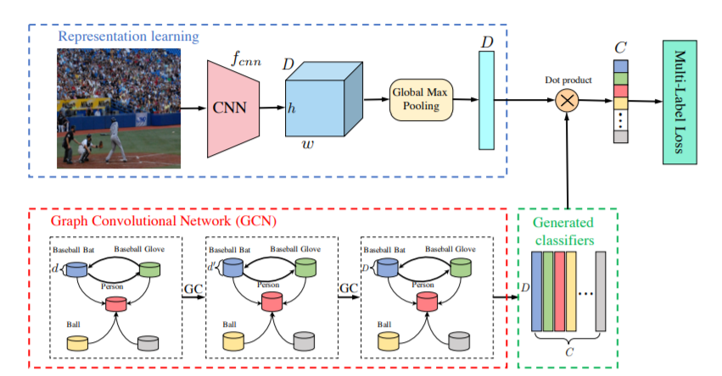
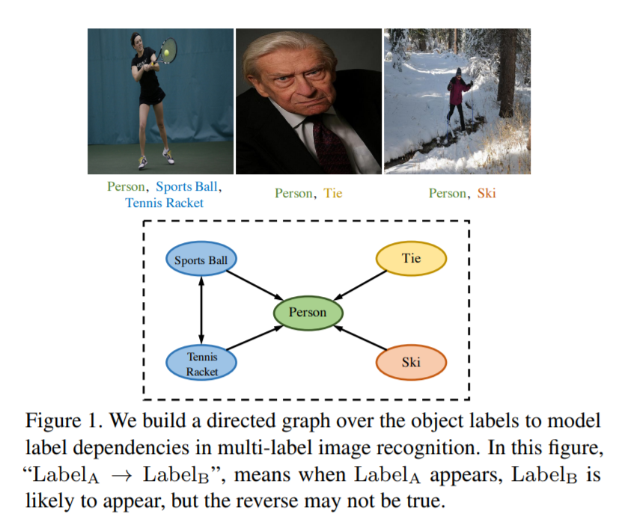
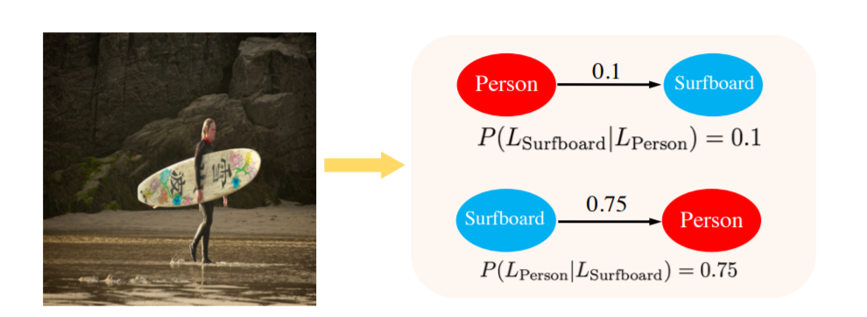
改进label间关系-GCN
Multi-Label Image Recognition with Graph Convolutional Networks. CVPR 2019
GCN Node：Glove embedding of labels ; Edge weight：label 共现的条件概率
End-to-end training with BCE loss
SOTA

Slide 5
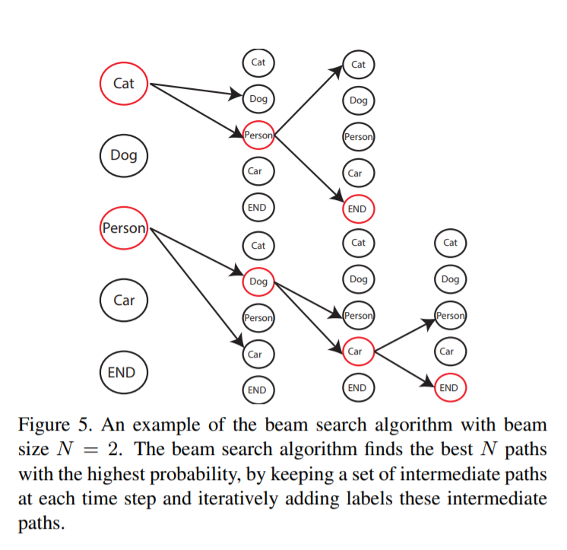
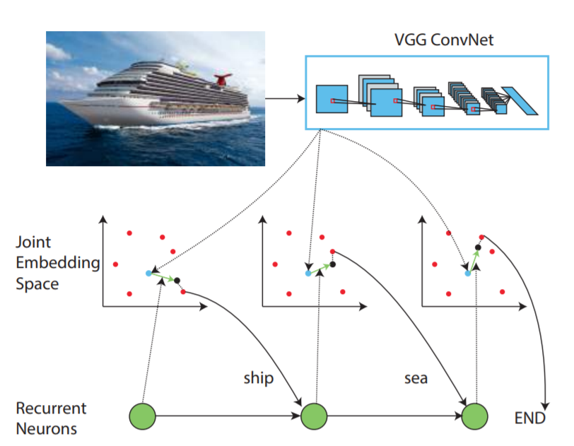
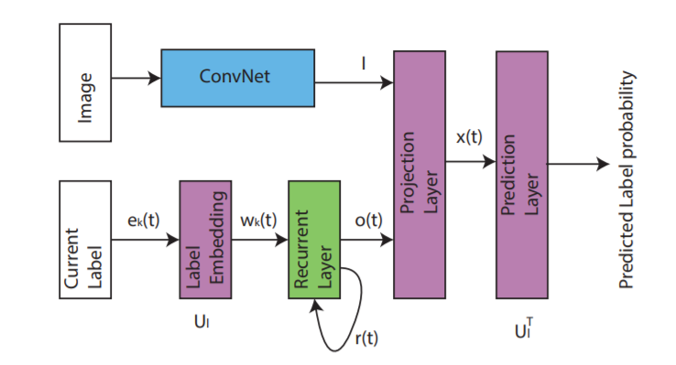
改进label间关系- Seq2Seq
CVPR 2016
Weakness：按label频率人为规定了label顺序（Random无法收敛）

Slide 6
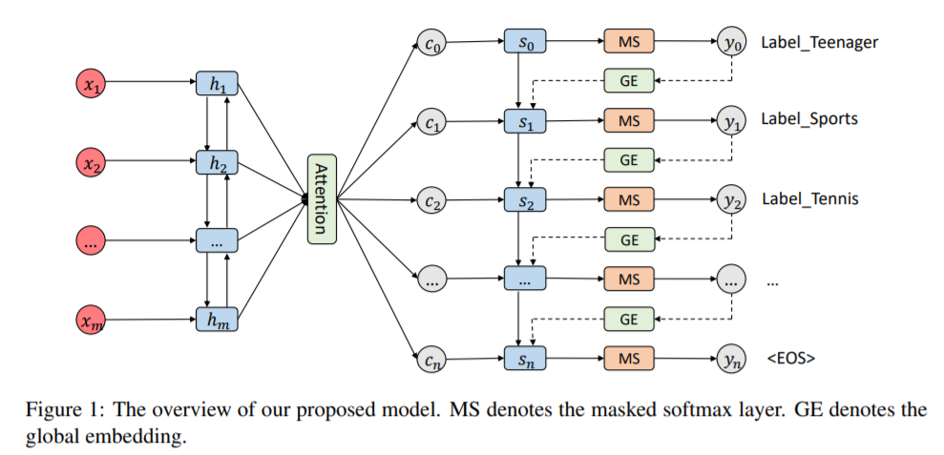
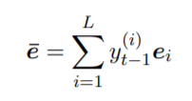
改进label间关系- Seq2Seq
COLING 2018 Best Paper
排除已预测的label
使用Global Embedding 减轻t-1预测错误的干扰

Slide 7
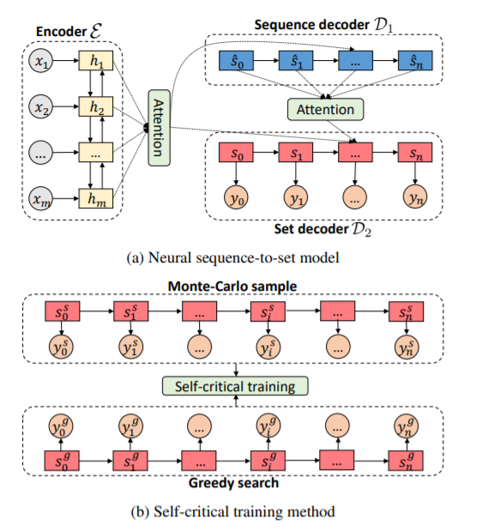
改进label间关系- Seq2Seq
ACL 2019
Seq2set
主要解决了ground-truth中label order的问题

Slide 8
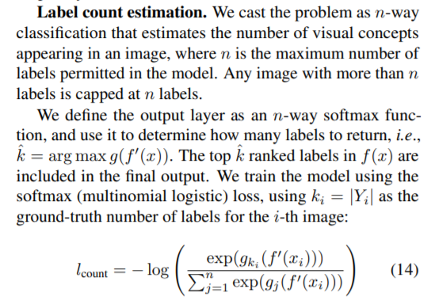
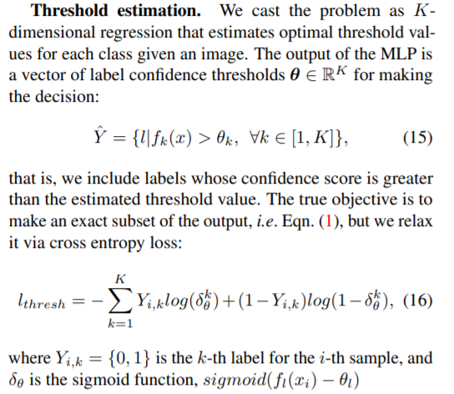
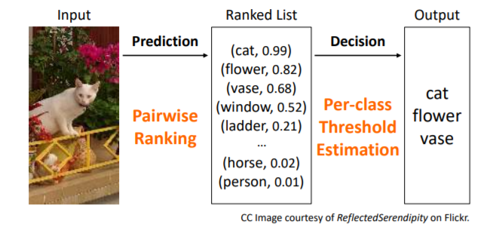
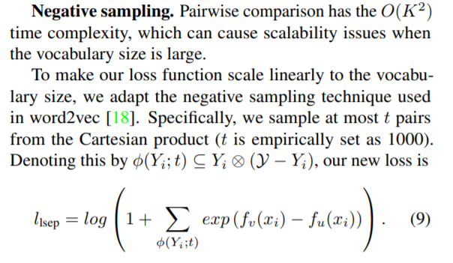
基于Embedding
CVPR 2017
接近Image-text matching
Key point
Metric learning.
Negative sampling.

Slide 9
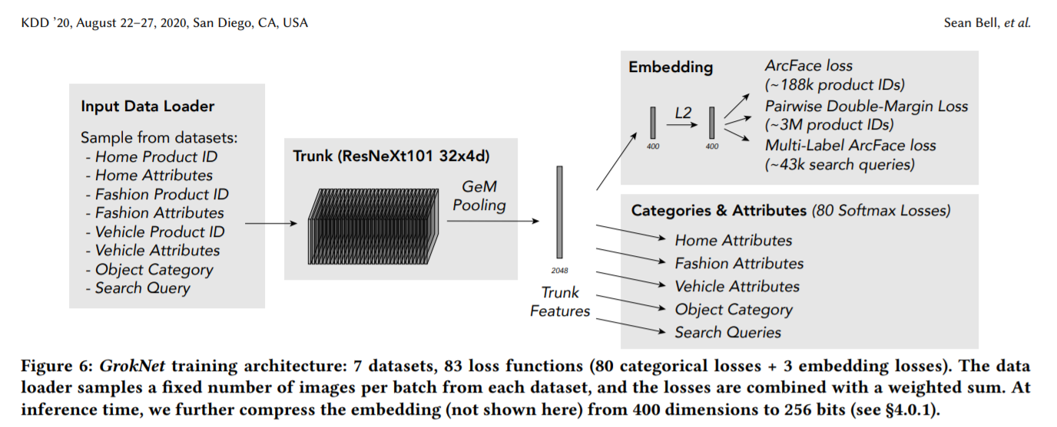
其他相关的工作
GrokNet
Multi dataset and Multi task.
Data preprocess + pre-training + fine-tuning
Multi-label Softmax loss
GT label: 1 -> 1/k
Multi-label ArcFace loss
Multiple “class center”
Pairwise loss

Slide 10
模型之外的工作
数据和任务定义是核心
Dataset collection
Automatic annotation
Label correction
模型之外的优化可能更有性价比
Active learning
Missing label
Task-oriented evaluation

