Slide 3
Plane Detection Network
Mask R-CNN

Slide 4
Plane normal estimation
通过将平面的方向做聚类得到七个类别（anchor normals）.
在mask-rcnn做物体分类的部分对平面划分到这七个类别中的某一类。
同时多输出3*7个输出，对平面normal做回归。
和 bounding box regression 的方法相同

Slide 5
Depthmap estimation
Decoder：3*3 convolution stride 1 and 4*4 deconvolution with stride 2

Slide 6
Plane offset estimation:

Slide 8
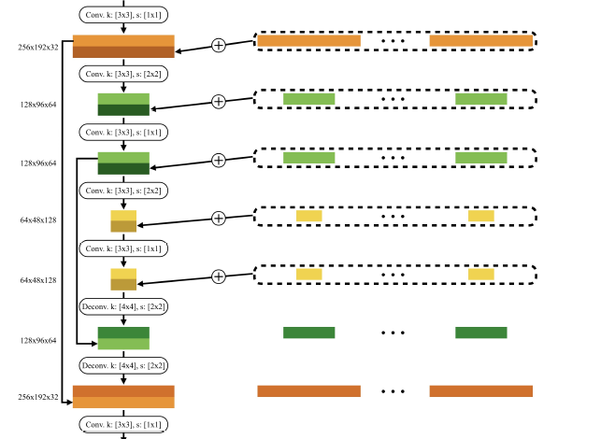
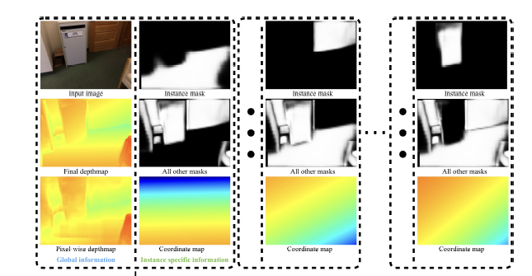
Segmentation Refinement Network

Slide 10
Warping Loss Module
1) computing depth values from the plane equations for planar regions
2) using pixel-wise depth values predicted inside the plane detection network for the remaining pixels.
3）Depthmaps are converted to 3D coordinate maps

Slide 11
4. project to the current frame, and use a bilinear interpolation to read the 3D coordinate
5. L2 norm of all such 3D distances divided by the number of pixels is the loss.

Slide 12
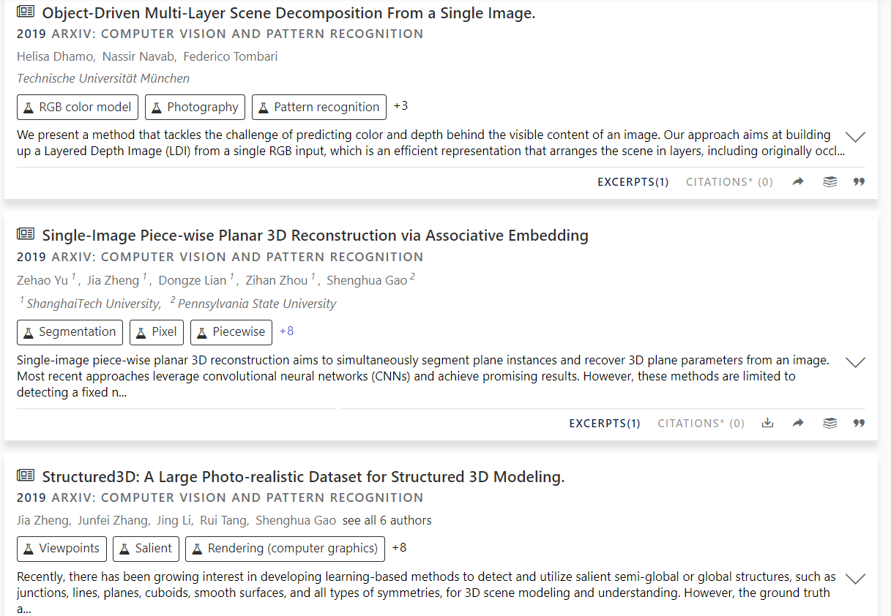

Slide 14
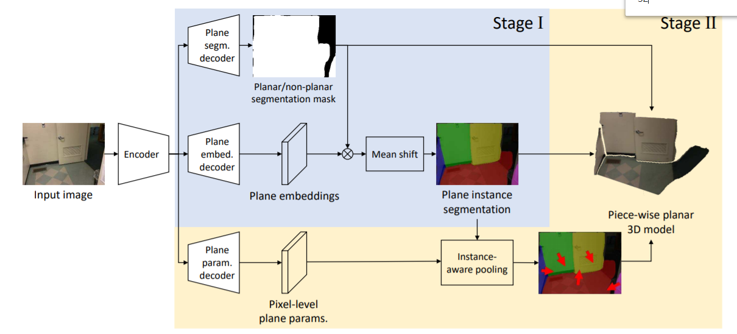
proposal-free instance segmentation，30fps

Slide 15
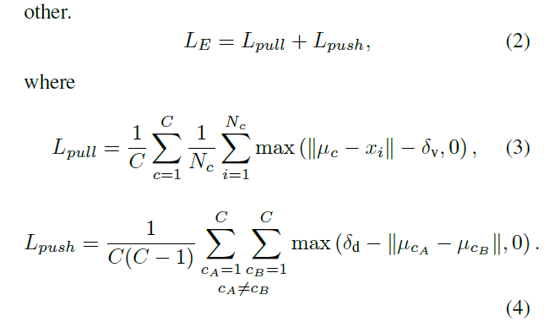

Slide 16
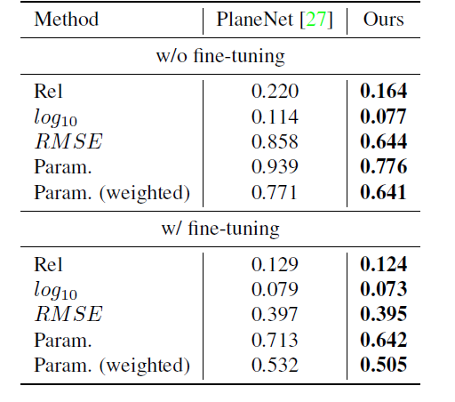

Slide 19
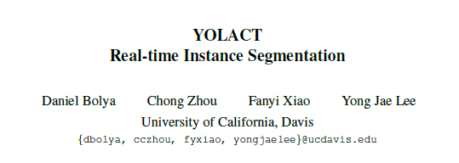

Slide 20
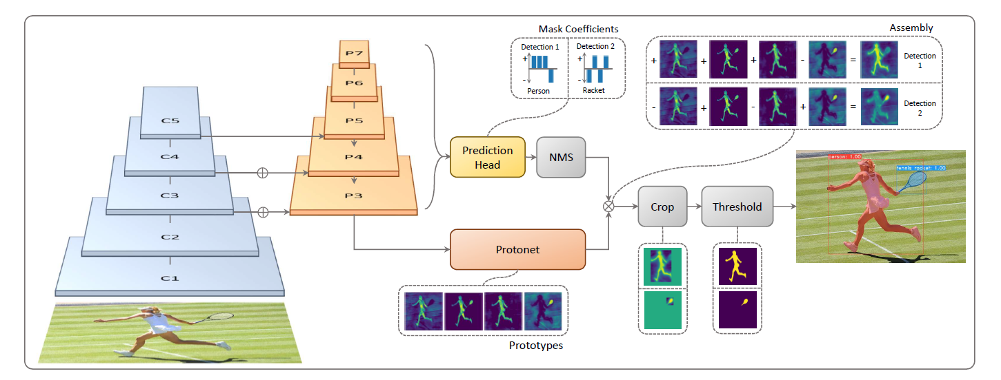

Slide 21
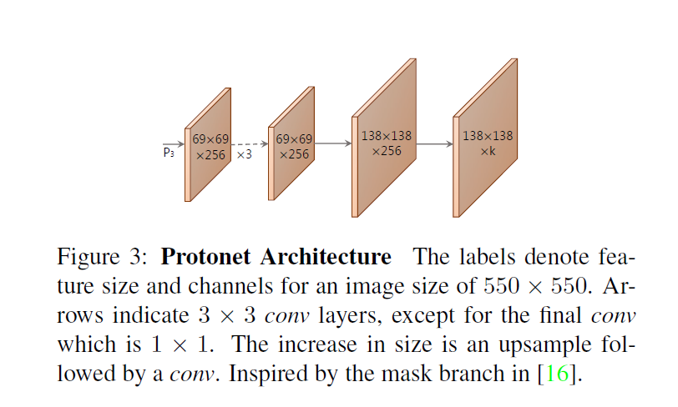

Slide 22
