Slide 1
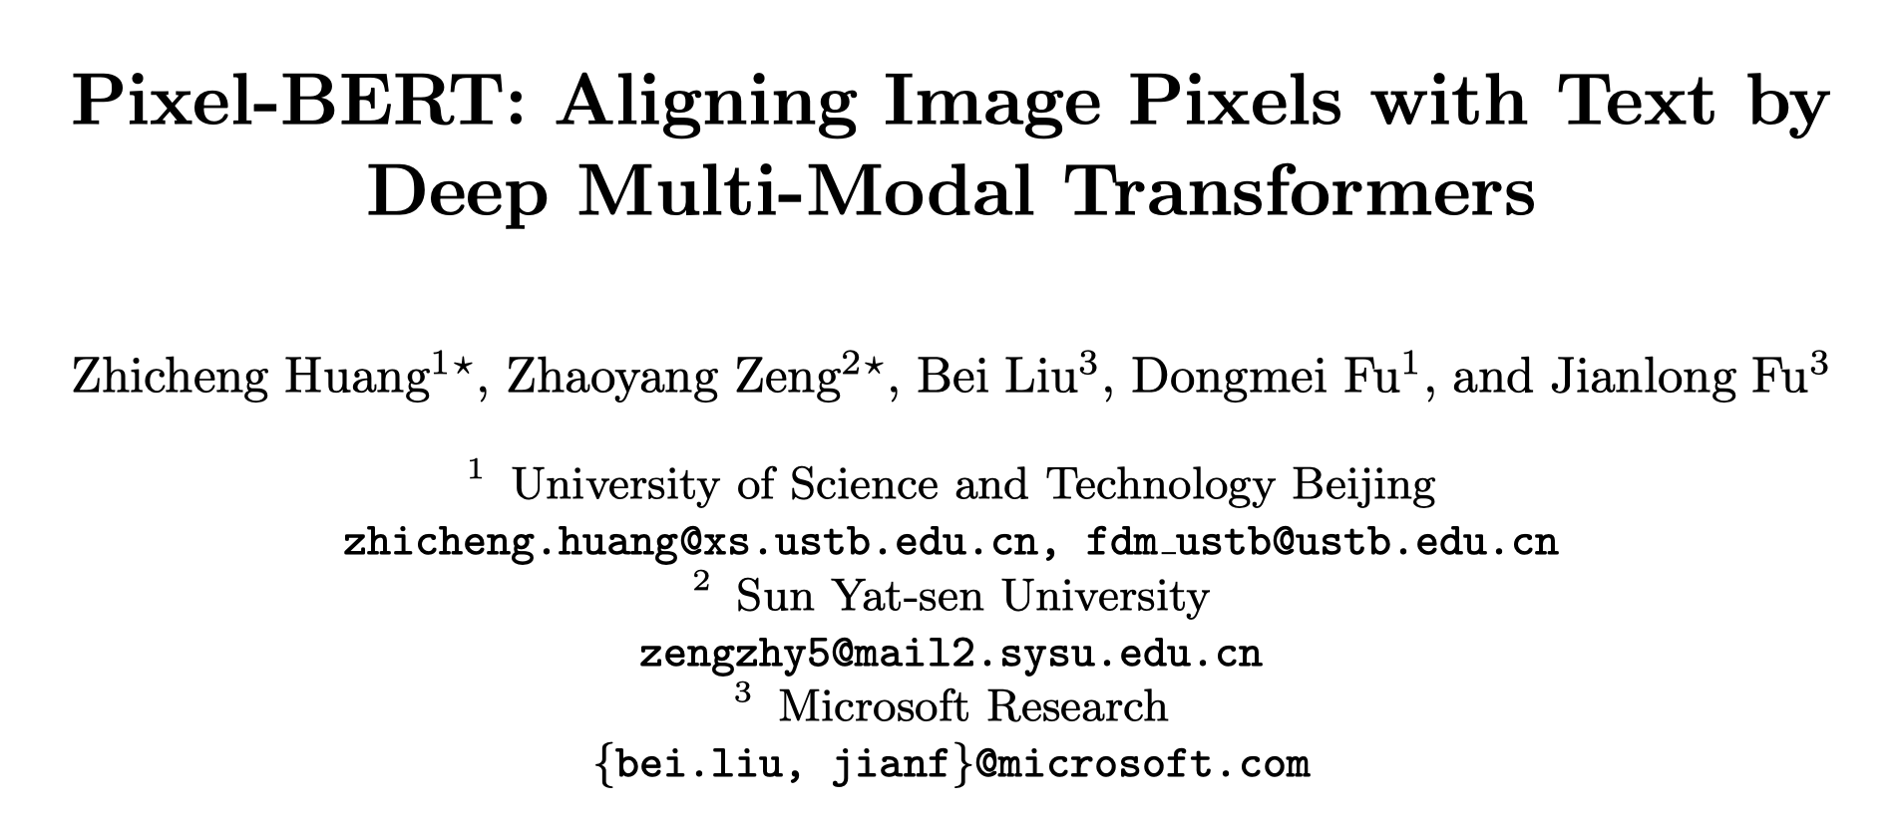

Slide 2
Motivation
Most methods in cross modality learning utilize BERT-based language feature and region-based visual feature as the input for joint embedding learning in pre-trained models
The shape rectangle of bounding boxes restricts will bring noisy information in the background
Some important factors of visual information are lost, such as shapes of objects, spatial relations between objects of overlapped bounding boxes, etc
The feature representation capability is limited to the given categories of object detection
Visual information about broader semantics such as scene and sentiment are also lost in the object detection model

Slide 3
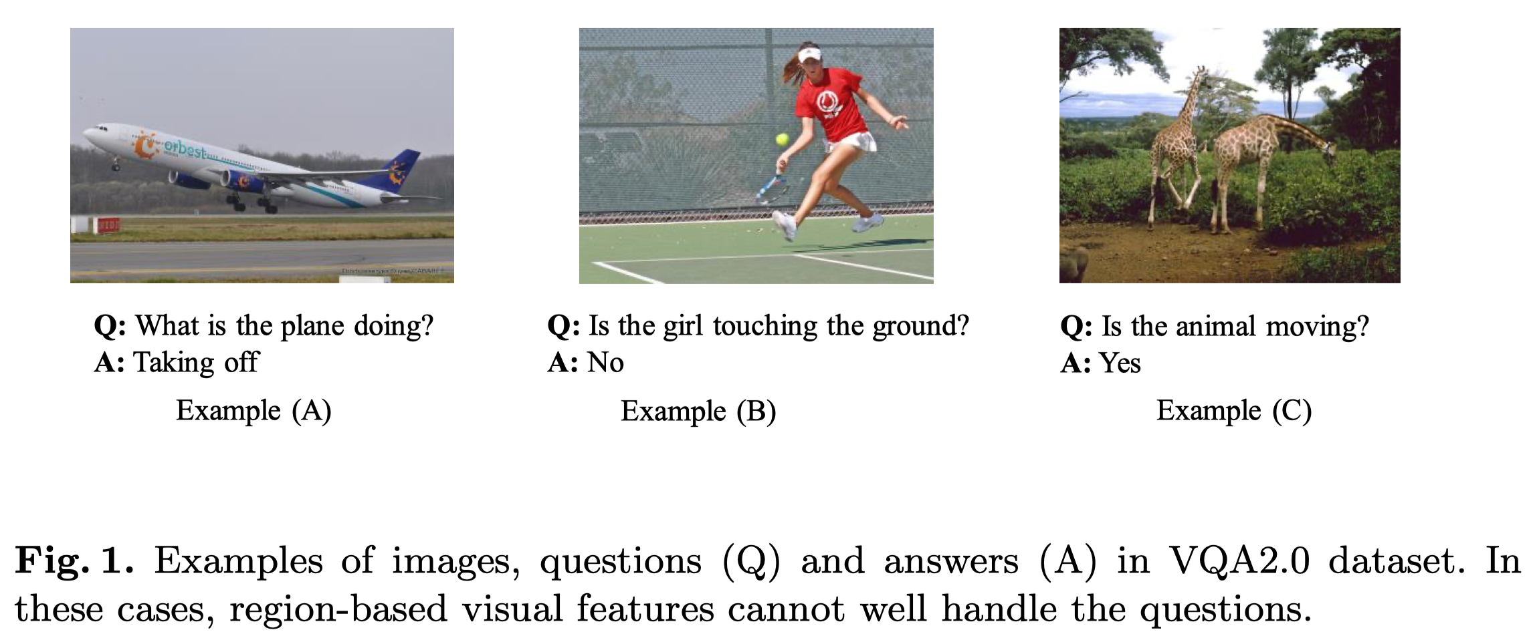
Motivation

Slide 4
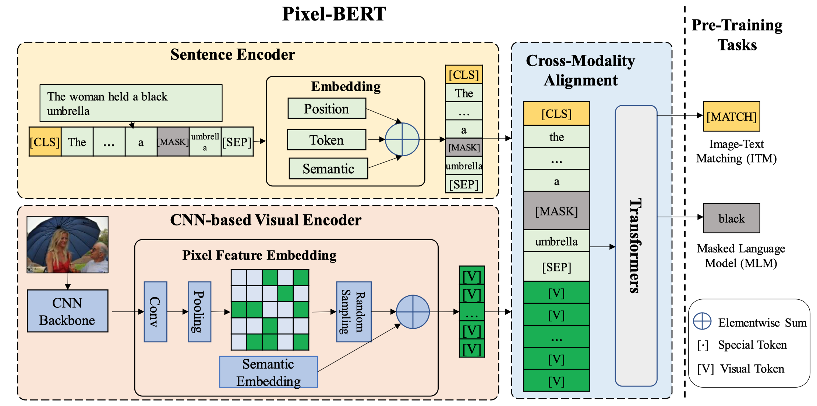
Framework

Slide 5
Pretraining Task
Masked Language Modeling: randomly mask language tokens with a probability of 0.15, and require the model to predict the masked tokens based on other non-masked tokens and visual tokens
Image-Text Matching: apply a binary classifier on the joint embedding feature of [CLS] token to classify whether the input image and sentence are matched or not

Slide 6
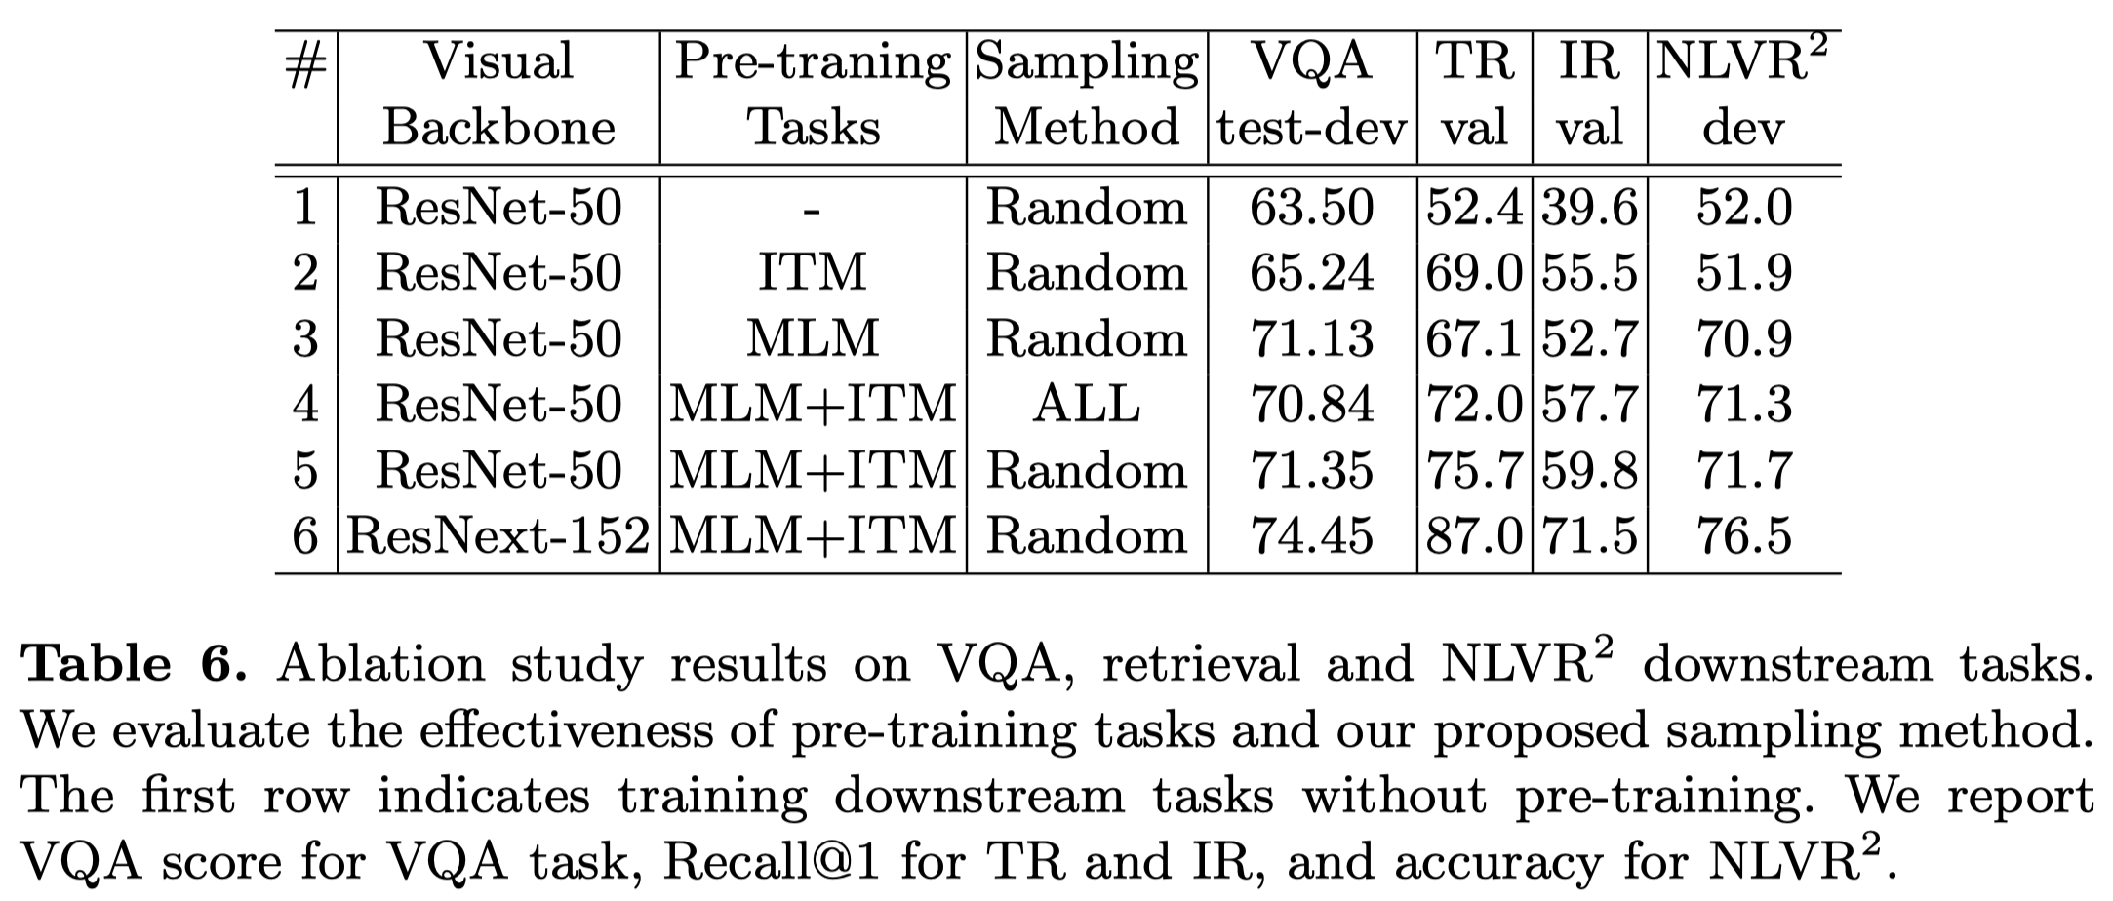
Experiments

Slide 7
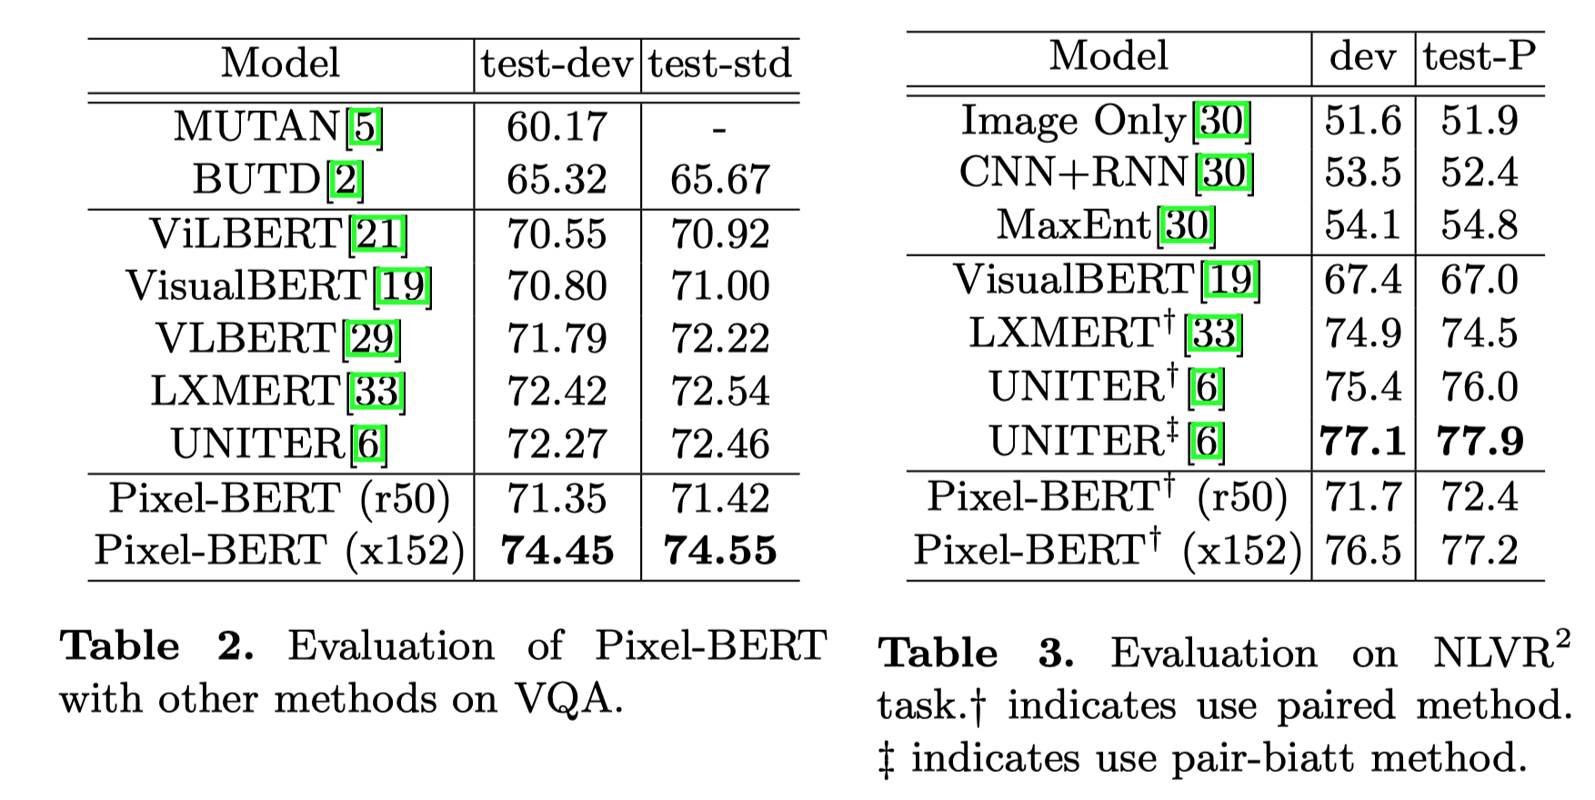
Experiments

Slide 8
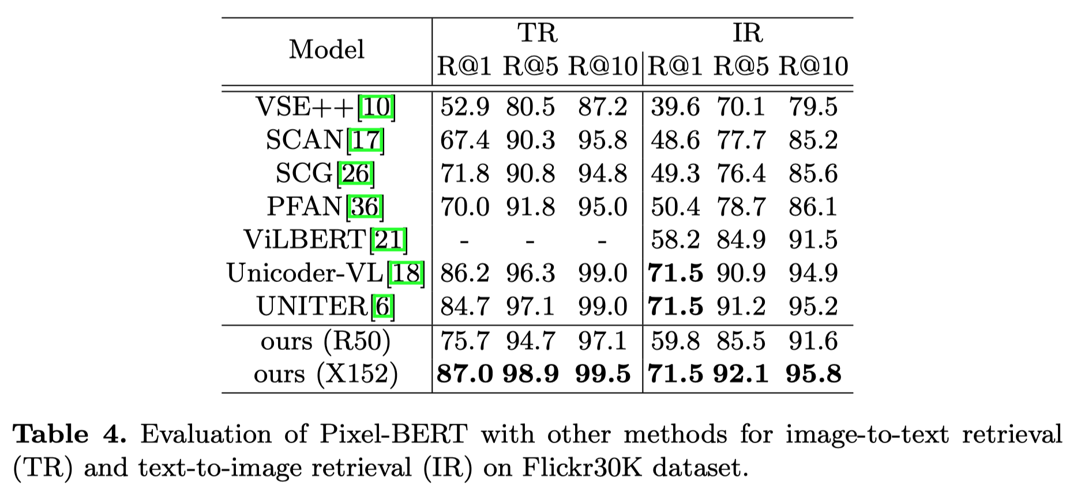
Experiments

Slide 9
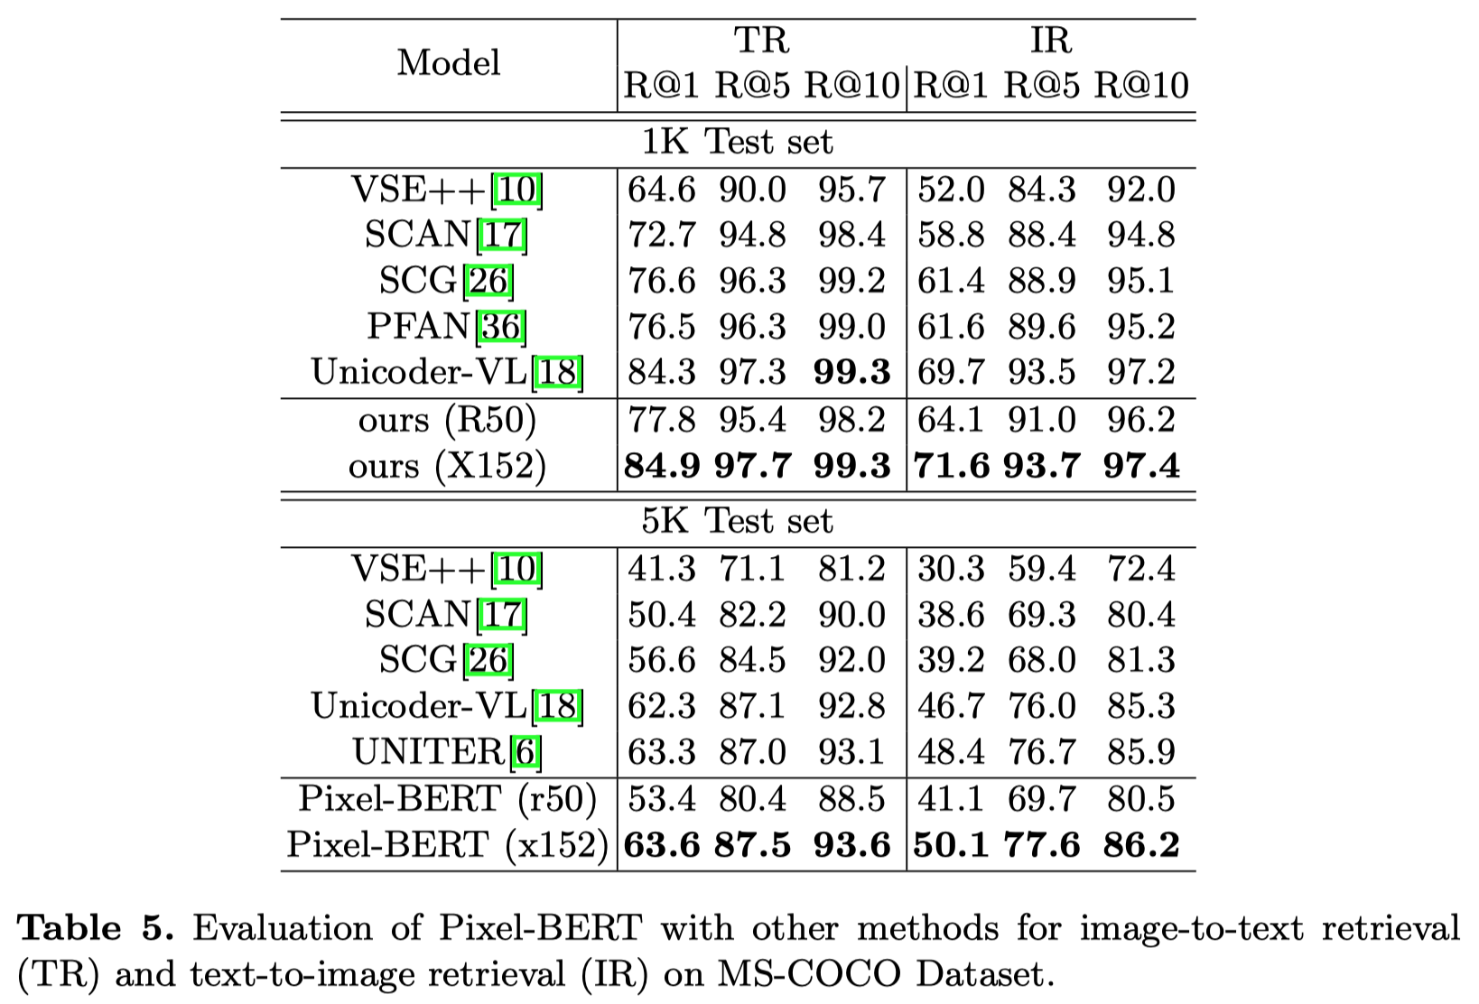
Experiments

