Slide 2
Motivation
To create a simple, single-network baseline that can perform both instance and semantic segmentation
To modify Mask R-CNN with FPN to enable pixel-wise semantic segmentation prediction.
做了相应的设计,将Semantic segmentation和instance segmentation统一到一个框架，并达到了较好的效果
基于丰富的实验，探究instance与semantic seg统一对各自任务的影响

Slide 3
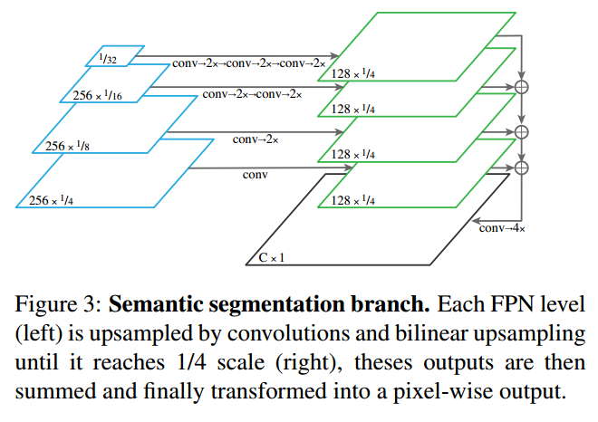
Framework

Slide 4
Framework
The feature used for this task should:
Be of suitably high resolution to capture fine structures,
Encode sufficiently rich semantics to accurately predict class labels,
Capture multi-scale information to predict stuff regions at multiple resolutions.

Slide 5
Panoptic inference
Semantic segmentation branch
Set special ‘other’ class for all pixels belonging to objects (to avoid predicting stuff classes for such pixels).
Inference
Resolving overlaps between different instances based on their confidence scores.
Resolving overlaps between instance and semantic segmentation outputs in favor of instances
Removing any stuff regions labeled ‘other’ or under a given area threshold

Slide 6
Panoptic inference
Training

Slide 7
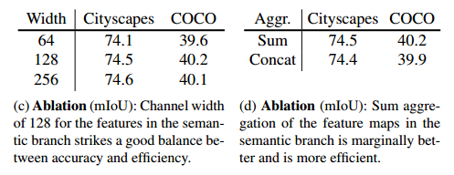
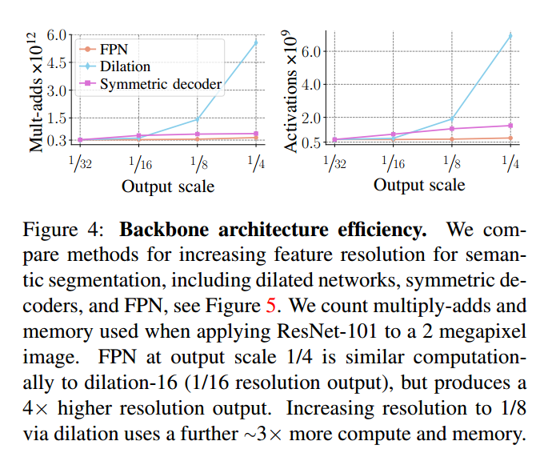
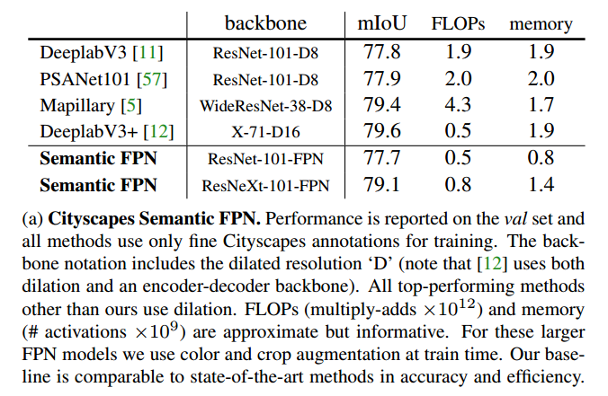
Analysis
For instance segmentation, this is expected, since our approach extends Mask R-CNN with FPN.
For semantic segmentation, While accuracy for both is comparable, summation is more efficient.

Slide 8
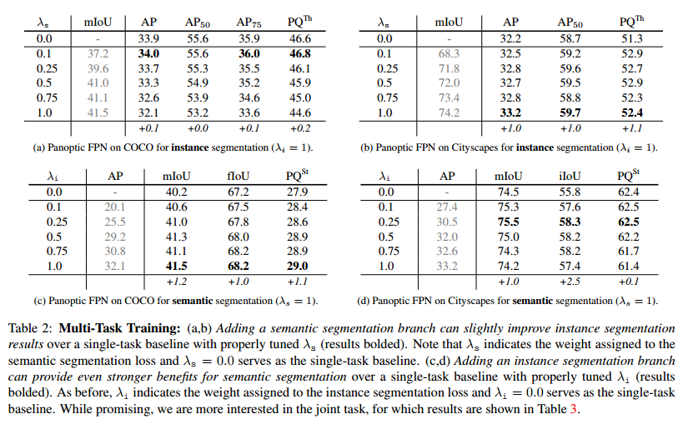
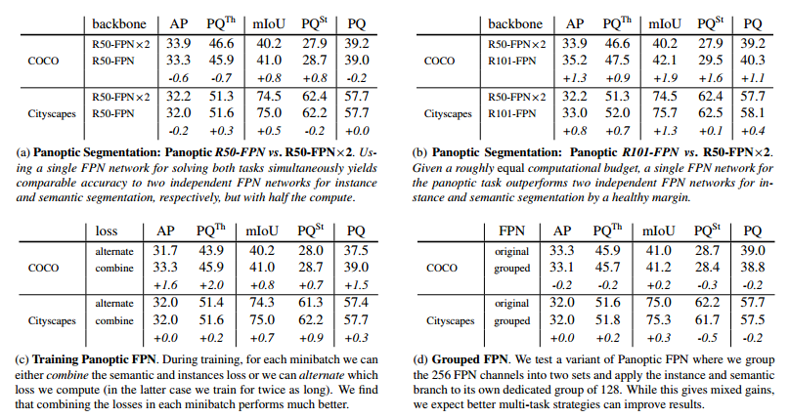
Analysis
Multi-Task Training

