Slide 1
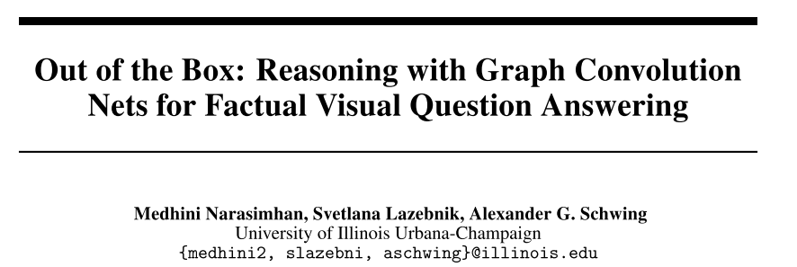
NIPS 2018

Slide 2
Motivation
FVQA: special information about the visual concept type and the answer source make it hard to generalize their approach to other datasets.
ECCV18: In contrast to focus on learning a joint image-question-fact embedding for retrieving the right fact, our current work uses a simpler method for retrieving multiple candidate facts
Exploits the graphical structure of the knowledge base and allows for sharing of information between possible answers.

Slide 3
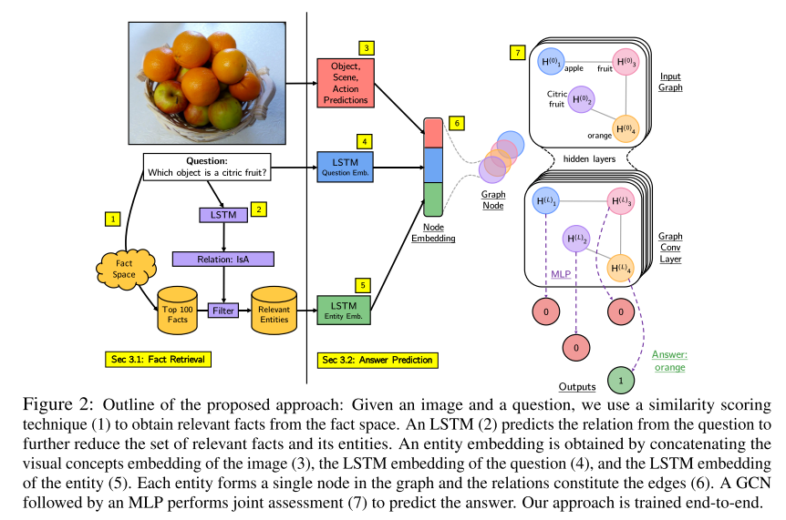
Framework
ECCV18 as baseline
Entities from retrieved facts form nodes.
GCN + MLP
Binary cross entropy.

Slide 4
Retrieval of Relevant Facts
Cosine similarity of the GloVe embeddings of the words
in the fact.
in the question .
of the visual concepts detected in the image.
(Maximum) 100 facts & 200 entities.
Filter by relation predictor.

Slide 5
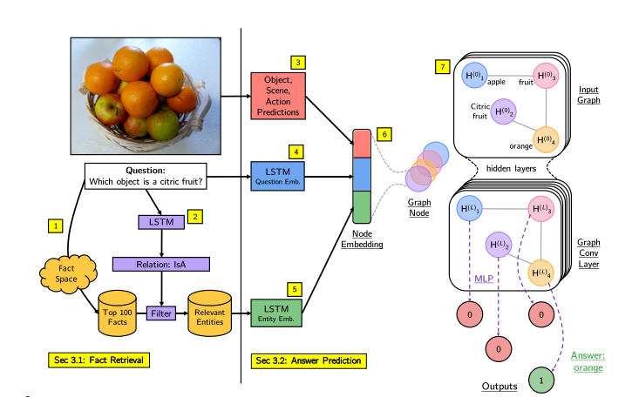
Answer Prediction
Image Representation
a multi-hot vector of visual concepts which are grounded in the image.
Question Representation
Question GloVe embeddings + LSTM
Entity Representation
Entity GloVe embeddings + LSTM
Concatenate all embeddings.
GCN + MLP + Binary prediction.

Slide 6
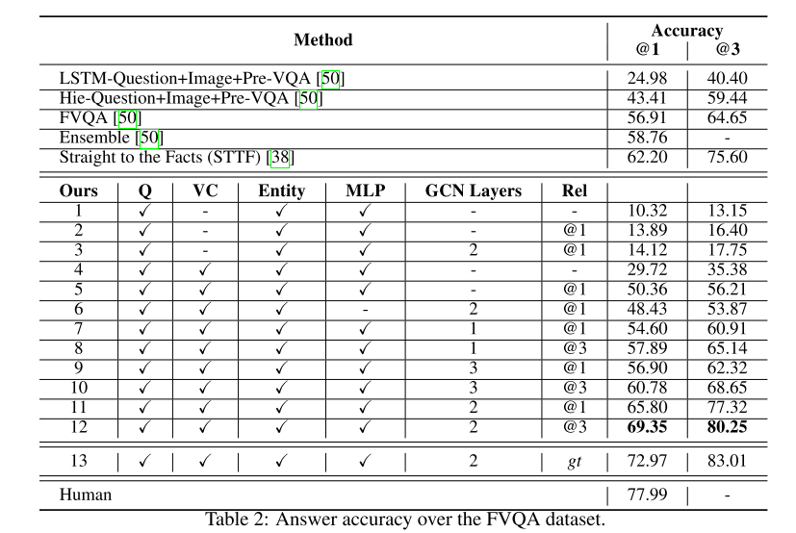
Experiments

