Slide 1
ICCV 2017
Zihan Ding
2022.05.26

Slide 2
Motivation
Most recognition models are still not capable of classifying objects at the level of a human, in particular, taking into account the taxonomy^{[1]} of object categories.
Open vocabulary scene parsing
Model predictions are not limited to a fixed set of categories, but also words in a larger dictionary, or even a knowledge graph.
100 classes vs. 100000 synsets
[1] https://baike.baidu.com/item/%E5%88%86%E7%B1%BB%E5%AD%A6/7584153?fromtitle=taxonomy&fromid=11331137&fr=aladdin

Slide 3
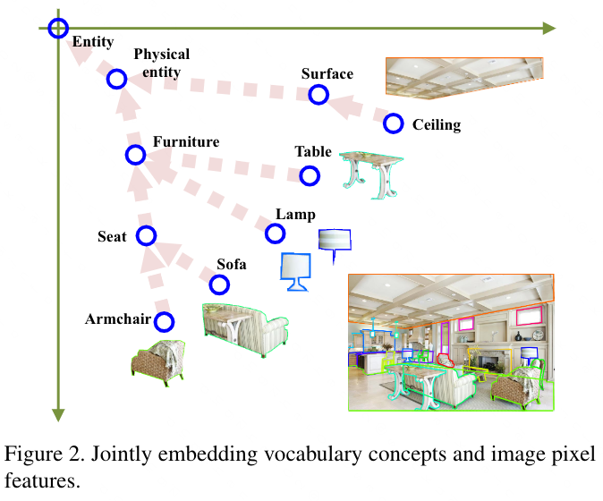
Learning Joint Embeddings for Pixel Features and Word Concepts
Retrieval problem for each pixel
Pixel features $→$ $ℝ_{+}^{N}$ $←$ word concepts
Image features close to their concept labels
Preserve semantic hypernym/hyponym relations
General concepts & Specific concepts
Relations $↔$ vector comparison

Slide 4
Framework

Slide 5
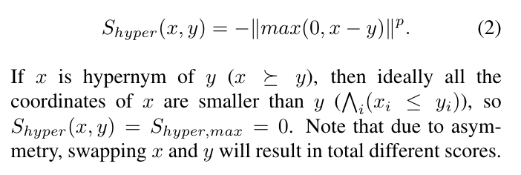
Scoring Functions

Slide 6
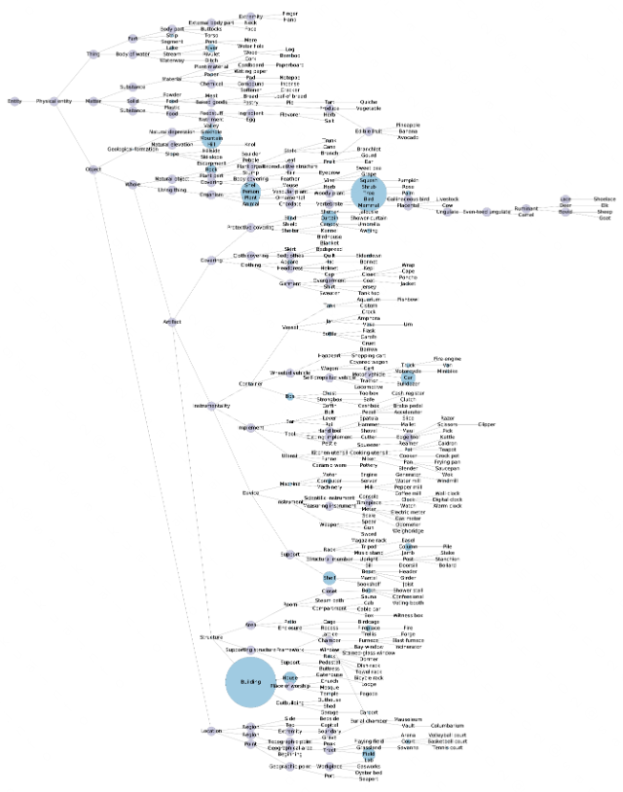
Concept Stream
WordNet hypernym/hyponym relations
Directed acyclic graph (DAG)
Common root: “entity”

Slide 7
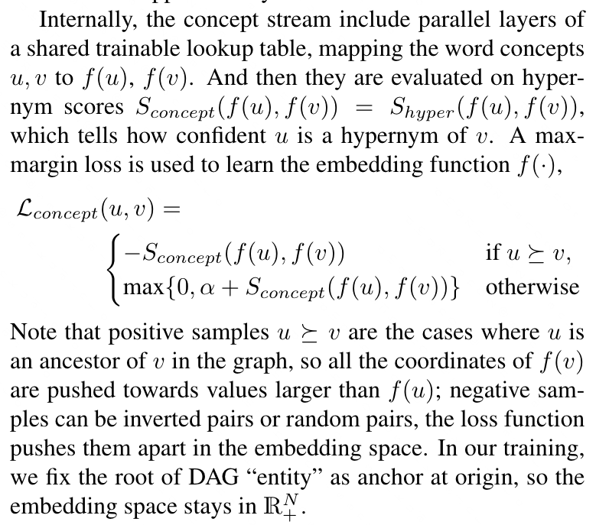
Concept Stream

Slide 8
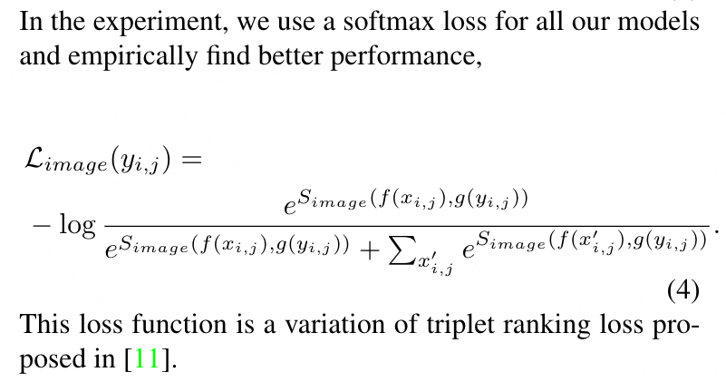
Image Stream

Slide 9
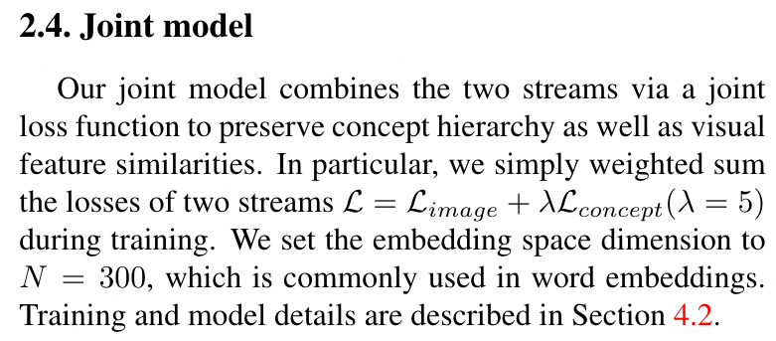
Joint Model

Slide 10
Evaluation Criteria
Baseline flat metrics
Pixel-wise accuracy: the proportion of correctly classified pixels
Mean accuracy: the proportion of correctly classified pixels averaged over all the classes
Mean IoU: the intersection-over-union between the predictions and ground-truth, averaged over all the classes
Weighted IoU: the IoU weighted by pixel ratio of each class

Slide 11
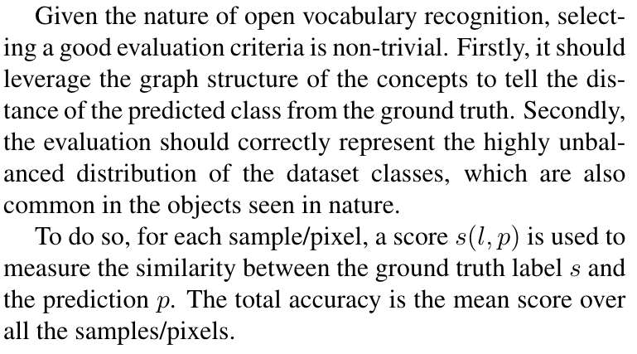
Evaluation Criteria
Open vocabulary metrics

Slide 12
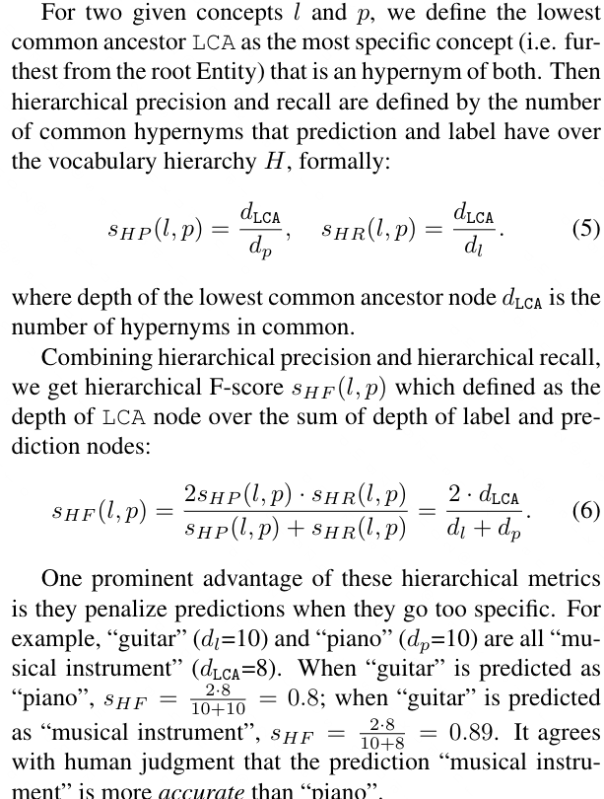
Evaluation Criteria
Hierarchical precision, recall and F-score

Slide 13
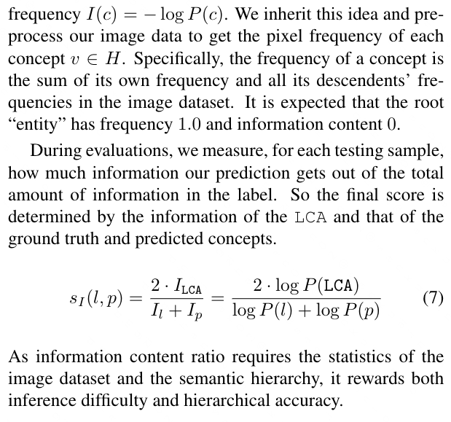
Evaluation Criteria
Information content ratio

Slide 14
Experiments

