Slide 1
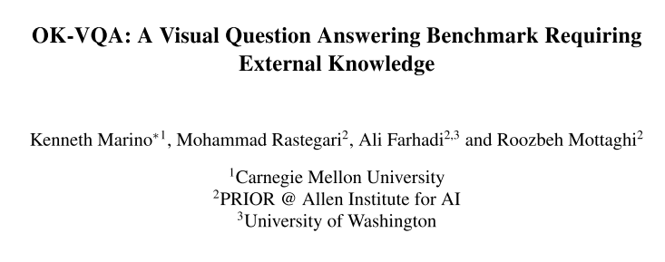
CVPR2019

Slide 2
Motivation
Questions require external knowledge
More than what the question entails or what information is contained in the images
Perform reasoning using unstructured knowledge.
Compared with current knowledge-based VQA

Slide 3
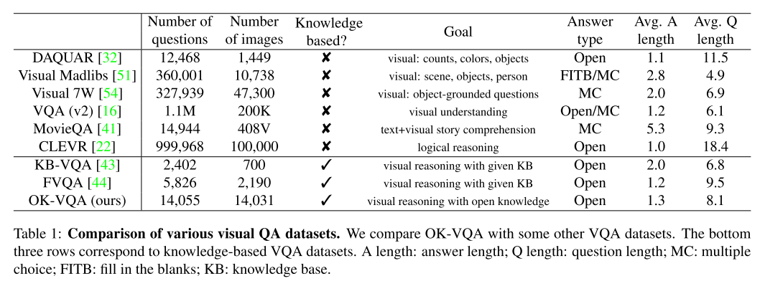
OK-VQA Dataset

Slide 4
OK-VQA Dataset

Slide 5
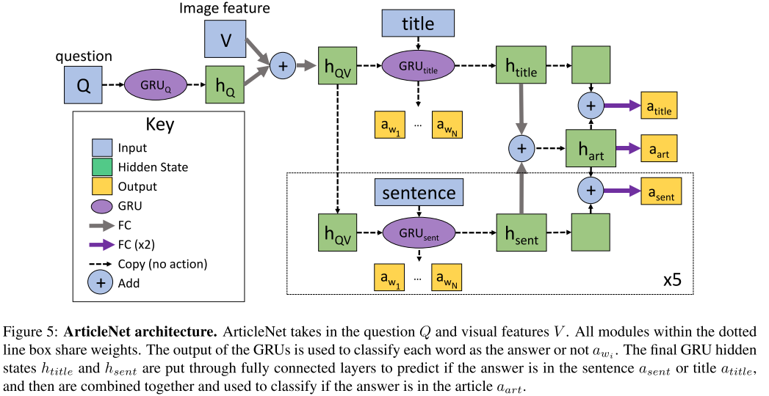
Benchmark-ArticleNet (AN)

Slide 6
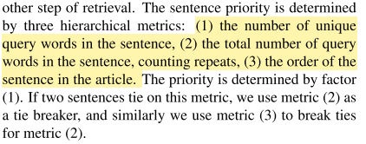
ArticleNet
Collecting possible search queries.
Object / Scene classifier; Object detector.
Get the top retrieved article for each query using the Wikipedia search API.
One or two word query.
Extracting 5 most relevant sentences of each article.
Predicts whether the answer is in the title, sentences or the article.
Word2vec encoding, or with skip-thought are not suitable
Feed top sentence in the memory in an end-to-end memory network.
Incorporate with baseline model.

Slide 7
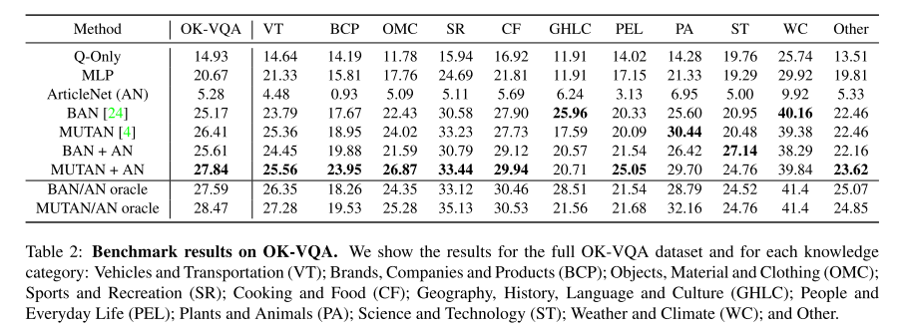

Slide 8
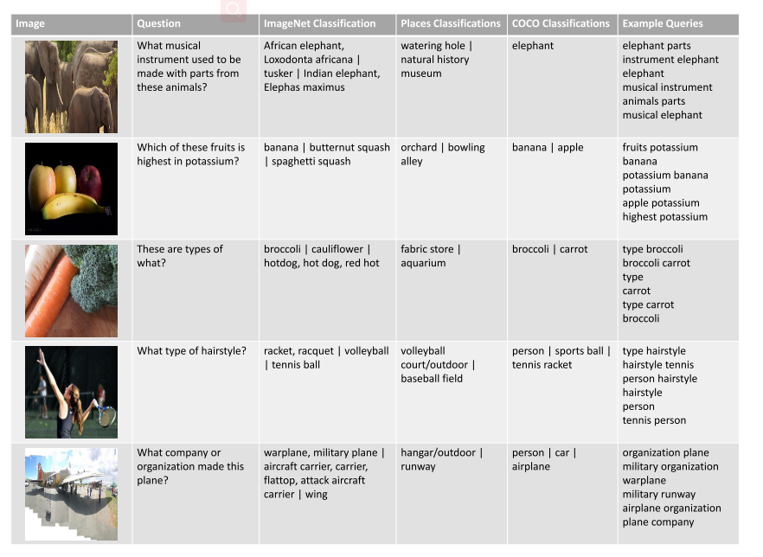
Example generated queries

Slide 9
Results

