Slide 1
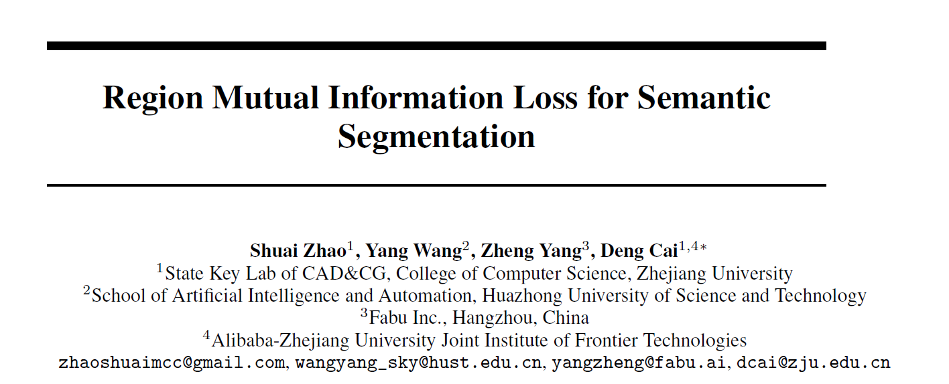
RLJ
20191215

Slide 2
Background
Semantic segmentation
Pixel wise classification
Independent
How to model the pixels correlation？
CRF
Affinity

Slide 3
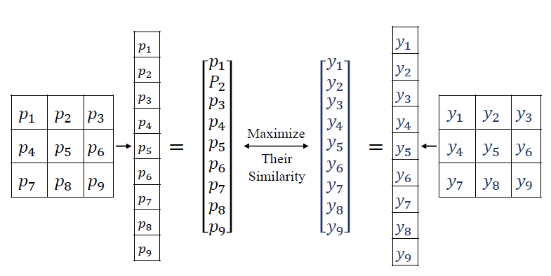
This paper

Slide 4
Mutual Information
H(X,Y) = H(X) + H(Y) - I(X,Y)
Maximize the I

Slide 5
Lower bound of I
“a normal distribution maximizes the entropy over all distributions with the same covariance”
ignore the constant

Slide 6
An approximation of posterior variance
approximation

Slide 7
Implementation details
Down sampling
0.33GB to 2.97GB when “Kernel size”=3
Normalization
Underflow issue
Overall loss function

Slide 8
Experiments

Slide 9
Experiments

Slide 10
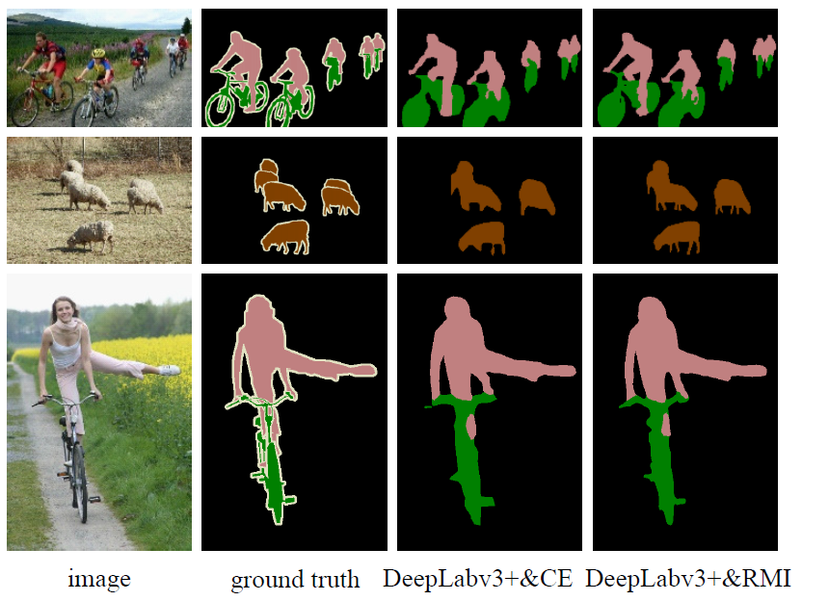
Experiments

