Slide 1
NAS-Det ——组会汇报
任广辉
2020.05.29

Slide 2
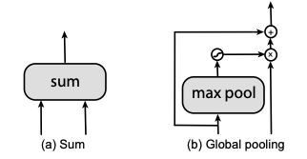
NAS-Det Preview
Searching for FPN: NAS-FPN
搜索空间: 任选两个输入1和2，再选择指定尺寸输出3，最后选择Op4
搜索方法: 利用强化学习Controller生成子网络、利用训练epoch更少的代理任务进行加速
NAS-FPN: Learning Scalable Feature Pyramid Architecture for Object Detection
Notes:
1. 训练detector很耗时，要么需要pretrain要么需要训练更多的epoch。只搜FPN，可以固定pretrained backbone，大幅减少训练时间。
2. Sum和global之前可以加最近邻或者maxpoling使得可以操作
3. 搜索空间那边会重复7次，生成7个merge-cell，选择5个作为输出 we take all feature layers that have not been connected to any of output layer and sum them to the output layer that has the corresponding resolution.
4. 选择的5个作为起始点，堆叠n遍提升性能

Slide 3
NAS-Det Preview
Searching for FPN: Mnas-FPN(Mobile版NAS-FPN)
特点
专门针对移动端设计，backbone搭配mobilenet
Reward里引入latency，w<0
搜索空间
搜索方法: 同NAS-FPN
Add w/wo SE
MnasFPN : Learning Latency-aware Pyramid Architecture for Object Detection on Mobile Devices
Notes:
训练detector很耗时，要么需要pretrain要么需要训练更多的epoch。只搜FPN，可以固定pretrained backbone，大幅减少训练时间。
Sum和global之前可以加最近邻或者maxpoling使得可以操作

Slide 4
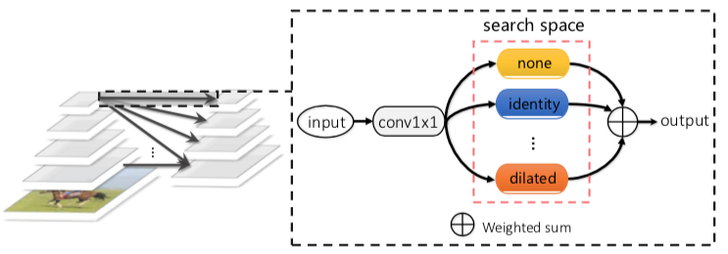
NAS-Det Preview
Searching for FPN+Head: Auto-FPN
Auto-fusion(堆叠2层)
skip connection (identity)
3×3 dilated conv with rate 2
3×3 depthwise-separable conv
……
Auto-head(堆叠2层)
和Darts类似，每个cell有2个输
入节点，1个输出节点，4个中间
节点，可选操作3x3和5x5
Auto-FPN: Automatic Network Architecture Adaptation for Object Detection Beyond Classification
Notes:
Head部分起始输入是7*7*512
Fix backbone
NAS-FCOS: Fast Neural Architecture Search for Object Detection

Slide 5
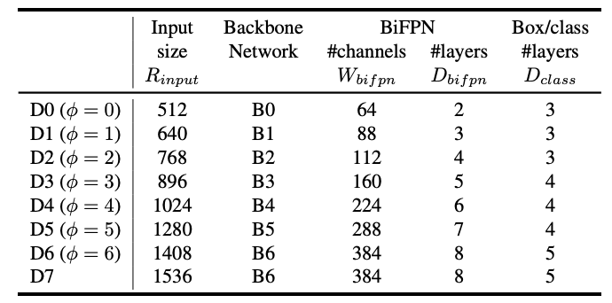
NAS-Det Preview
Searching for FPN+Input: EfficientDet
搜索空间
以EfficientNet为基础
加入input和BiFPN的放缩
搜索方法
强化学习
EfficientDet: Scalable and Efficient Object Detection
Notes:
利用EfficientNet的pretrain model

Slide 6
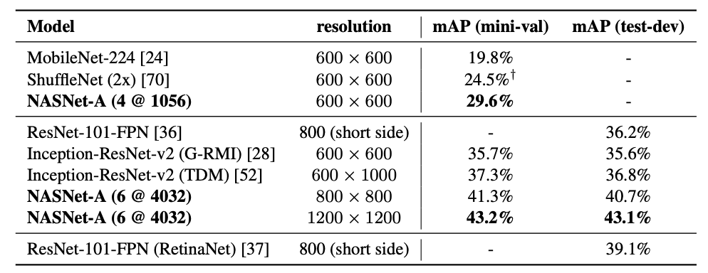
NAS-Det Preview
Searching for Backbone: 在cls搜，然后搬运到det
NASNet
EfficientNet
……
Learning Transferable Architectures for Scalable Image Recognition
MnasNet: Platform-Aware Neural Architecture Search for Mobile
EfficientNet: Rethinking Model Scaling for Convolutional Neural Networks

Slide 7
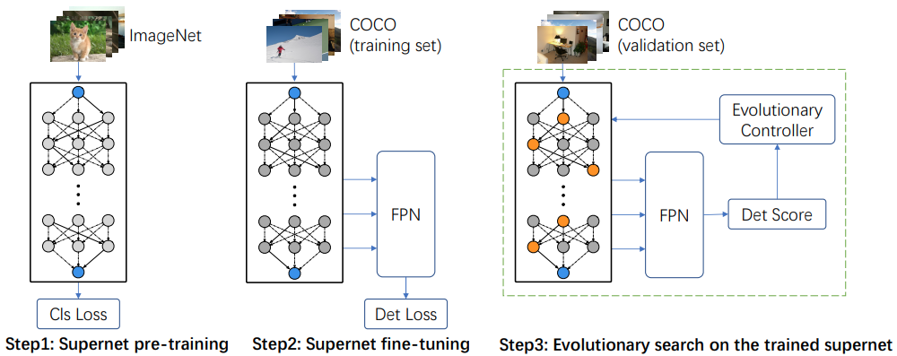
NAS-Det Preview
Searching for Backbone: DetNAS
特点
在det任务上直接搜Backbone
One-shot(weight sharing)
只能搜Sequential model
DetNAS: Backbone Search for Object Detection

Slide 8
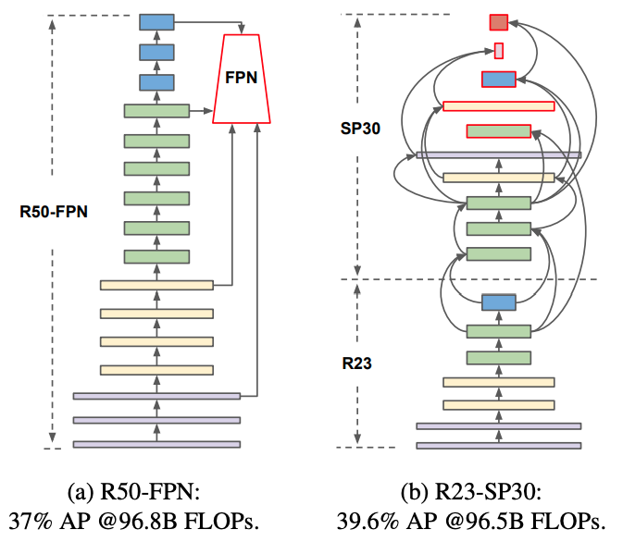
NAS-Det Preview
Searching for Backbone+FPN: SpineNet
搜索空间
固定了各种尺寸feature的channel
每层可选6个阶段的尺寸
每层可选前面任两层作为输入
每层可选操作Basicblock/Bottleneck
搜索方法: 强化学习
SpineNet: Learning Scale-Permuted Backbone for Recognition and Localization

Slide 9
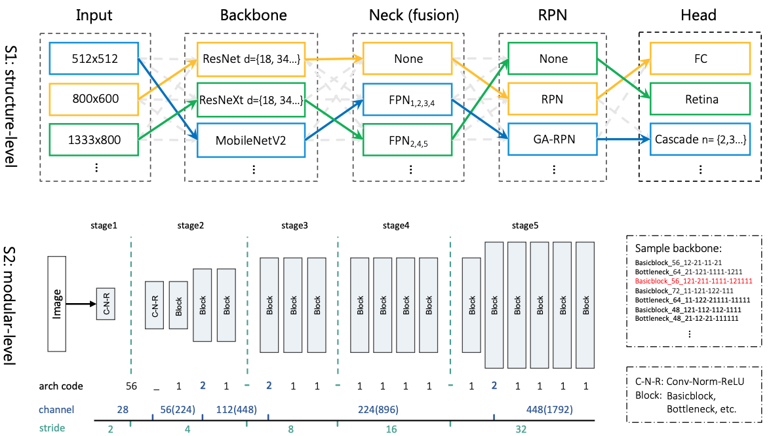
NAS-Det Preview
Searching for Input+Backbone+FPN+Head+Channel: SM-NAS
先搜Structure
预设了不同的Input，
Backbone, Neck, RPN, Head
每个模块的空间比较小
再搜Modular
Block的选择，全局一致
都是basicblock/bottleneck
各个block的channel，有
不变和翻倍两种
FPN的输出channel也可选
SM-NAS: Structural-to-Modular Neural Architecture Search for Object Detection
Notes:
SM-NAS: Structural-to-Modular Neural Architecture Search for Object Detection

