Slide 1
ACM MM 19

Slide 2
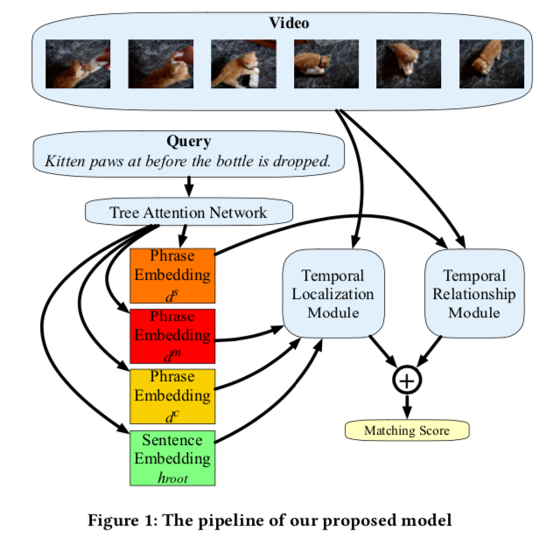
Task:
Video moment localization
涉及A和B两个事件，由before, after, then连接
Motivation：
temporal dependencies and reasoning between events within the text are not fully consider
Contribution:
propose a novel model called Temporal Compositional Modular Network
form an ensemble model
SOTA on TEMPO dataset

Slide 3
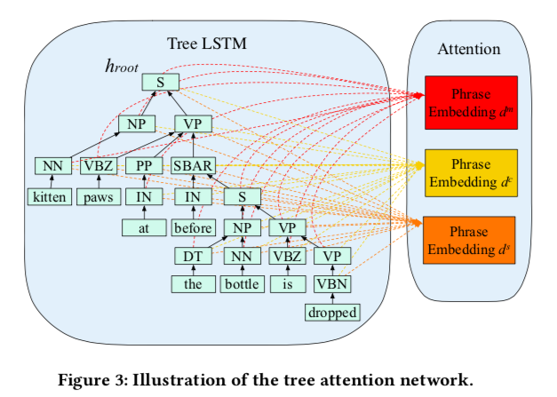
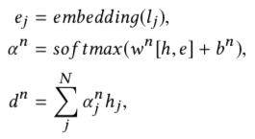
MODEL – Tree Attention Network

Slide 4
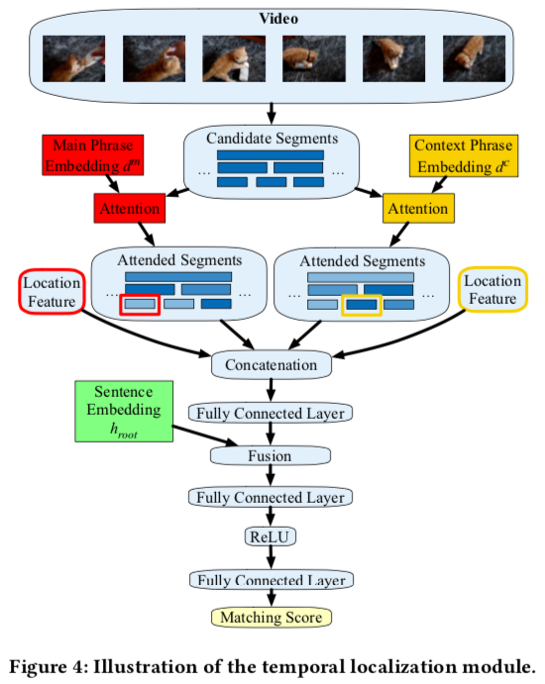
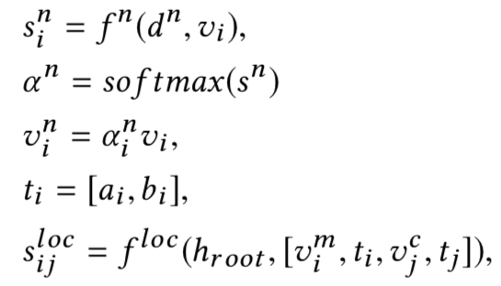
MODEL – Tree Localization Module

Slide 5
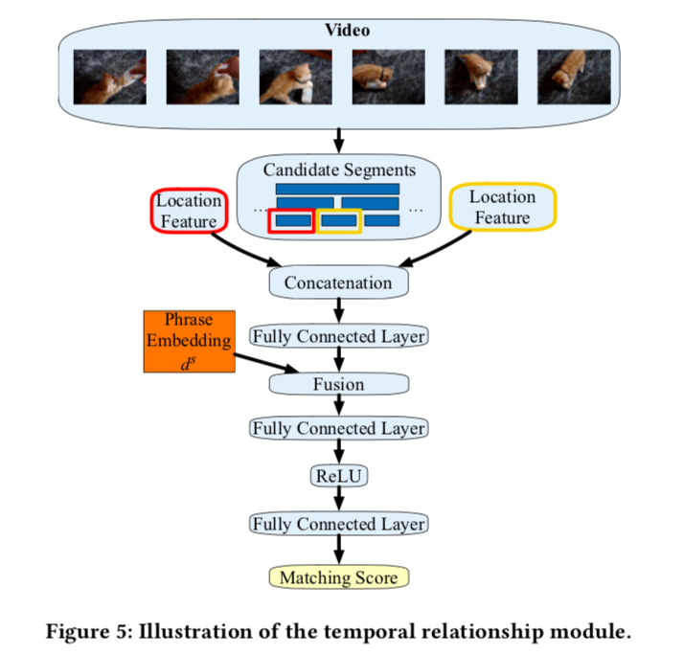
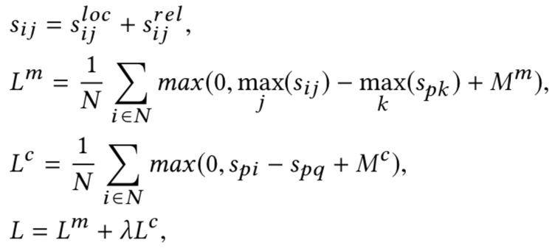
MODEL – Temporal Relationship Module
Loss Function

Slide 6
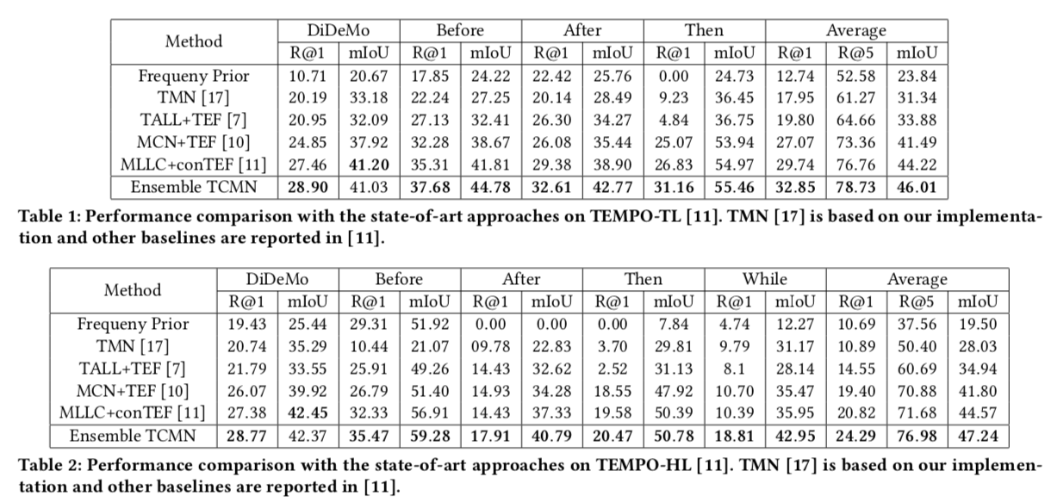

Slide 7
Main Contribution: 将modular的思想应用在了Video Segment Localization上

