Slide 1
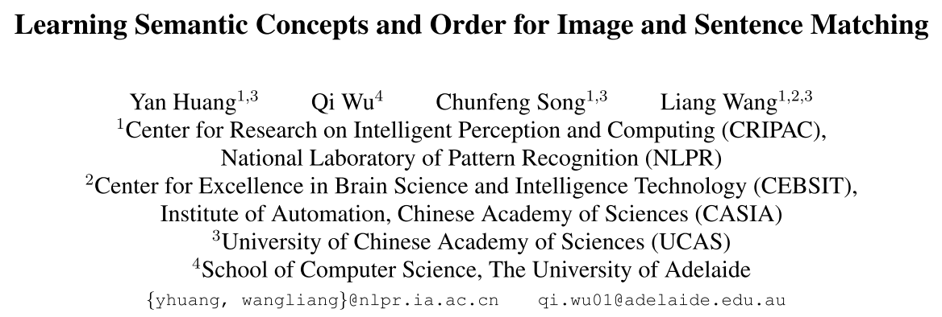
CVPR 2018
Notes:
The title of this paper I share today is learning semantic concepts and order for image and sentence matching
This paper is published in cvpr two thousand and eighteen

Slide 2
Motivation
﻿To bridge the visual-semantic discrepancy between image and sentence
﻿Enhancing the image representation
Notes:
﻿The high-level semantic concepts are the essential content to be compared with the matched sentence, but they cannot be easily represented from the pixel-level image.
﻿﻿Most existing methods jointly represent all the concepts by extracting a global feature vector. ﻿As a result,some primary foreground concepts tend to be dominant, while other secondary background ones will probably be ignored, which is not optimal for fine-grained image and sentence matching.
So the image representation needs to be enhanced

Slide 3
Contributions
Propose a semantic-enhanced image and sentence matching model
﻿Improving the image representation by learning semantic concepts and then organizing them in a correct semantic order
Notes:
So the contributions of this paper are two-fold
The first is they propose
And the second is they improved

Slide 4
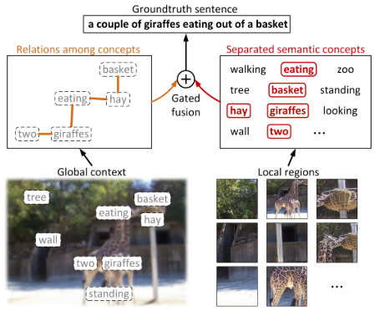
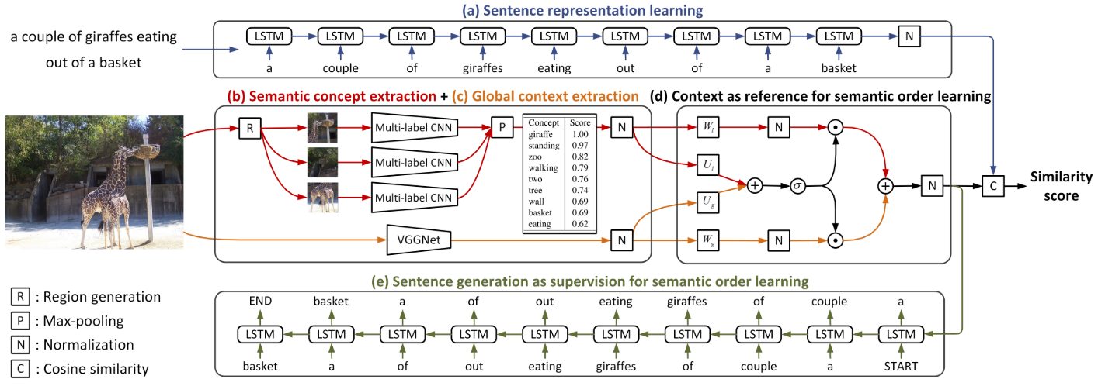
Framework
Notes:
Next，﻿I will detail their proposed semantic-enhanced image and sentence matching model from there aspects.
The first is ﻿sentence representation Learning, ﻿To learn the sentence representation that can capture those semantic-related words and model their semantic order, they use a conventional LSTM. ﻿They sequentially feed all the words of the sentence into the LSTM at different timesteps, and then regard the hidden state at the last timestep as the desired sentence representation.
The second is ﻿Image Semantic Concept Extraction。﻿the prediction of semantic concepts is equivalent to a multi-label classification problem。 Considering that the semantic concepts usually appear in image local regions and vary in size, they perform the concept prediction in a regional way。﻿they first selectively extract image regions and then resize them to square shapes and ﻿separately feed these regions into the learned multi-label NN﻿。They simply use the VGGNet pre-trained on the ImageNet as their multi-label NN. They use the sigmoid activation instead of softmax on the outputs, so that the task of multi-label classification is transformed to multiple tasks of binary classification。﻿Then they perform element-wise max-pooling across these score vectors to obtain a single vector, which includes the desired confidence scores for all the semantic concepts。
The third is ﻿Image Semantic Order Learning。﻿they propose to use the image global context as auxiliary reference for semantic order learning by ﻿using a pre-trained VGGNet to process the whole image content。 So that ﻿their model can refer to the global context to find their relations and then combine them to facilitate the prediction of semantic order。﻿Considering the relative importance of semantic concepts and context is not equivalent in most cases。They design a gated fusion unit by learning ﻿gate vector t to selectively balance the relative importance of semantic concepts and context。﻿To learn the semantic order based on the fused representation，﻿they feed the enhanced image representation into the initial hidden state of a generative LSTM, and let it to generate the matched sentence。 So the image representation can learn the relations between words and the semantic order。

Slide 5
Framework
=
=
Notes:
﻿During the model learning，they minimize the combined objectives ﻿to jointly perform image-sentence matching and sentence generation。
The loss mat ﻿a structured objective that encourages the cosine similarity scores of matched images and sentences to be larger than those of mismatched ones，﻿where m is a margin parameter。
﻿The loss gen is the negative conditional log-likelihood of the matched sentence for learning the semantic order。

Slide 6
Experiments
Notes:
1. This table shows the ﻿Comparison results of image annotation and retrieval by ablation models on the Flickrk and MSCOCO (1000 testing) datasets，we can observe the model use 10-crop，combine context and concept via gated unit and learning semantic order achieve the best results。

Slide 7
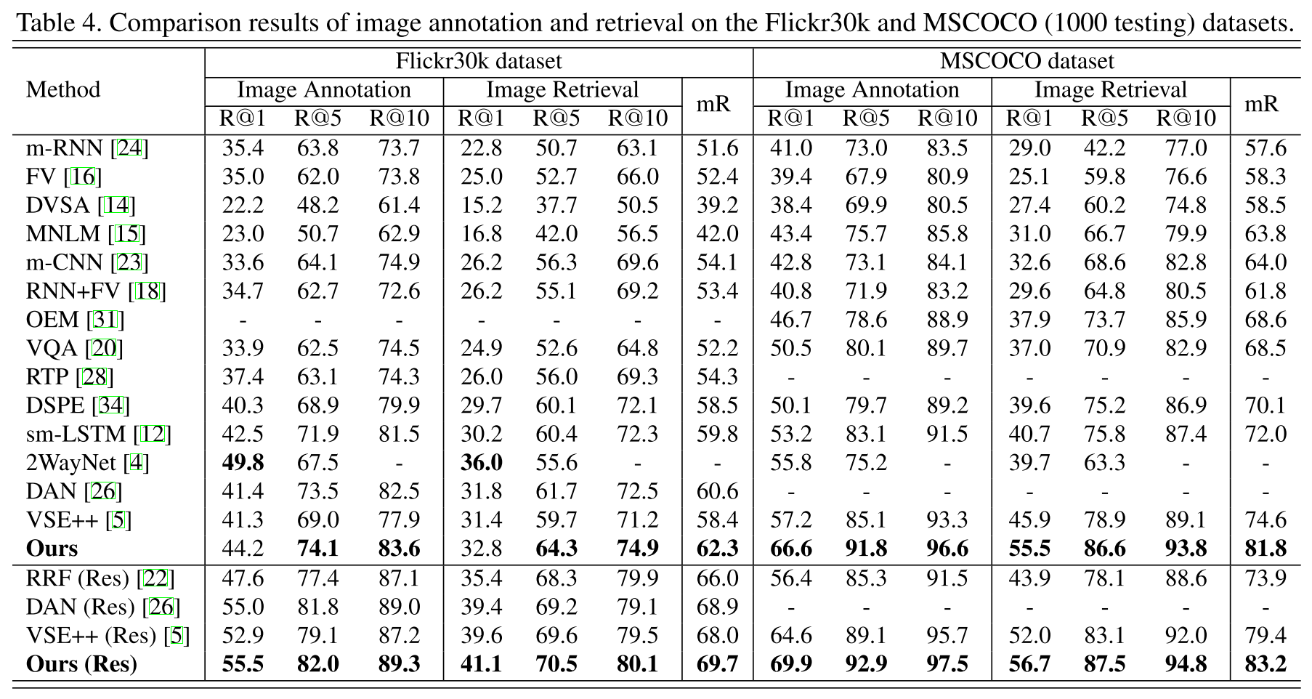
Experiments
Notes:
1. ﻿This table shows the Comparison with State-of-the-art Methods。It demonstrates that their proposed method set new SOTA results under several metrics。

Slide 8
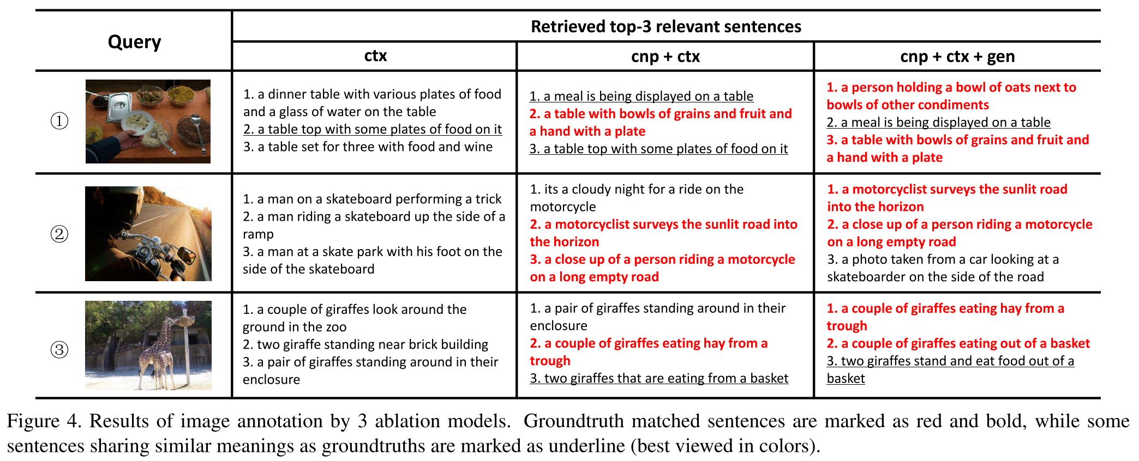
Experiments
Notes:
﻿This figure is the ﻿analysis of Image Annotation Results，which demonstrate the effectiveness of the proposed components。For example, ﻿without the help of the predicted semantic concepts the retrieved sentences contain some clearly wrong semantic concepts including water and wine for the first image。And by further learning the semantic order with sentence generation, the final model is able to associate all the related concepts and retrieve the matched sentences with all the image details。

