Slide 2
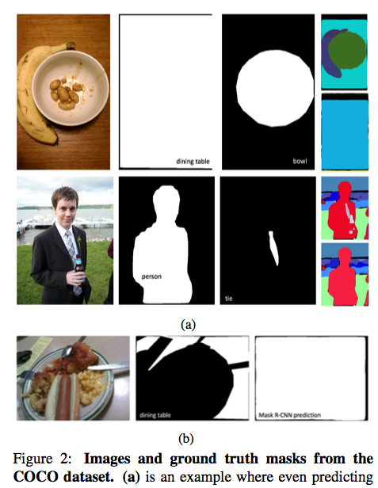
Motivation
Instance ordering with detection confidence does not correlate well with natural occlusion relationship。
Add a branch that is tasked with modeling how two instance masks should overlap one another as a binary relation.

Slide 3
Motivation
Instance segmentation proposals are first sorted in order of decreasing detection confidence.
If this is above a certain ratio τ (usually 0.5), this instance is entirely skipped in the output.
Otherwise, pixels in this mask that have yet to be assigned are assigned to the instance in the output.

Slide 4
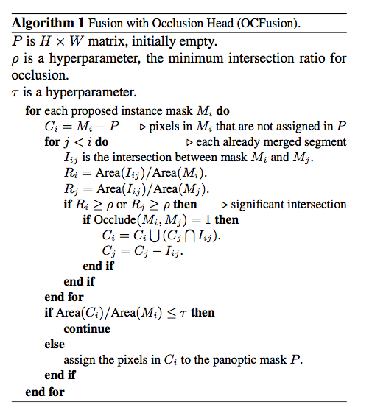
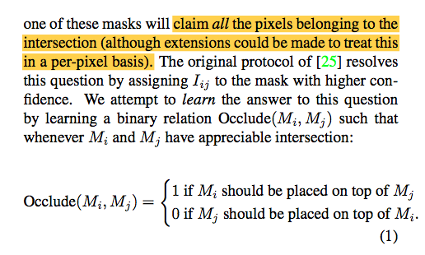
Framework

Slide 5
Framework

Slide 6
Results

