Slide 2
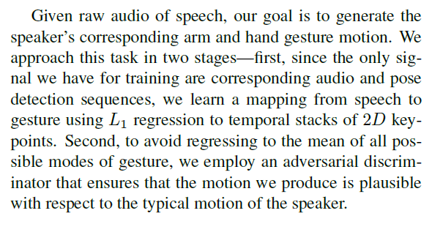
Method

Slide 3
Experiments
the percent of correct keypoints (PCK)

Slide 4
Experiments
We found that humans were not
sensitive to the alignment of
speech and gesture.

Slide 5
Experiments
The Predicted Gestures are Person-Specific

Slide 6
Experiments
Speech is a Good Predictor for Gesture

Slide 7
Further research
The first is in using gestures as a representation for video analysis
The second is using in-the-wild gestures as a way of training conversational agents
Finally, our method is one of only a handful of initial attempts to predict motion from audio

