Slide 1
ECCV 2018

Slide 2
Motivation
temporal consistency
Task-specific approaches
Task-independent approaches
Challenges of flow-based approaches
Require domain knowledge
Slow（flow computation at test time）

Slide 3
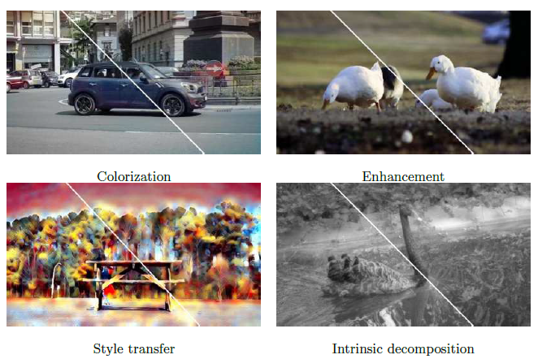
Blind

Slide 4
Framework

Slide 5
Learning Temporal Consistency
Recurrent network
Image transformation network
Loss functions
Content perceptual loss
Short-term temporal loss
Long-term temporal loss

Slide 6
Recurrent network

Slide 7
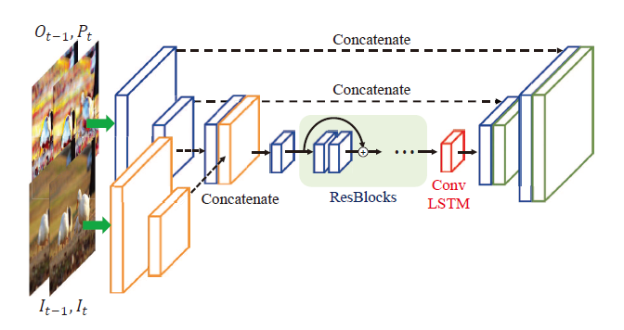
Image transformation network
Two streams
Skip connection on processed stream to avoid visual artifacts

Slide 8
Loss functions
Content perceptual loss
VGG19
Short-term temporal loss
Long-term temporal loss

Slide 9
Experimental Results
Dataset：
DAVIS-2017
Metrics：
Temporal stability

Slide 10
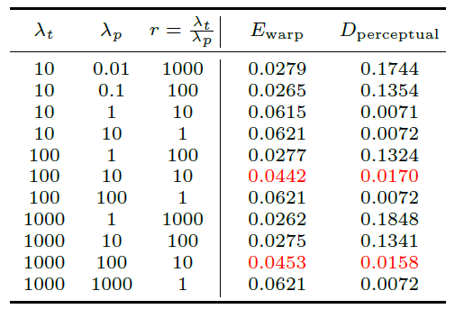
Experimental Results

Slide 11
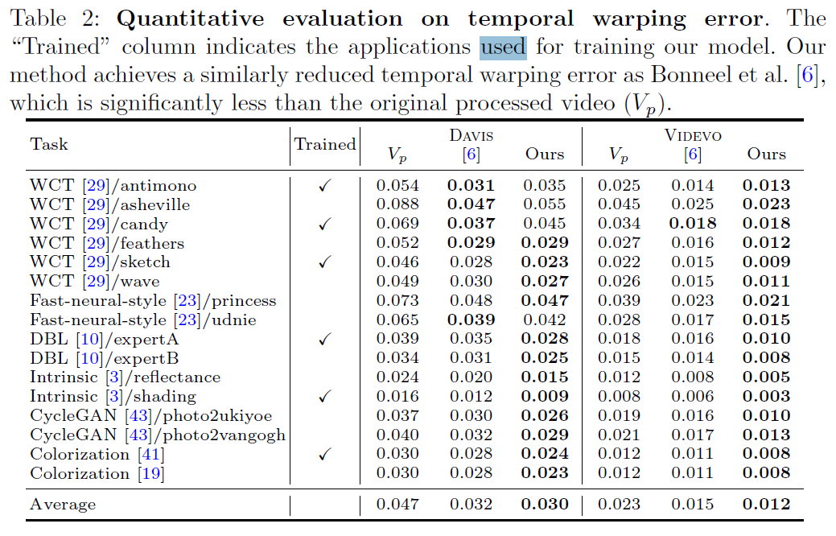
Experimental Results

Slide 12
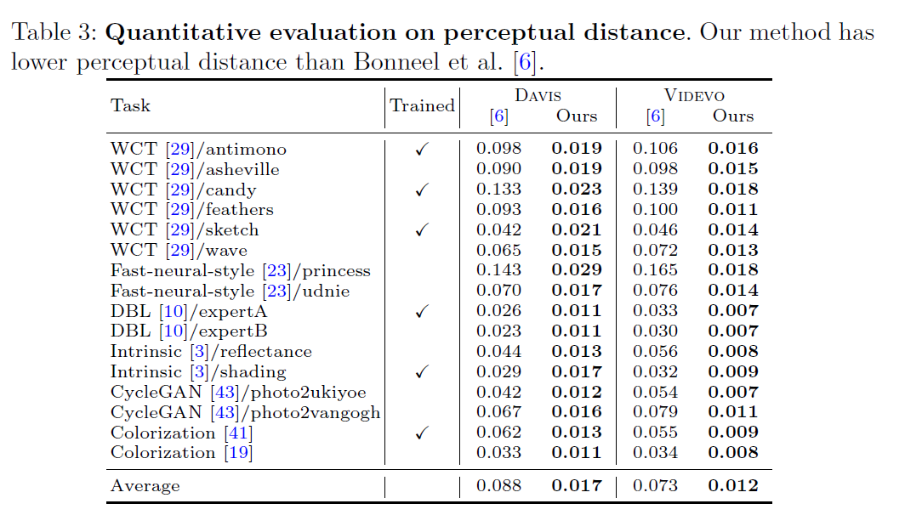
Experimental Results

