Slide 2
Motivation
Modeling non-local relations and capturing long-range dependencies are fundamental to visual recognition
Deep ConvNets stacking many local operations of convolution and pooling, which are effectively limited to local receptive fields and short-range context
Non-local Net can be viewed as a densely-connected graph neural network (GNN) module with attention mechanism
Two limitations of NL-Net
Computing dense affinity matrix and its product with the node messages. Heavy computations.
Relations between two node features are typically defined by a simple pairwise function. Limited capacity.

Slide 3
Non-local Graph Neural Networks
Conv features: $X=\left[x_{1},…,x_{N}\right]$, $x_{i}∈ℝ^{c}$, $i∈[1,…,N=h∙w]$
A fully-connected graph $𝒢=\left(𝒱,ℰ\right)$ with $N$ nodes $v_{i}∈𝒱$, and edges $\left(v_{i}, v_{j}\right)∈ℰ$, $∀i<j$
Each iteration updates the node features as follows,
In matrix form,

Slide 4
Latent GNN for Non-local Feature Context
Latent features: $Z=\left[z_{1},…,z_{d}\right]$, $z_{i}∈ℝ^{c}$, $d≪N$
An augmented graph $𝒢_{L}=\left(𝒱_{L},ℰ_{L}\right)$ with $N+d$ nodes, $𝒱_{L}=𝒱∪𝒱_{h}$, and edges $ℰ_{L}=ℰ_{v}∪ℰ_{h}$
Step 1: Visible-to-latent propagation
Step 2: Latent-to-latent propagation
Step 3: Latent-to-visible propagation

Slide 5
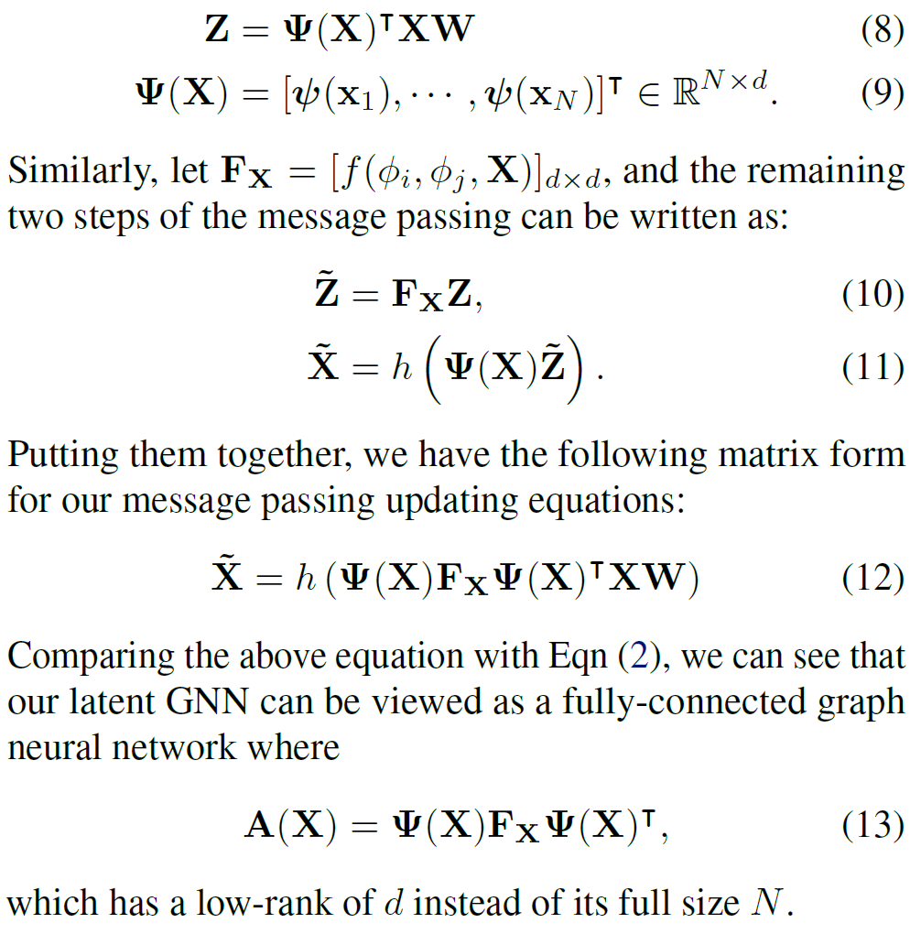
An Equivalent Low-rank Kernel Representation

Slide 6
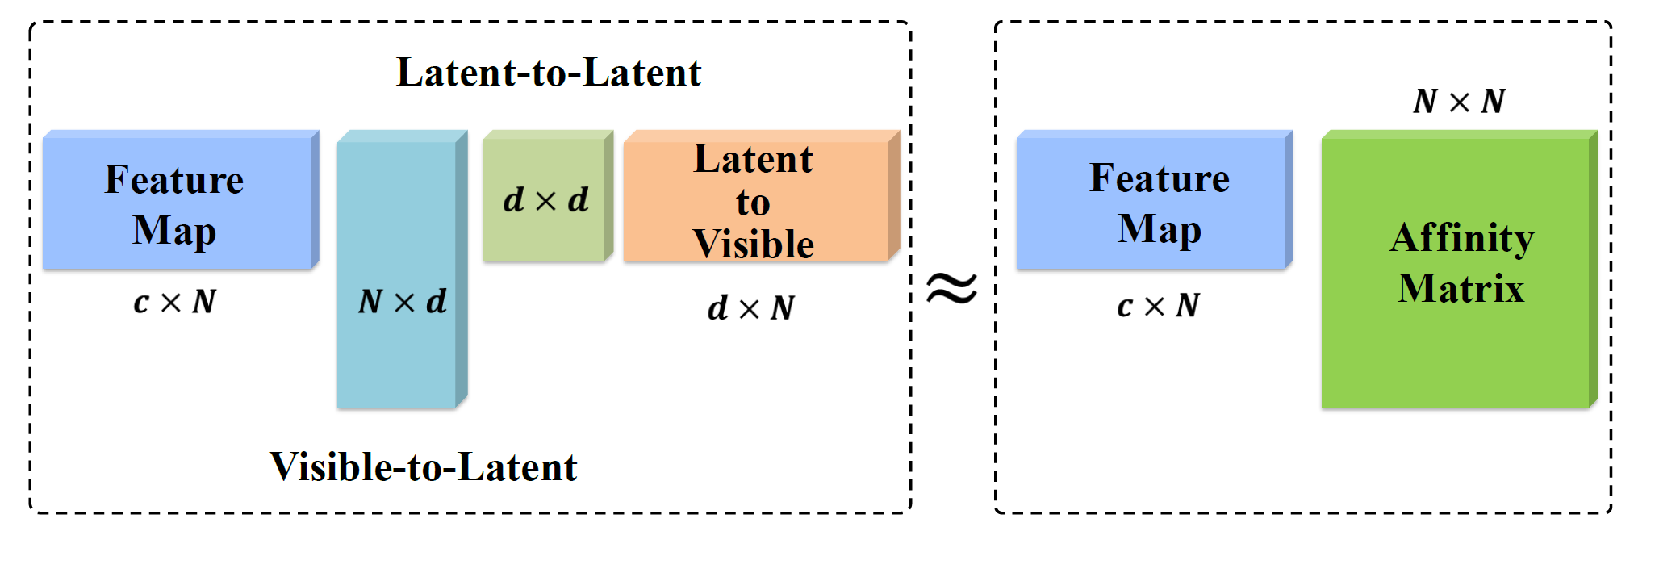
An Equivalent Low-rank Kernel Representation

Slide 7
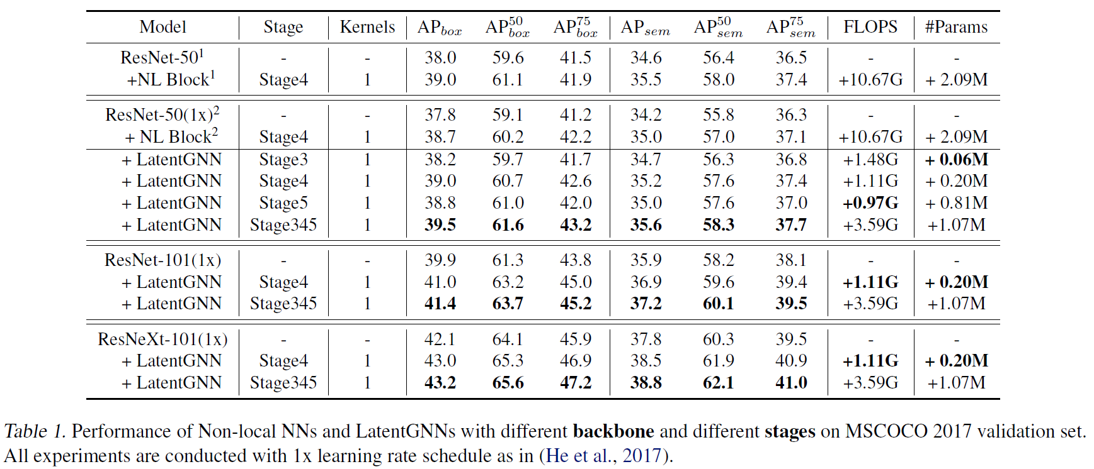
Experiments

Slide 8
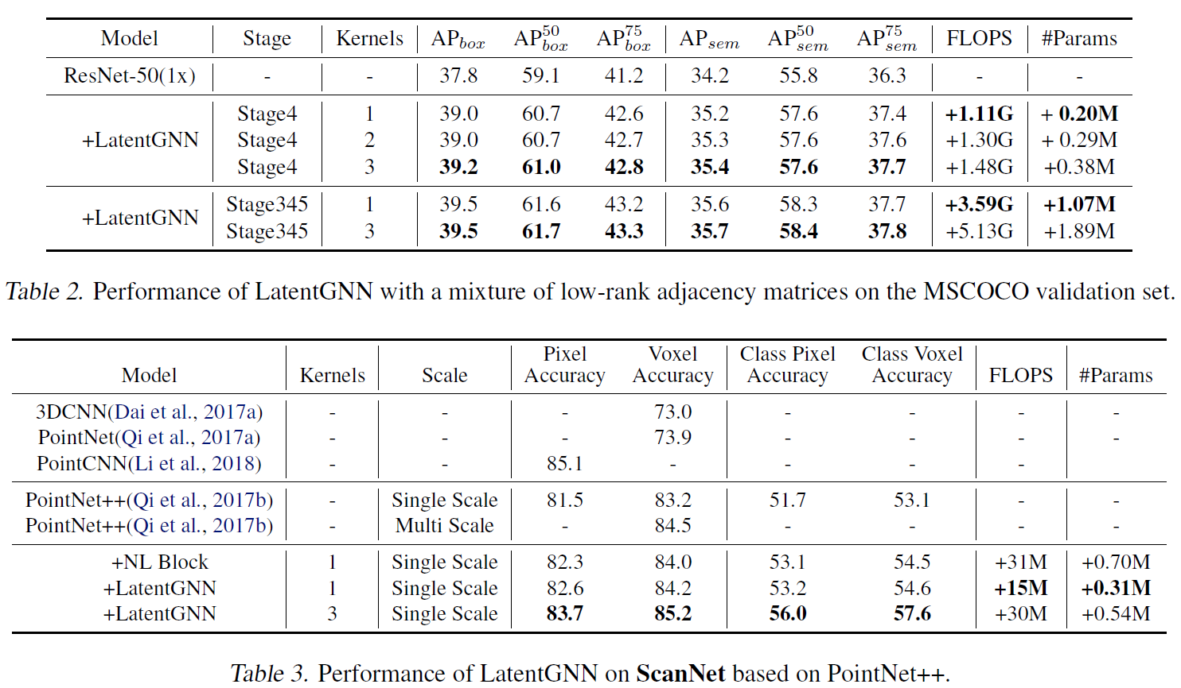
Experiments

