Slide 1
IEEE Transactions on Image Processing 2022

Slide 2
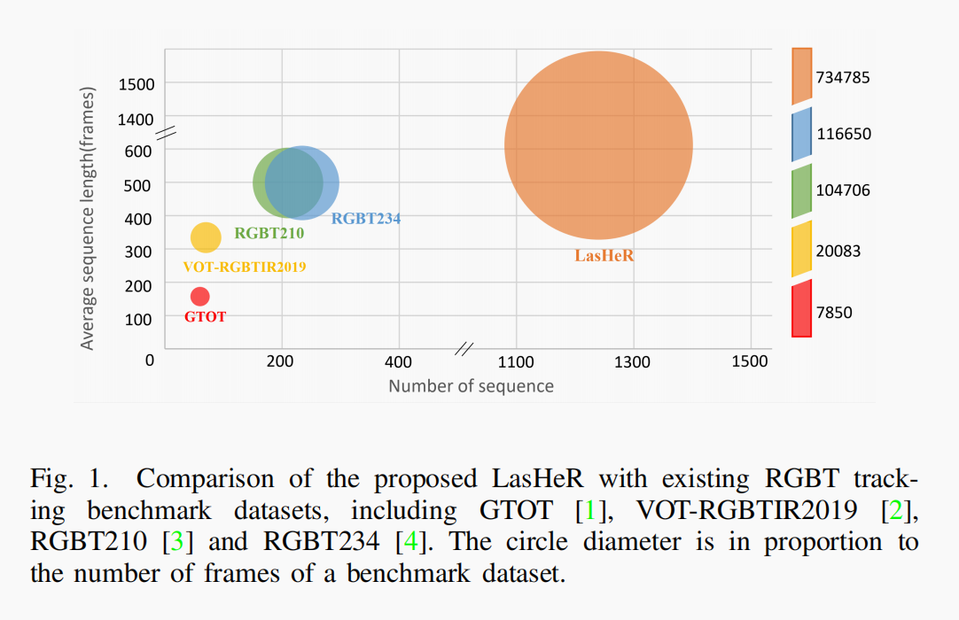
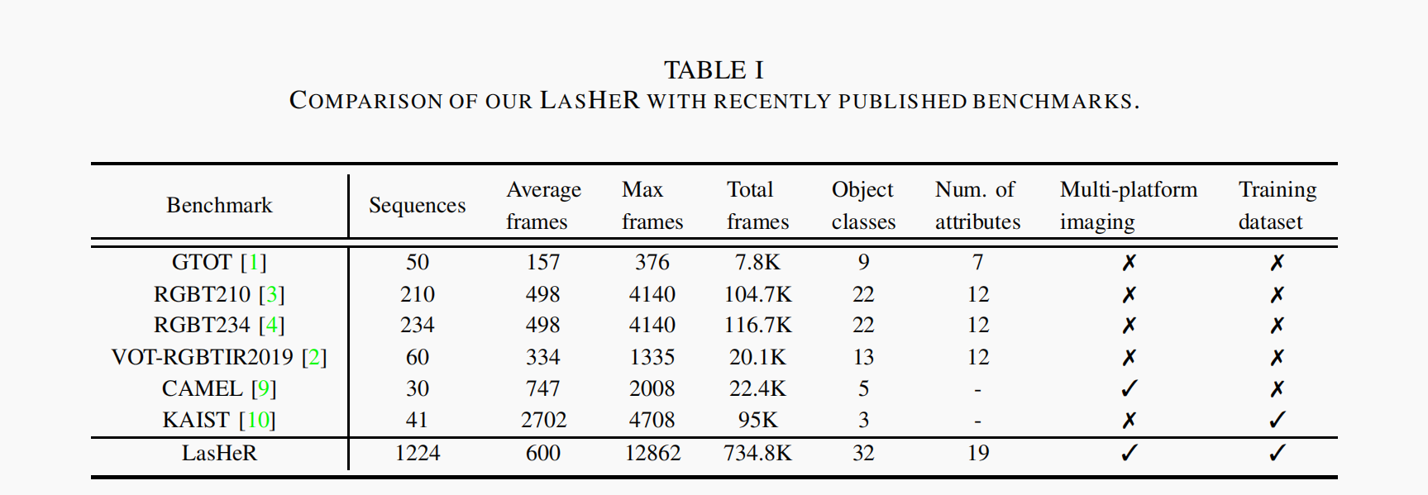
1224 visible and thermal infrared video pairs with more than 730K frame pairs in total. Each frame pair is spatially aligned and manually annotated with a bounding box, making the dataset well and densely annotated.

Slide 3
Motivation:
several issues are remained in development and assessment of RGBT
1.Lack of a large-scale dataset
2. Single imaging platform
3. Limited number of scenes and categories
4. Missing some real-world challenges
hyaline occlusion, frame lost, high illumination, abrupt illumination variation, out of
view, similar appearance and aspect ratio change.
Multi-Modal Fusion for End-to-End RGB-T Tracking:use pix2pix to transfer the selected RGB videos in GOT- 10k to synthetic TIR videos, along with the labels.

Slide 4
Details:
A. Multi-platform Imaging Setup
multiple types of imaging platforms and same frame rate
B. Multi-modal Alignment
keep the thermal infrared image unchanged, apply the homography parameters(单应性参数) on the visible one to transform it into the unifified coordinate system with the thermal infrared image.
C. Annotation
Modality shared annotation
D. Data Statistics
Scene type:more than 20 scenes
Object category: 32 types of target objects, long tail distribution
Challenge:19

Slide 5
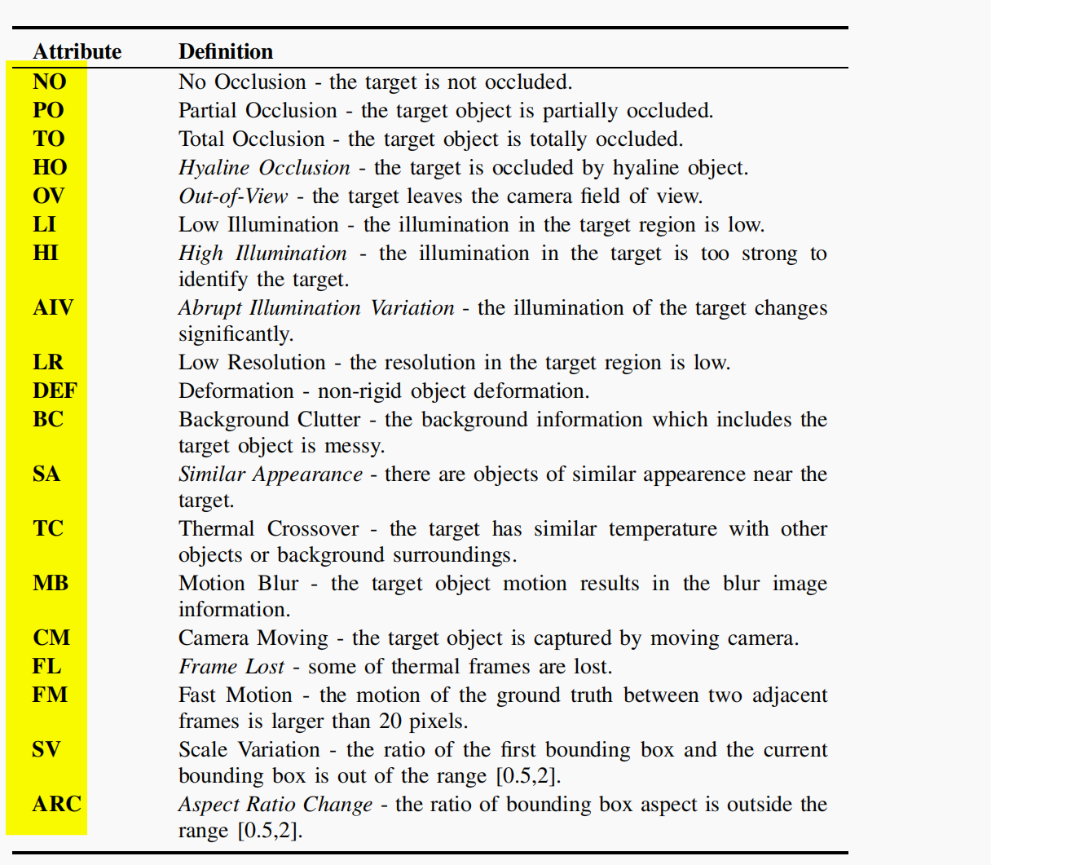

Slide 6
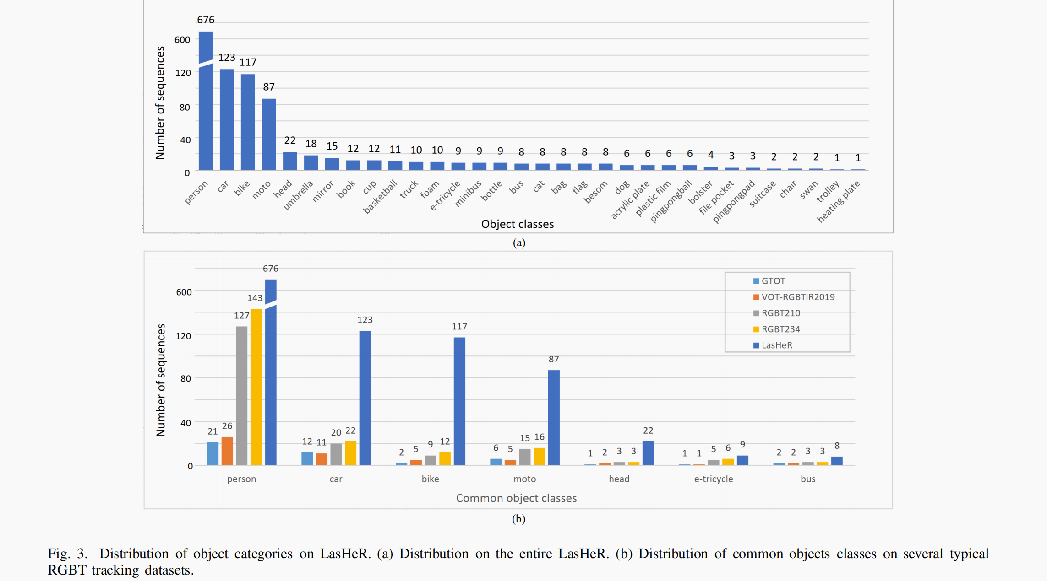

Slide 8
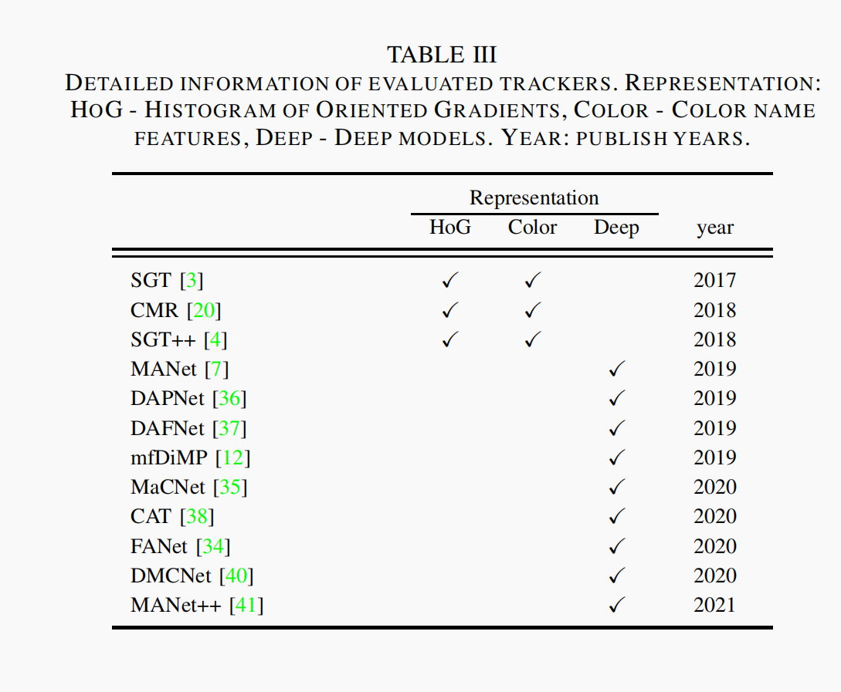
Experiments:
Evaluation Metrics
Precision rate (PR).•
Normalized precision rate (NPR).
Success rate (SR).
A. Overall Evaluation Results
B. Challenge-based Evaluation Results
C. Qualitative Evaluation
D. Retraining Experiment on LasHeR
E. Evaluation of RGB Trackers on LasHeR

