Slide 2
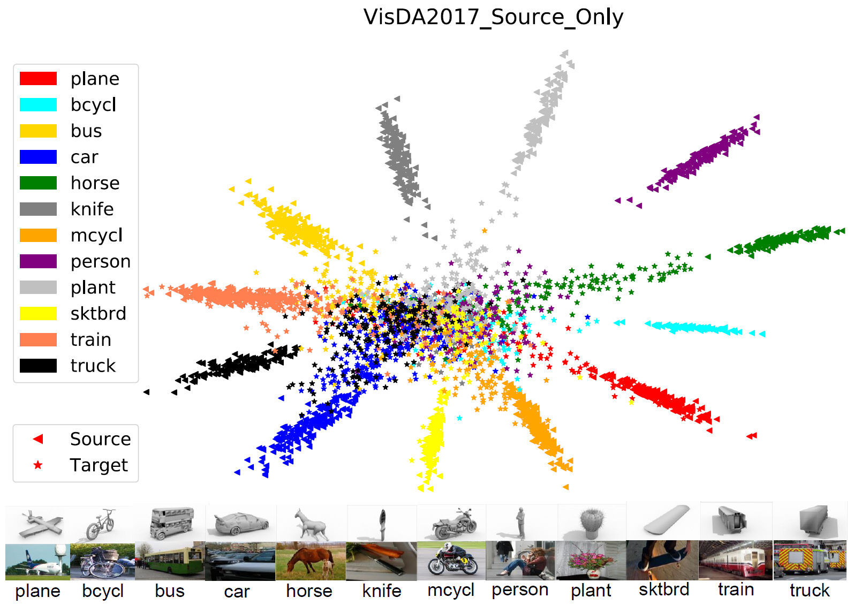
Motivation
Empirical observation - the excessively smaller norms of target domain features with respect to that of the source domain account for their erratic discrimination

Slide 3
Motivation
Misaligned-Feature-Norm Hypothesis: The domain shift between the source and target domains relies on their misaligned feature-norm expectations. Matching the mean feature norms of the two domains to an arbitrary shared scalar is supposed to yield similar transfer gains.
Smaller-Feature-Norm Hypothesis: The domain shift substantially relies on the excessively less-informative features with smaller norms for the target task. Despite non-rigorous alignment, adapting the target features far away from the small-norm regions can lead to safe transfer.

Slide 4
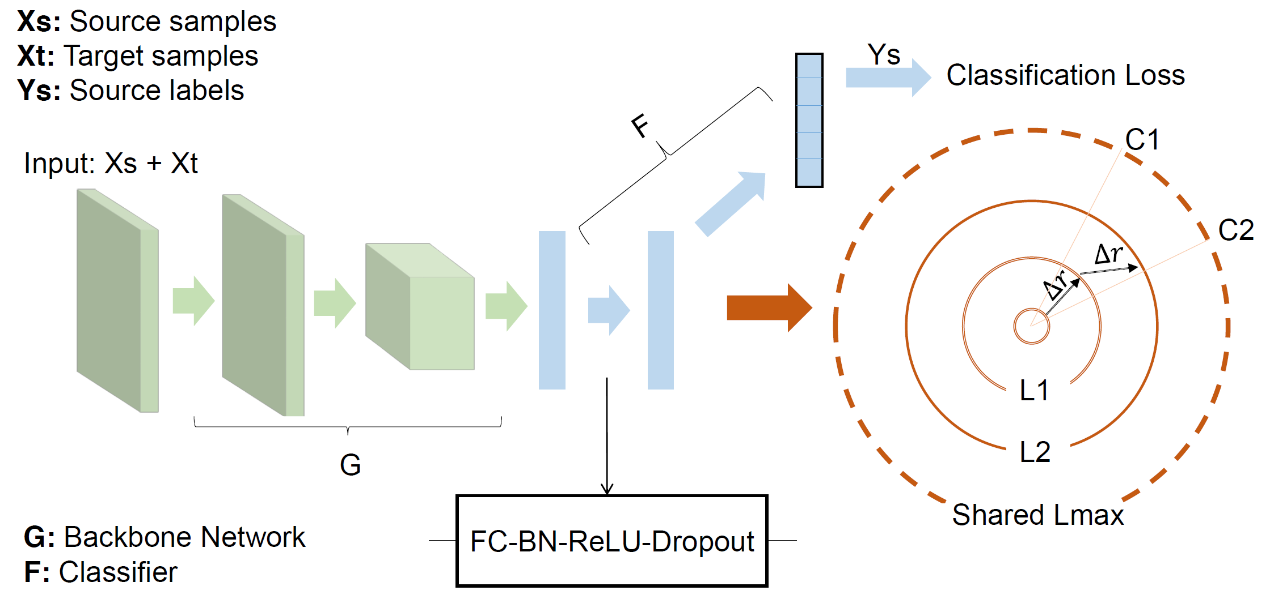
Framework

Slide 5
Hard Adaptive Feature Norm
Maximum Mean Feature Norm Discrepancy is defined as follow:
The upper bound will greatly deviate from zero if there is no restriction on the function type
Place a restrictive scalar $R$ to match the corresponding mean feature norms

Slide 6
Stepwise Adaptive Feature Norm
With $R$ gradually increases, the obtained models are still prone to achieve higher accuracies on the target task
It is natural to explore a sufficiently large $R$ and verify whether the rigorous alignment between the feature-norm expectations is necessary
$θ_{0}$: Parameters of the last iteration
$θ$: Parameters of the current iteration

Slide 7
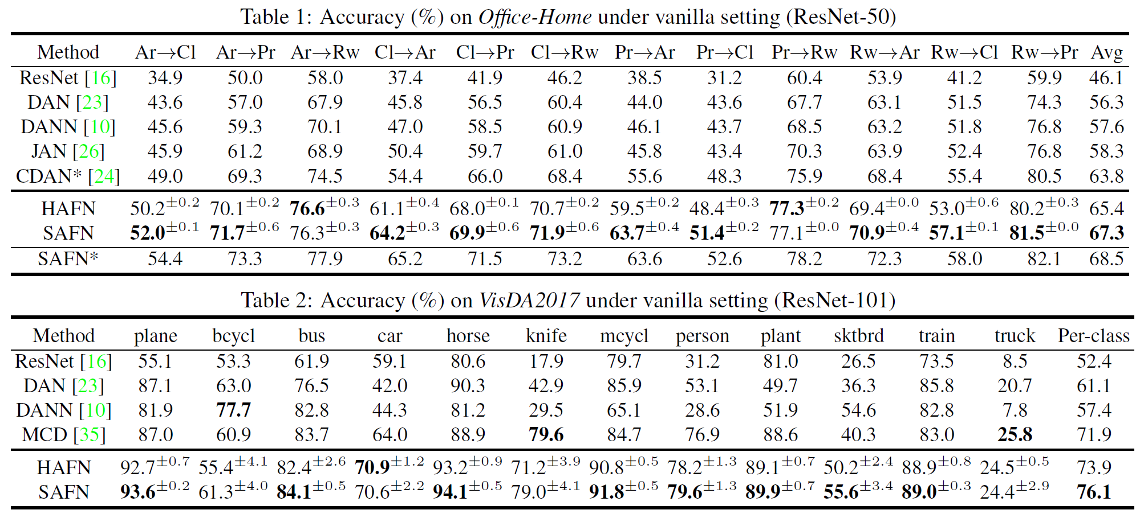
Experiments

Slide 8
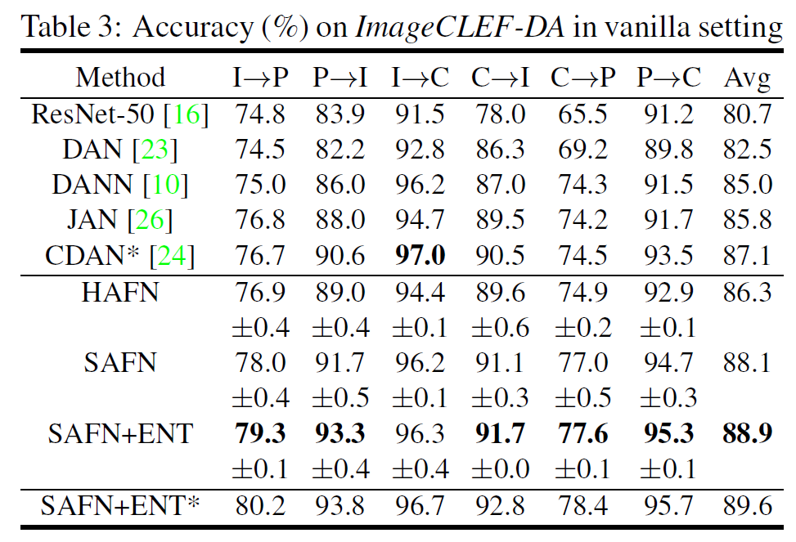
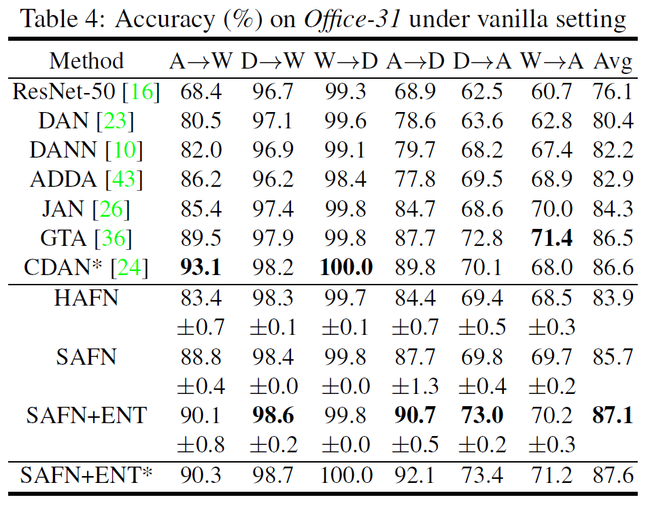
Experiments

Slide 9
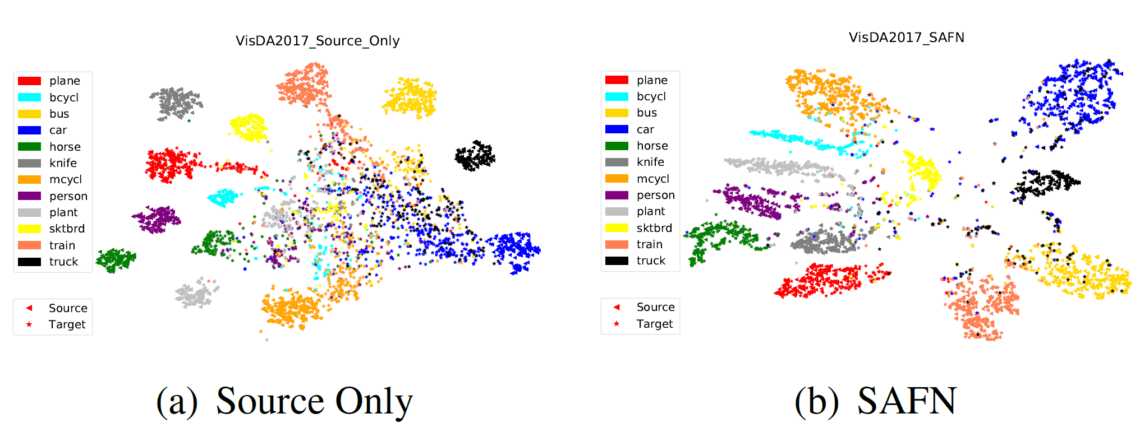
Experiments

