Slide 2
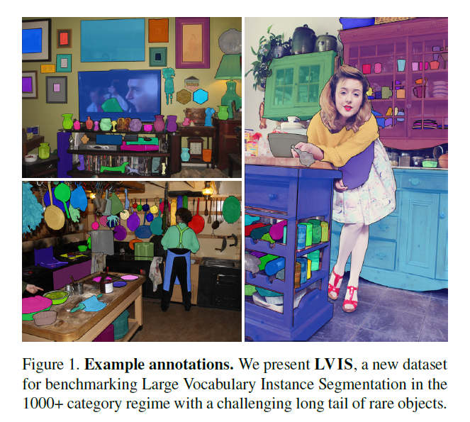
Dataset statistic
Images：164k
Instance segmentation masks：2.2 million
Categories: 1000+

Slide 3
Dataset design
Evaluation-first design principle
Federated dataset: composed of many constituent dataset, each exhaustively annotated for a single category.
Include hierarchy categories and synonyms

Slide 4
Metric
For each category c there must exist disjoint subsets of the entire dataset D for which the following guarantees hold:
Positive set: $P_{c}⊆D，$exhaustively annotated for category c
Negative set: $N_{c}⊆D$，category c does not appear
For each category c, AP is only test on $P_{c}∪N_{c}$

Slide 5
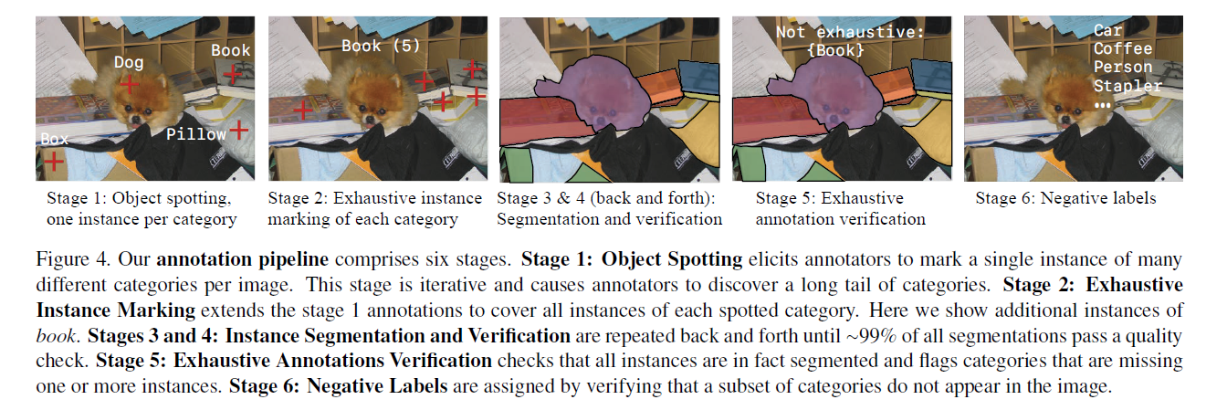
Pipeline of dataset construction

Slide 6
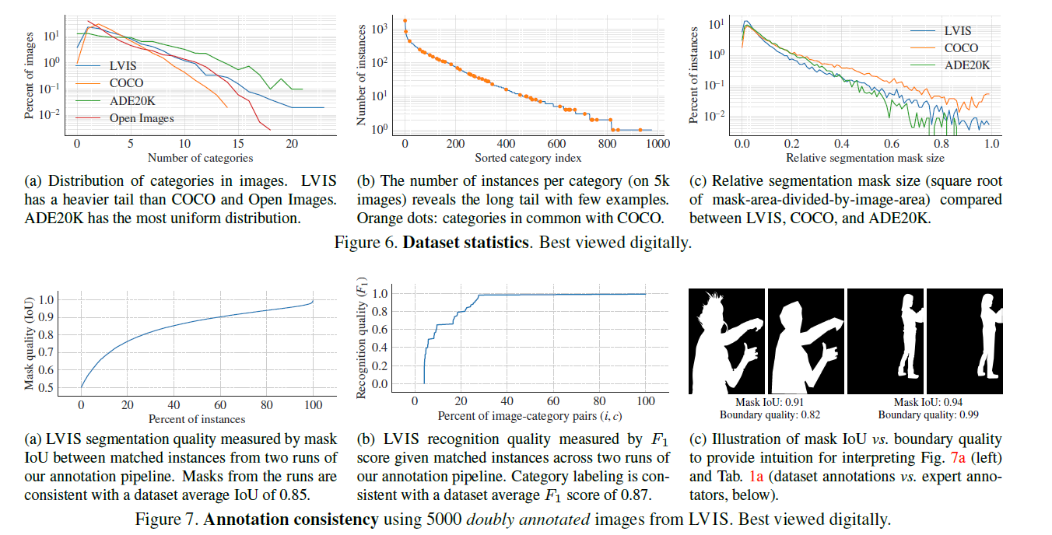
Dataset analysis

Slide 7
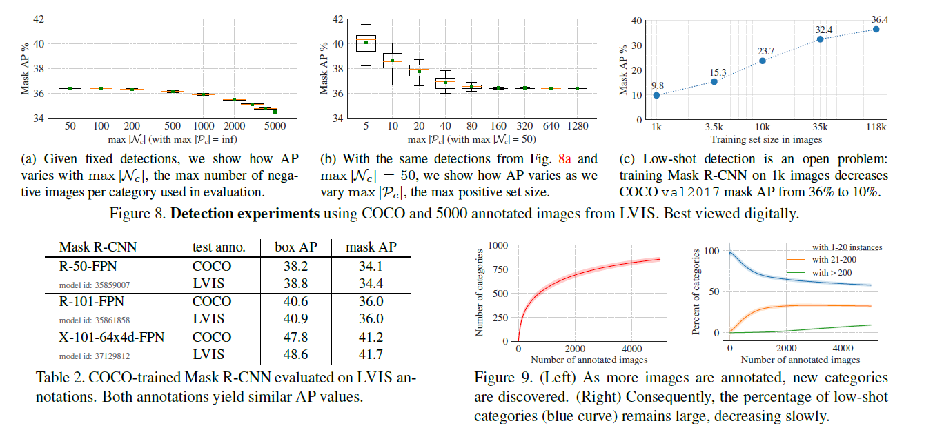

Slide 8
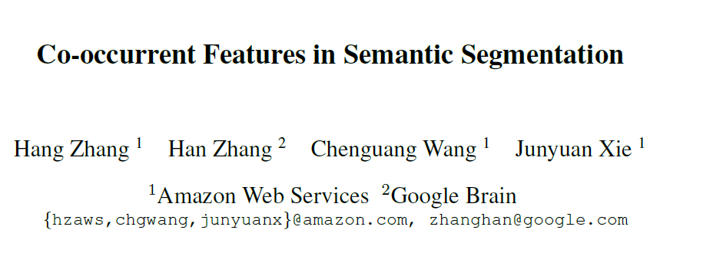

Slide 9
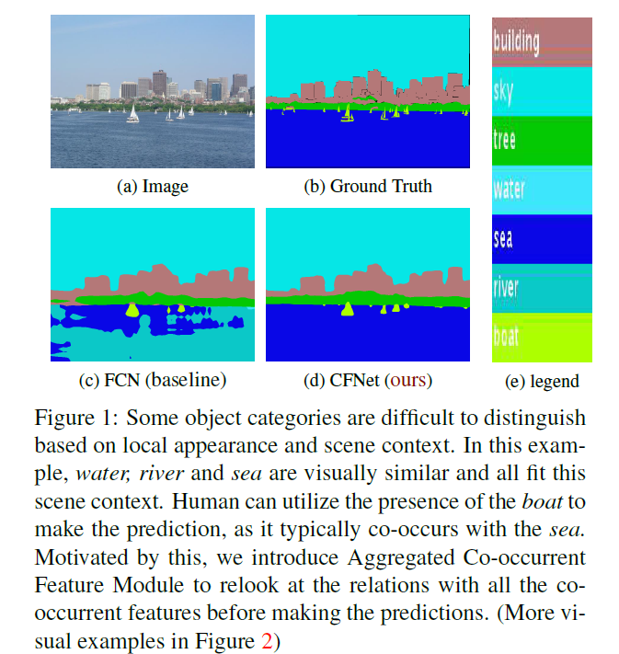
Motivation

Slide 10
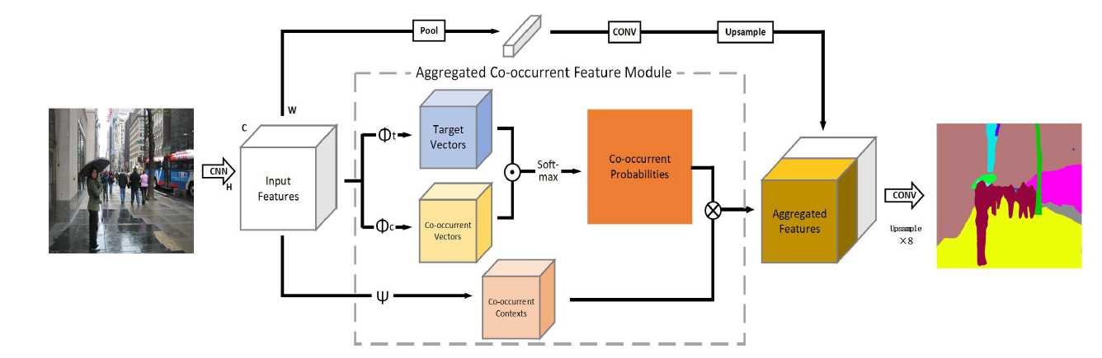
Pipeline

Slide 11
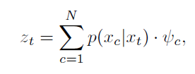
Co-occurrent features
普通co-occurrent feature model
Mixture of softmax (MoS)模型
Aggregated co-occurrent feature module
$x_{c}:$co-occurrent feature
$x_{t}:$target feature
Similarity between $x_{c}, x_{t}$
Capture the contextual information

Slide 12
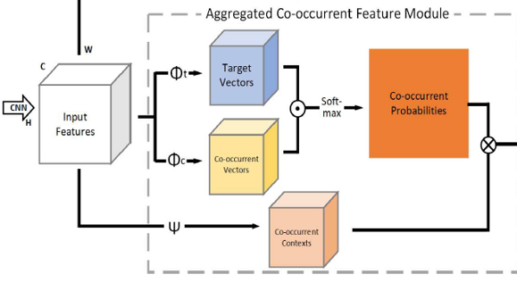
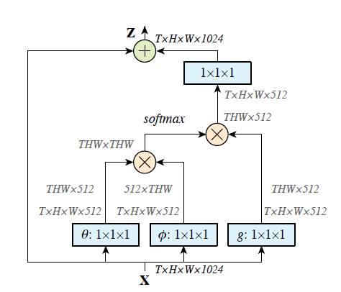
A key difference between Co-occurrent Feature Model with self-attention or non-local network is that the proposed Cooccurrent Feature Model learns a prior distribution conditioned on the semantic context
表示怀疑。。。
Non-local block

Slide 13
