Slide 1
ICLR 2019

Slide 2
Motivation
Fail on challenging tasks
significant changes in shape of instances
contains multiple target instances

Slide 3
Contributions
Instance-augmented neural architecture
translates both an image and the corresponding set of instance attributes
context preserving loss

Slide 4
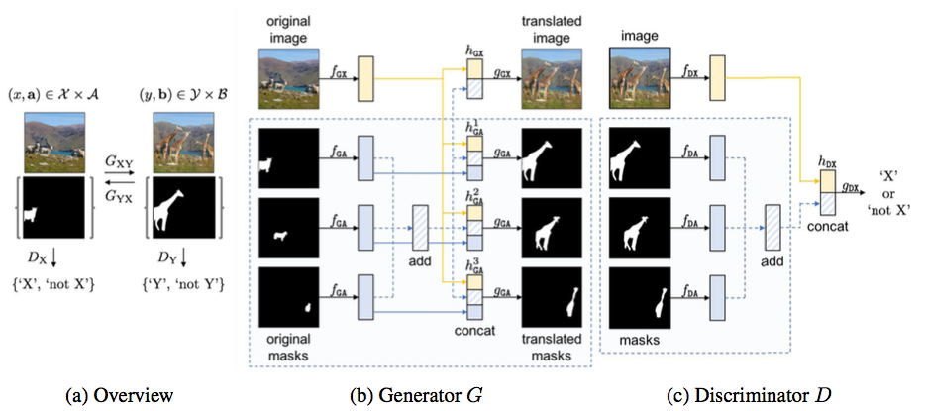
Framework

Slide 5
