Slide 1
CVPR 2020

Slide 2
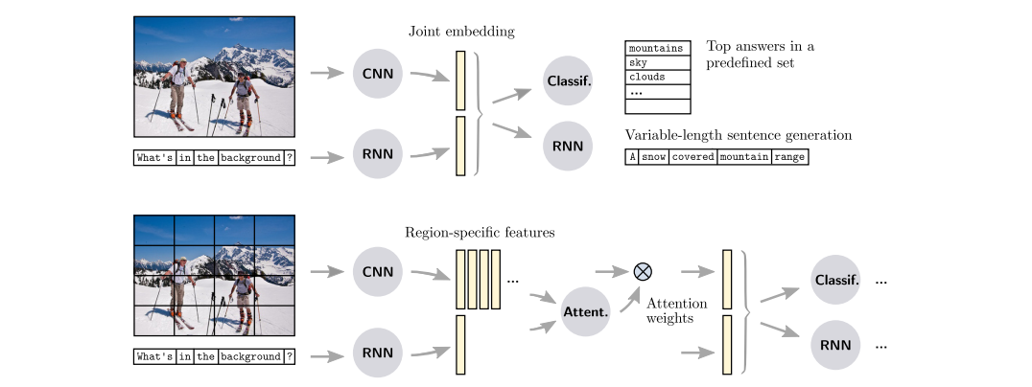
Introduction
Visual feature in VQA
Traditional VQA methods
Grid feature: CNN (classification, ImageNet pretrained)
Bottom-up top-down
Region feat: Detector (detection, VG/COCO pretrained)

Slide 3
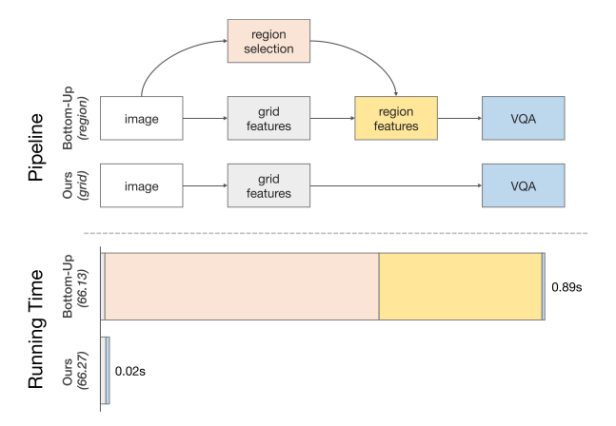
Contribution
Find that Grid feature is faster than Region feature with the same accuracy.
Proof is that pre-training tasks and image size affect accuracy, not feature format.
Propose a grid feature based and end-to-end VQA framework.

Slide 4
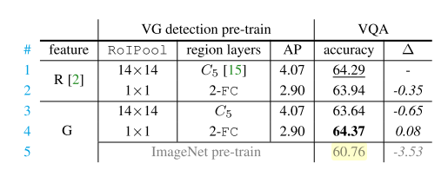
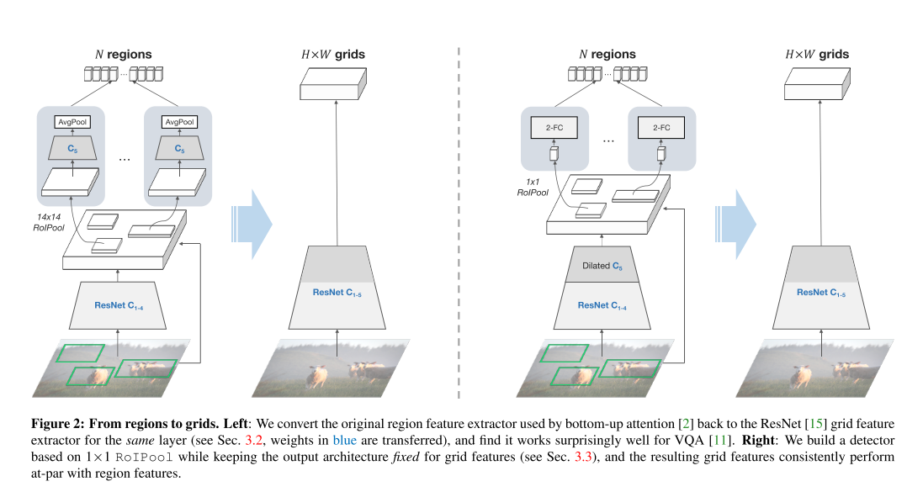
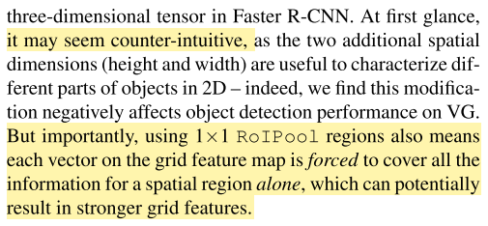
Grid feature
Faster R- CNN is optimized for region-based object detection, and likely not so much for grids.
Replace 14X14 RoIPool with 1X1 RoIPool.

Slide 5
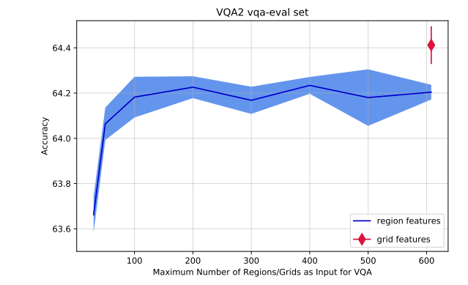
Why do Our Grid Features Work?
Number of Regions
Grid Feature: 32 stride feat of 600x1000 image -> 608 grid.
Region: from 30 to 200 regions.
Is not the reason for its improved VQA accuracy.

Slide 6
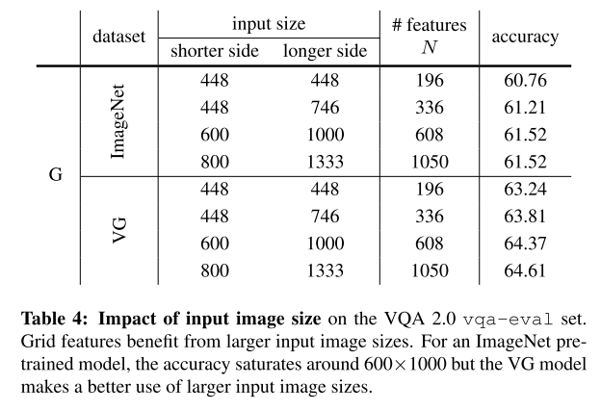
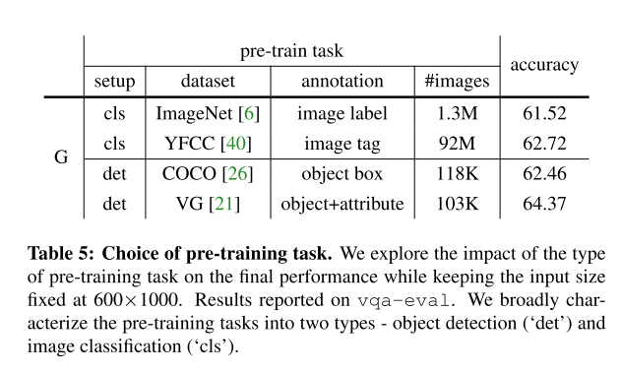
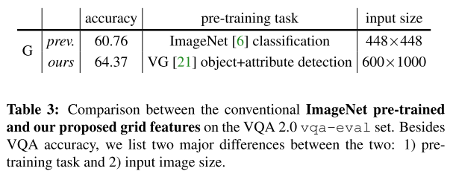
Why do Our Grid Features Work?
The large-scale object and attribute annotations.
The high spatial resolution.

Slide 7
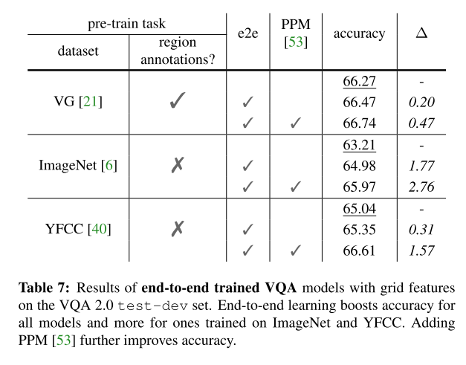
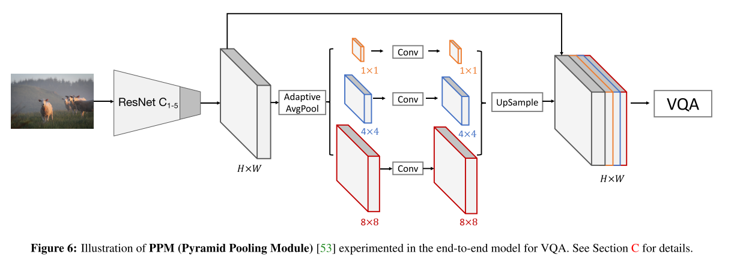
Towards End-to-end VQA

Slide 8
Summary
Key factors about bottom-up attention features:
The large-scale object and attribute annotations.
The high spatial resolution.
The feature format – region or grid –only affects accuracy minimally.
Grid feature benefits for inference speed.
Easy to be optimized for the final objective without extra grounding. (End-to-end training)

