Slide 1
Human-object interaction
2019.3.15

Slide 2
HOI问题定义
HOI—Human-Object Interaction

Slide 3
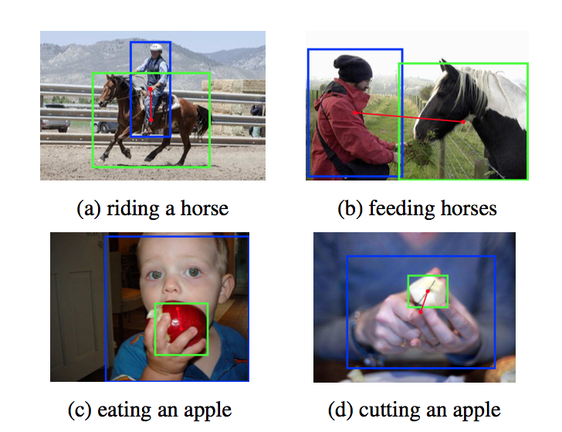
HOI-Det问题定义
HOI—Human-Object Interaction
主语->Human 宾语->Object 谓语-> Action
检测出 Human和Object
预测Human和Object交互产生的动作

Slide 4
HOI的发展
传统方法
起源：Observing human-object interactions using spatial and functional compatibility for recognition. TPAMI 2009.
Pose + hoi的先行者：Recognizing Human-Object Interactions in Still Images by Modeling the Mutual Context of Objects and Human Poses. TPAMI 2012
深度学习时代
数据库开启新时代：Learning to Detect Human-Object Interactions. WACV 2018.
根据动作定位相关物体：Detecting and Recognizing Human-Object Interactions. CVPR 2018.
精细化到Part和物体的交互：
Attention: Pairwise Body-Part Attention for Recognizing Human-Object Interactions .ECCV 2018.
:No-Frills Human-Object Interaction Detection: Factorization, Appearance and Layout Encodings, and Training Techniques. Arxiv 2018.
图卷积
Zero-shot: Compositional learning for human object interaction. ECCV 2018.
起源：Learning Human-Object Interactions by Graph Parsing Neural Networks. ECCV 2018.
Two Stage: Transferable Interactiveness Prior for Human-Object Interaction Detection. CVPR 2019.

Slide 5
HOI的常用
Pose特征 源于Action
位置信息
外部语言知识

Slide 6
Learning to Detect Human-Object Interactions

Slide 7
Contributions
Propose HICO-DET dataset: the first large benchmark for HOI detection.
Propose HO-RCNN: Human-Object Region-based Convolutional Neural Networks.

Slide 8
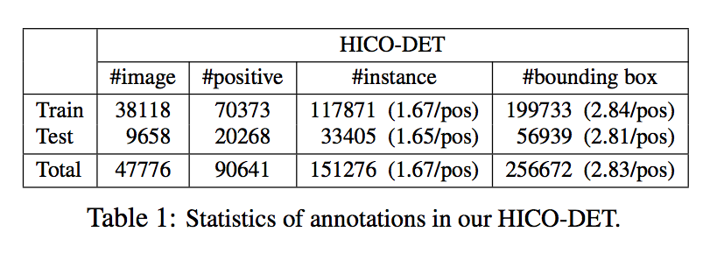
HICO-Det Dataset
统计信息
600 HOI classes of interest

Slide 9
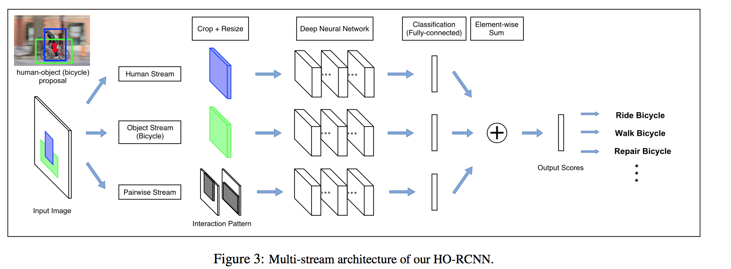
Method
HO-RCNN

Slide 10
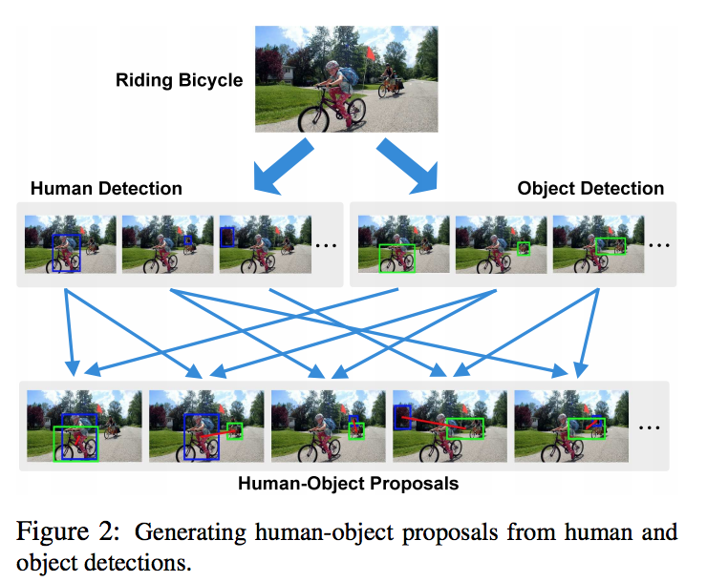
HO-RCNN
Human-Object Proposals
First detect bounding boxes for
humans and the object categories of
Interest.
Then Figure2.

Slide 11
HO-RCNN
Human and Object Stream
Given a human-object proposal, the human stream extracts local features from the human bounding box, and generates confidence scores for each HOI class.
Object stream as same.

Slide 12
HO-RCNN
Pairwise Stream

Slide 13
Detecting and Recognizing Human-Object Interactions

Slide 14
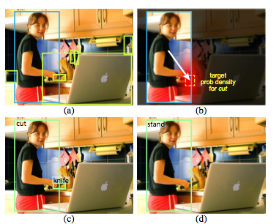
Motivation
人的动作可以一定程度上确定和人产生交互物体的位置
如<人，打，球>那么球在人手周围的概率会很大，如果是<人，踢，球>那么球更大概率会出现在脚的旁边。

Slide 15
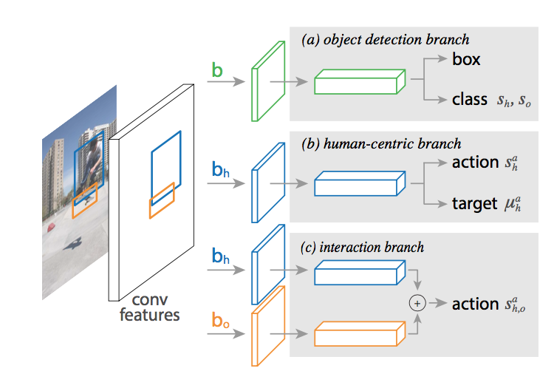
Method
Model Architecture
Model Components
Object Detection :Image->Faster-Rcnn->human and object
box and associated score.
Human-centric Branch: input: Human Conv5 Feature
action output: action score (sigmoid)
target output: Gaussian Map
Interaction Brach: input: Human and Object Conv5 Feature
output: HOI score.

Slide 16
Method
We then write our target localization term as:
Decompose the triplet score into four terms

Slide 17
Transferable Interactiveness Prior for Human-Object Interaction Detection

Slide 18
Motivation
Implicitly predict whether human-object is interactive or not.
How to utilize interactiveness and improve HOI detction learning

Slide 19
Contribution
Propose a general and transferable Interactiveness Prior learning method
Interactiveness prior can be learned across many datasets and applied to any specific dataset
Outperforms state-of-the-art HOI detection results by a great margin.

Slide 20
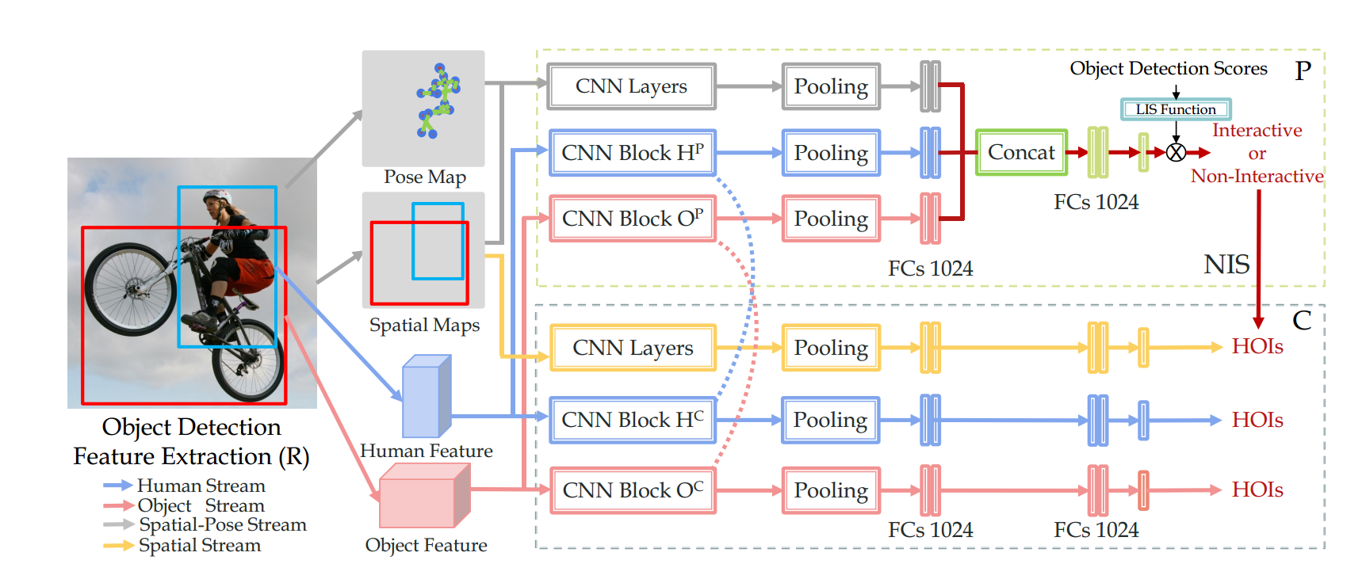
Method
Framework

Slide 21
Method
Representation and Classification Networks
Human and Object Detection: Detectron with ResNet-50-FPN.
Representation Network: Faster R-CNN with ResNet-50 based R here.
HOI Classification Network: multi-stream architecture and late fusion strategy.

Slide 22
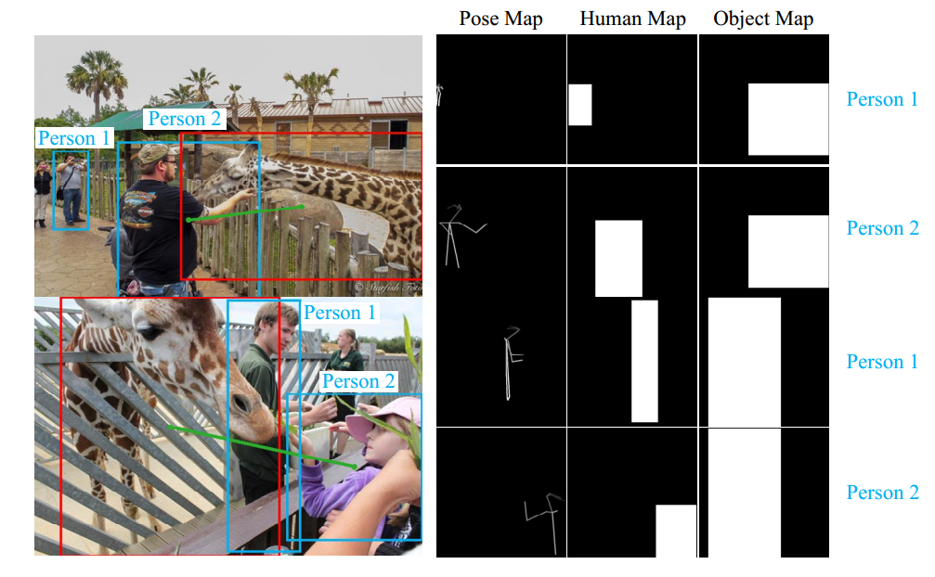
Method
Interactiveness Network
Human and Object stream
ROI pooling features from representation network R.
Spatial-Pose Stream

Slide 23
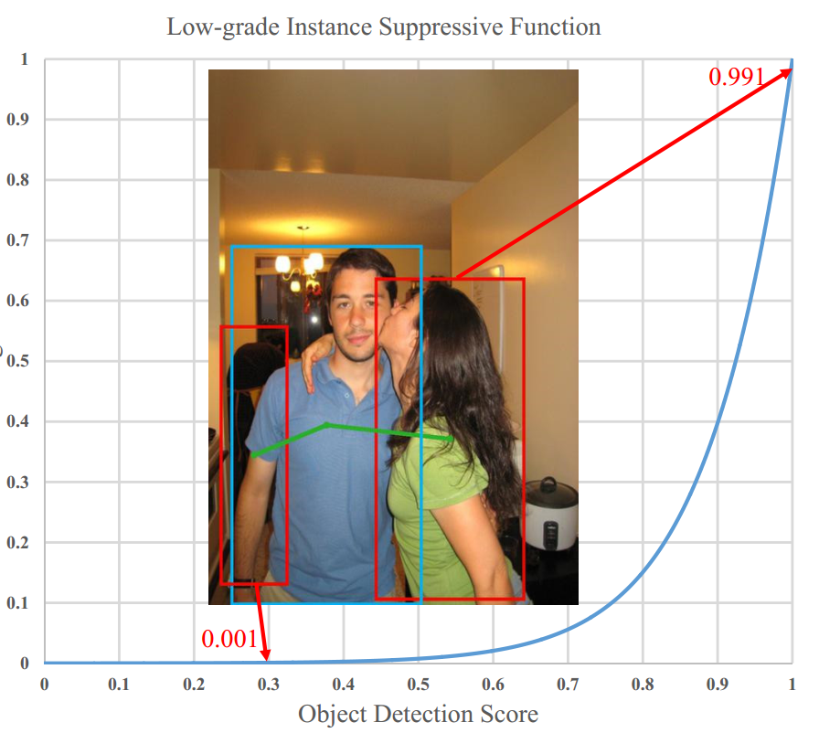
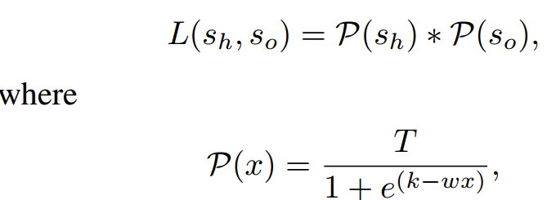
Method
Confidence Function

Slide 24
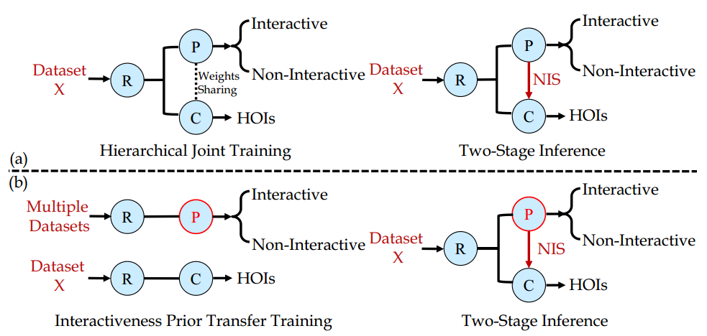
Method
Interactiveness Prior Transfer Training

Slide 25
Modeling Mutual Context of Object and Human Pose in Human-Object Interaction Activities

Slide 26
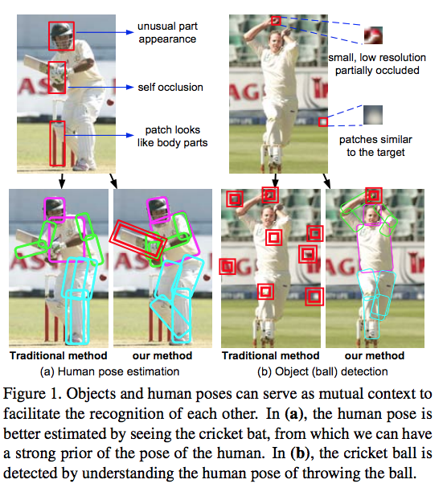
Difficulties
HOI: the relevant object tends to be small
or only partially visible.
Pose: the human body parts are often
self-occluded

Slide 27
Contributions
Propose a new random field model to encode the mutual context of objects and human poses in human-object interaction activities.
Significantly outperforms state-of-the art in detecting very difficult objects and human poses.

Slide 28
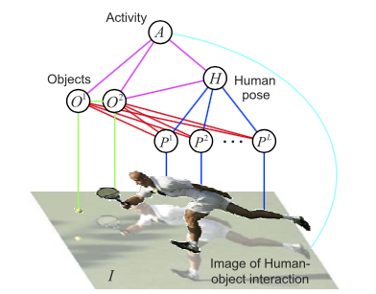
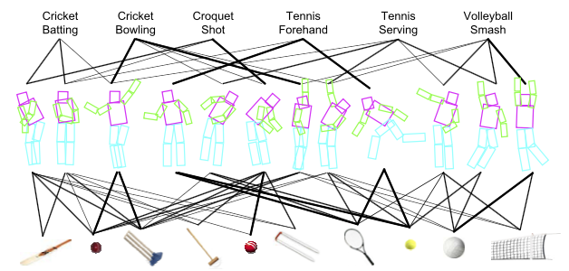
Modeling mutual context of object and pose
Goal: To estimate the human pose and to detect the object that the human interacts with.
The model

Slide 29
Model
The overall model can be computed as
Co-occurrence context

Slide 30
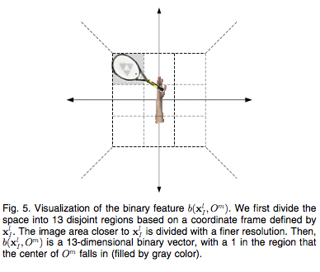
Model
Spatial Context

Slide 31
Model
Modeling objects

Slide 32
Model
Modeling human pose.
Modeling activities

Slide 33
Properties of the model
Co-occurrence context for the activity class, object, and human pose
Multiple types of human poses for each activity
Spatial context between object and body parts.
Relations with the other models.

Slide 34
Pairwise Body-Part Attention for Recognizing Human-Object Interactions

Slide 35
Motivation
Human interacts with an object by using some parts of the body .
Different body parts should be paid with different attention in HOI recognition.
The correlations between different body parts should be further considered

Slide 36
Contributions
Propose a new pairwise body-part attention model which can learn to focus on crucial parts, and their correlations for HOI recognition.
A novel attention based feature selection method and a feature representation scheme that can capture pairwise correlations between body parts .
Our proposed approach achieved 10% relative over the SOTA results in HOI recognition on the HICO dataset.

Slide 37
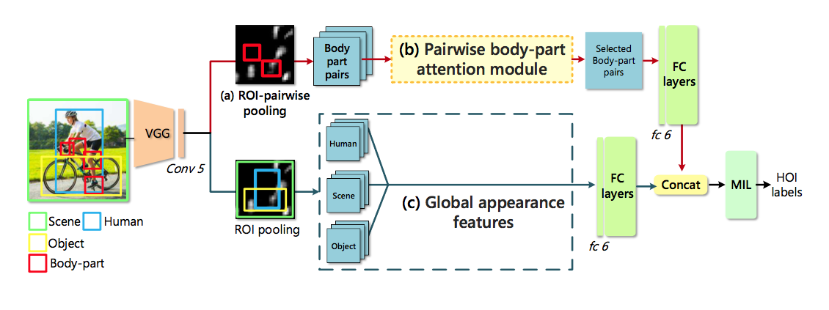
Method
Framework

Slide 38
Method
Global Appearance Features
Scene and Human Features
ROI pooling layer extracts ROI features for each person and the scene given their bounding boxes.
Concatenate Human Features and Scene Features.
Incorporating Object Features
Set ROI as a union box of detected human and object.
Sample multiple union boxes of different objects and the person

Slide 39
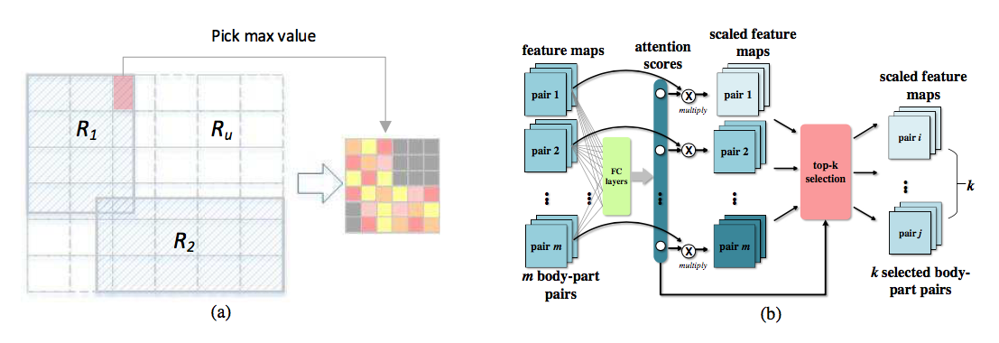
Method
Local Pairwise Body-part Features
Given a pair of body parts, to extract their joint feature maps while preserving their relative spatial relationships.

Slide 40
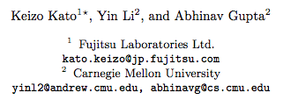
Compositional Learning for Human Object Interaction

Slide 41
Motivation

Slide 42
Contribution
Propose a novel method using external knowledge graph and graph convolutional networks which learns how to compose classifiers for verb-noun pairs.
Provide benchmarks on several dataset for zero-shot learning including both image and video.

Slide 43
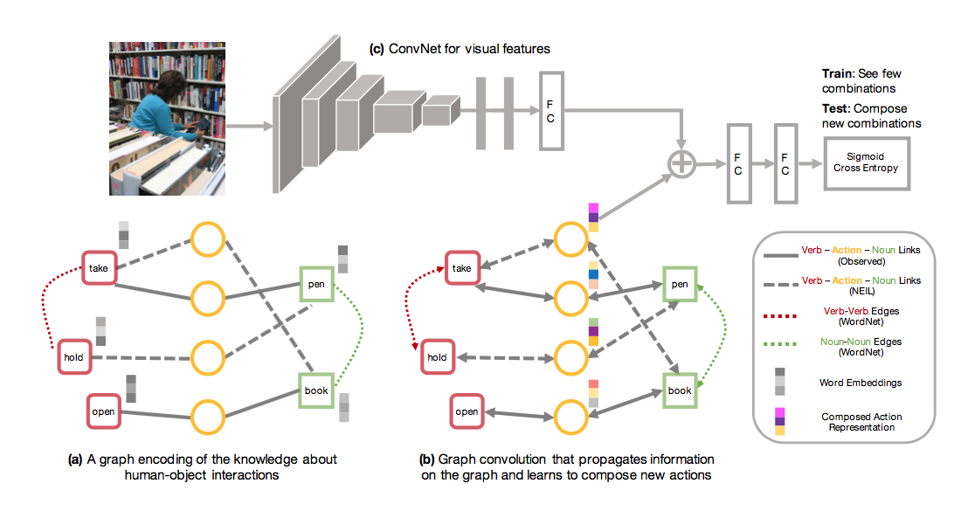
Method
Framework

Slide 44
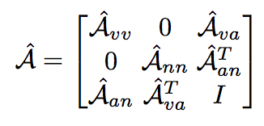
Method
A Graphical Representation of Knowledge
Graph Construction
Nodes: Verb and Noun , and Actions
Node Feature: word embeddings , （zero Init）.
Edges: A verb node can only connect to a noun node via a valid action node.
Adjacency matrix
normalization->

