Slide 1
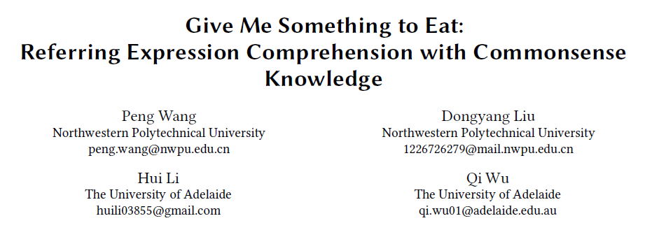
CVPR 2020

Slide 2
背景
任务
指代表达理解
现有数据集缺点
只描述外形属性和空间位置关系
例“the second white cup on the table”
启发
人类通常使用丰富的知识去寻求所需要的东西，不局限于视觉信息
例“Can you pass me something to knock in this pin”和“I want to eat something low fat”
依靠常识知识

Slide 3
贡献
带常识的指代表达数据集
KB-Ref
Baseline
Expression Conditioned Image and Fact Attention network (ECIFA)

Slide 4
KB-Ref数据集
Image and Objects
Images: sample from Visual Genome (VG)
Ignore
Objects that do not belong to any synset in WordNet
Objects appear alone in one image
Objects whose sides are less than 32 pixels
Images which has labeled objects less than 5
24,453 images, 2,075 object categories, 208,532 bounding boxes

Slide 5
KB-Ref数据集
Knowledge Base
Collect facts from three knowledge resources (Wikipedia, ConceptNet and WebChild)
Related to the 1,805 object categories appeared in out dataset

Slide 6
KB-Ref数据集
Data Annotation
Amazon Mechanical Turk (MTurk) wokers
Requests
At least one fact from the constructed knowledge base should be used in referring expression
The specific object name cannot appear in the expression
Multiple auxiliary objects appeared in the image are encouraged to be mentioned in the expression

Slide 7
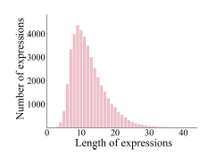
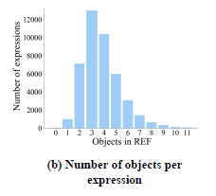
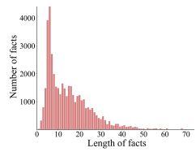
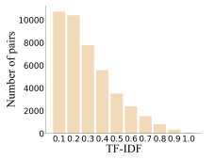
KB-Ref数据集
Data Analysis
43,284 expressions for 1,805 object categories on 16,917 images

Slide 8
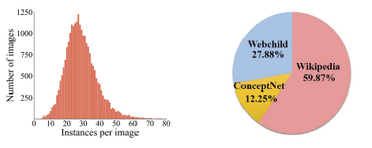
KB-Ref数据集
Data Analysis
31,284 expressions with 9,925 images in training set
4000 expressions with 2,290 images in validation set
8,000 expressions with 4,702 images in test set

Slide 9
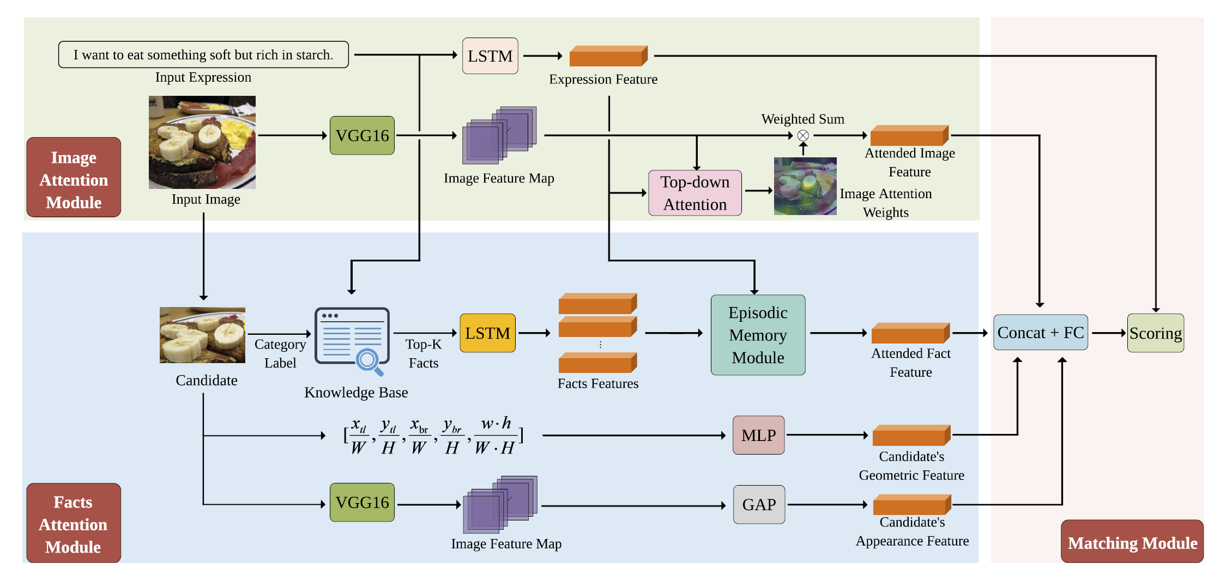
ECIFA
According to the cosine similarity between the averaged Word2Vec word embeddings of each fact and the expression
focus attention on a
subset of the K retrieved facts
The hidden states at all time steps are added together

Slide 10
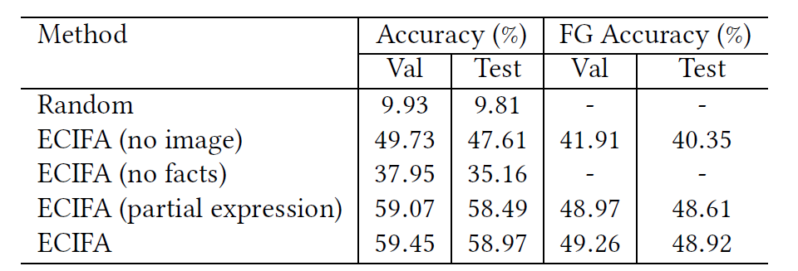
数据集偏差

Slide 11
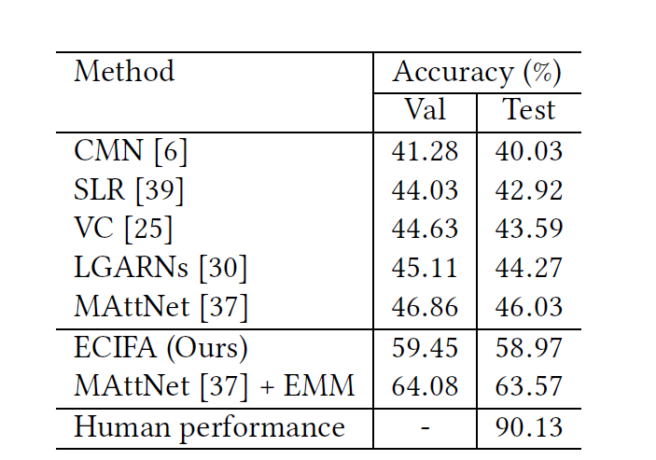
Compared with SOTA

Slide 12
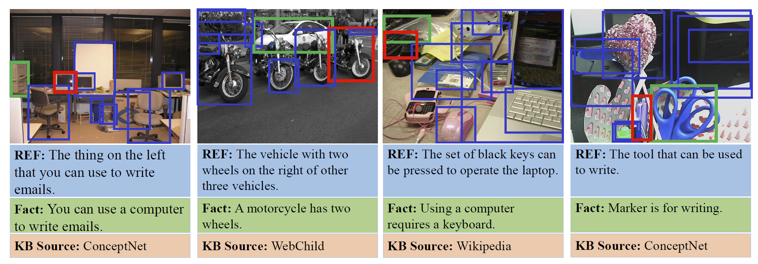
Compared with SOTA

Slide 13
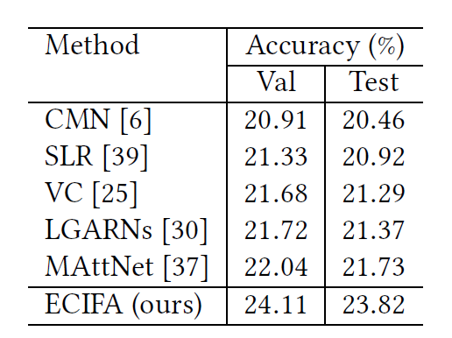
Compared with SOTA

