Slide 1
GPipe: Efficient Training of Giant Neural Networks - using Pipeline Parallelism

Slide 2
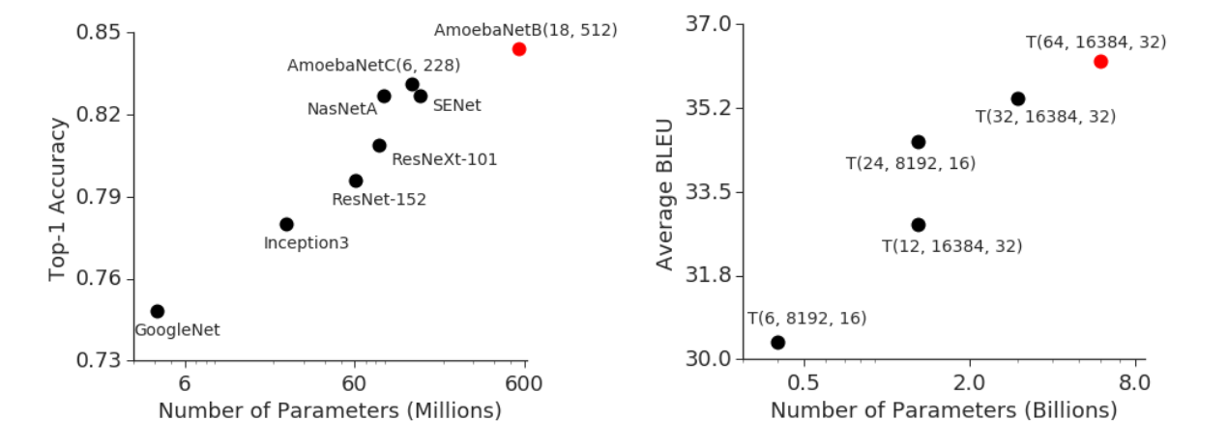

Slide 3
主要技术
re-materialization
micro-batch
activation-checkpointing
节省内存
并行化
节省内存

Slide 4
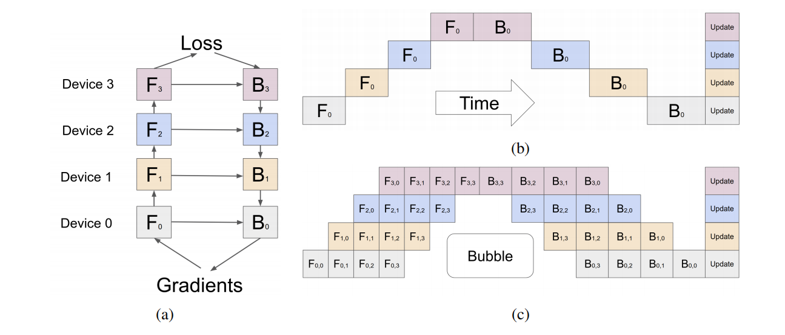

Slide 6
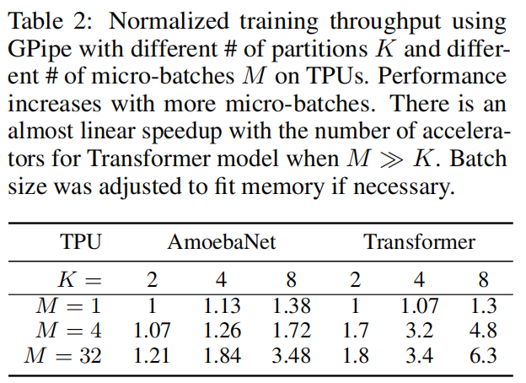
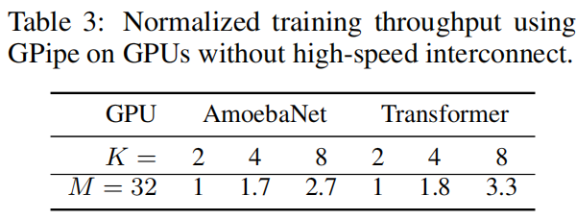

Slide 7
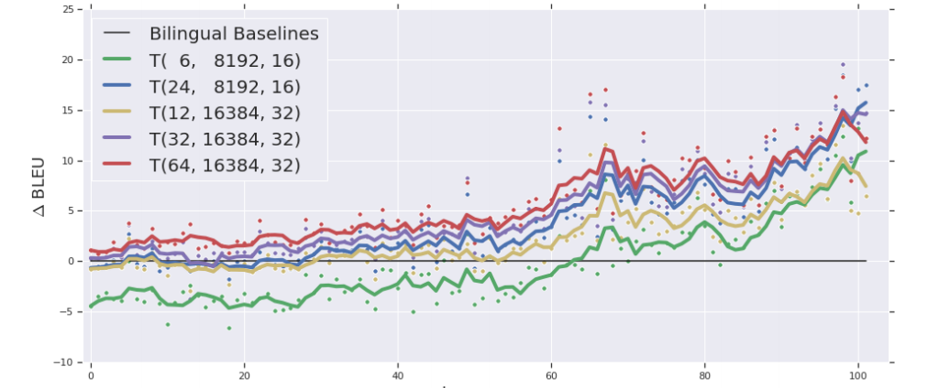

Slide 8
