Slide 2
CRIC dataset

Slide 3
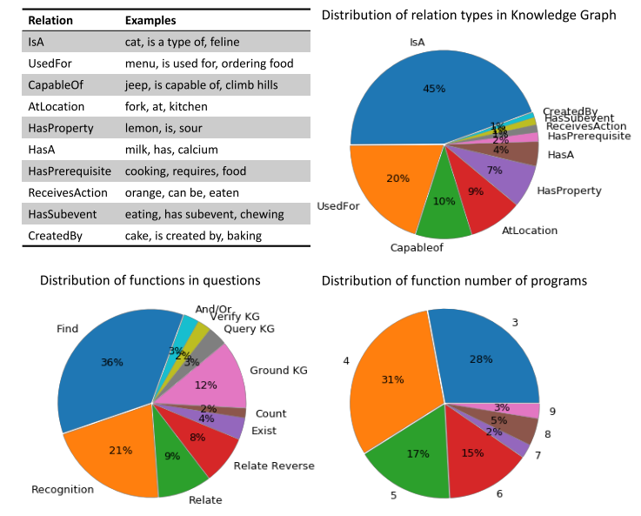
CRIC dataset
Visual Genome
108K images and scene graph
907 distinct objects, 225 attributes and 126 relationships
ConceptNet (Knowledge graph)
3,019 knowledge triplets, 113 categories
10 relations

Slide 4
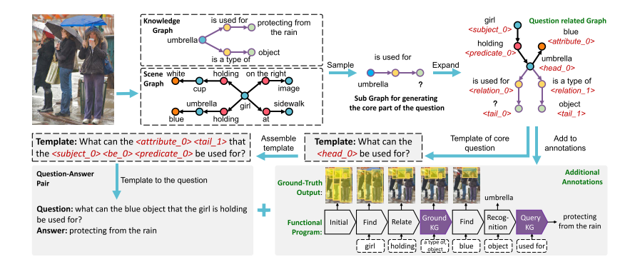
Dataset Collection
1) Process the scene graph
2) Collect useful knowledge triplets
3) Define the basic functions that the question will involve
4) Automatically generate QA samples
5) Obtain additional annotations
6) Balance the dataset

Slide 5
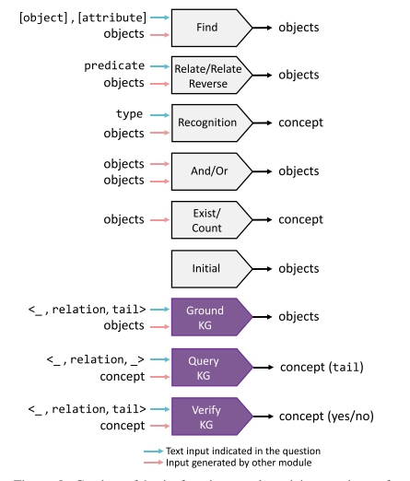
Function Definition
Define the basic functions that the questions will involve.
12 basic functions

Slide 6
Question generation
Build template of
Querying one object in the image / one element of object-attribute tuple / relationship triplet
Use one object-attribute tuple or visual/ knowledge triplet to decorate one object

Slide 7
Additional Annotations
The sub scene graph and sub knowledge graph used in QA pair.
The representation of the question
In the form of a functional program
The ground truth output of every function in the program

Slide 8
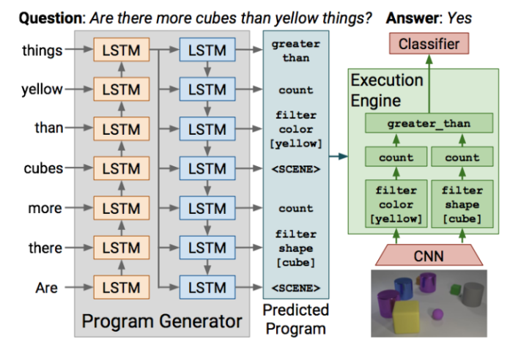
Approach
Builds upon neural module networks
Johnson, Justin, et al. "Inferring and executing programs for visual reasoning." CVPR 2017.

Slide 9
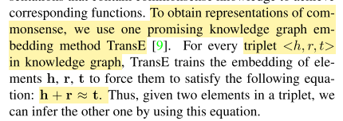
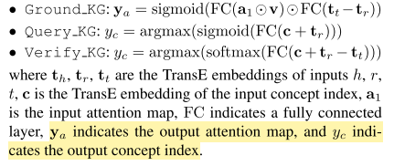
Neural Modules
Input
Tensors (x1, ...., xn) from other neural modules
Image feature v
Text input t.
Output
An attention map a over image regions
Or an discrete index c representing one concept.

Slide 10
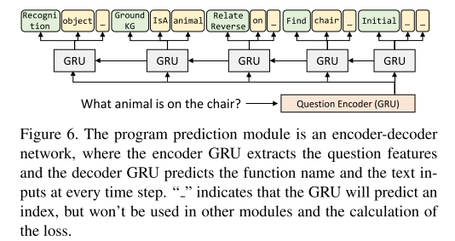
Program Prediction

Slide 11
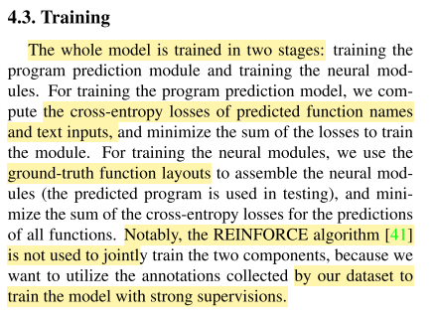
Training

Slide 12
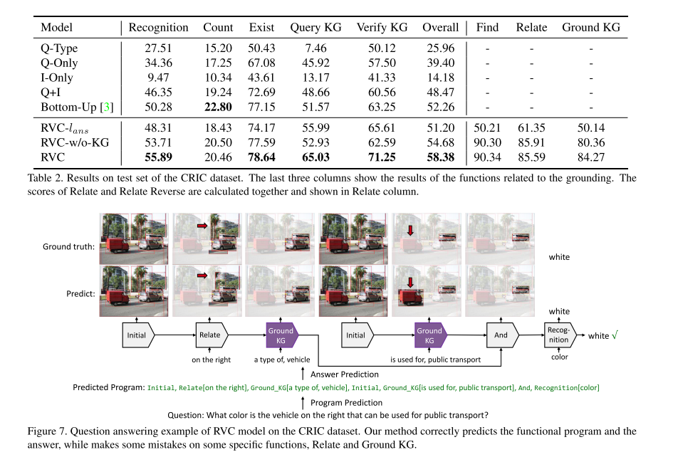
Experiment

