Slide 1
TPAMI 2018

Slide 2
Motivation & Contribution
Current datasets and the models focus on questions which are answerable by direct analysis of the question and image alone.
Excludes questions require common sense, or basic factual knowledge to answer.
Introduce FVQA (Fact-based VQA) which requires much deeper reasoning and external information to answer.
Extend conventional VQA dataset with supporting facts, represented as triplets, such as <Cat, CapableOf, ClimbingTrees>.

Slide 3
FVQA Dataset
Images and Visual Concepts
Object
COCO-80 U ImageNet-200 U 92 = 326 distinct object classes
Scene
MIT Places 205-class dataset U 25 = 221 distinct scene classes
Action
24
These visual concepts are further linked to a variety of external knowledge bases.

Slide 4
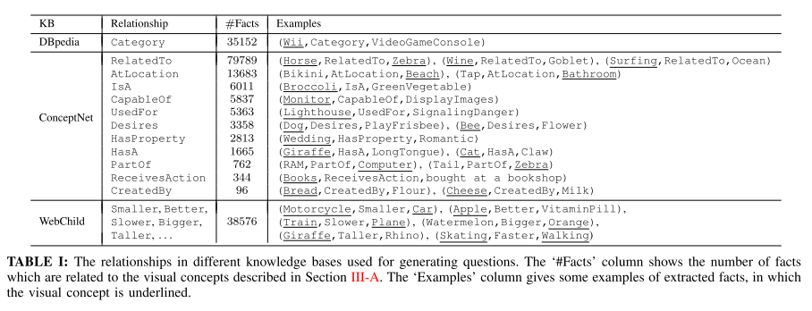
Knowledge Bases
3 structured knowledge bases.

Slide 5
Question Collection
Selecting Concept
Choose one of the visual concepts (object, scene and action) related to image.
Selecting Fact
Select a correct and relevant fact from knowledge base.
Asking Question and Giving Answer
Ask a question, answering which needs the information from both of the image and the selected fact.
The answer is limited to the two concepts in the supporting-fact.

Slide 6
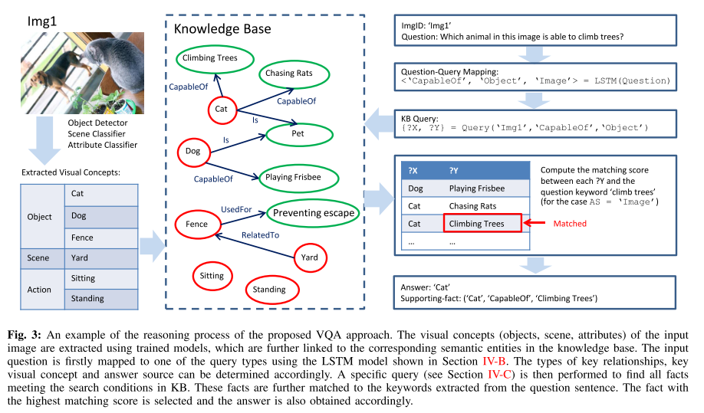
Method
Image, Question -> KB-queries -> Answer
Learn the mapping between questions and a set of KB-queries.

Slide 7
Constructing a Unified KB
Links the visual concepts of images to the corresponding concepts in multiple KBs.
A visual concept X of type T (T = Object, Sence or Action) extracted from the image with id I is stored in two triples
(X, Grounded, I)
(X, VC-Type, T)

Slide 8
Question-Query Mapping
Key visual concepts (T_{KVC})
Value can be Object, Scene or Action
Key relationships (T_{REL})
13 relationship type in the supporting-fact.
Answer sources (T_{AS})
TAS = Image if answer is the key visual concept, and TAS = KB otherwise.
< T_{KVC}, T_{REL}, T_{AS} >.
Obtained through the annotated supporting- fact and the given answer.
Collect 32 different combinations of < T_{KVC}, T_{REL}, T_{AS} >.
Consider each combination as a query type and learn a 32-class classifier using LSTM models.

Slide 9
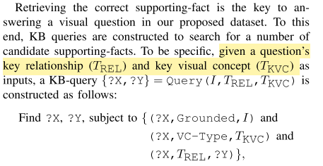
Querying the KB
Find a list of entities from facts.

Slide 10
Answering
Select answer by T_{AS}
T_{AS} = Image -> Find X by matching Y & Q
T_{AS} = KB
T_{KVC} = Scene or Action
The visual concept ?X with the highest probability is selected and the corresponding concept ?Y is considered as the answer.
T_{KVC} = Object
The visual concept ?X is selected based on the question keywords describing location (such as top, bottom, left, right or center) or size (such as small and large).
Answers are ordered according to their frequency in the training data: the most frequent answer appears first

Slide 11
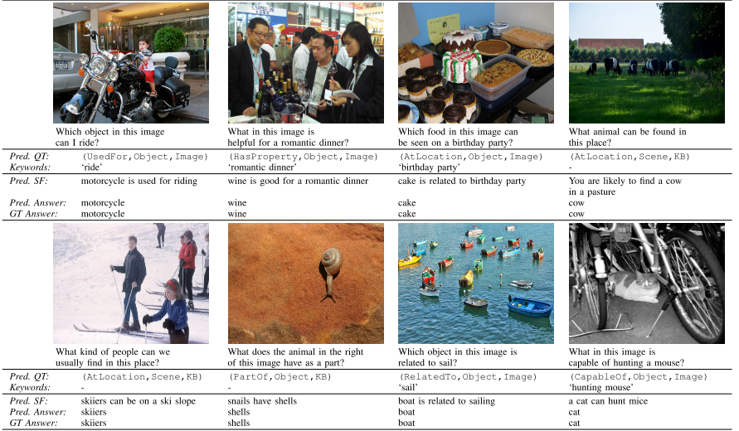
Results

