Slide 2
Introduction
Few-Shot object Segmentation.
1000 object classes, 5 annotated training examples per class.
Our dataset contains significant number of objects that have never been seen or annotated in previous datasets.
Such as tiny daily objects, merchandise, cartoon characters, logos, etc.

Slide 3
Motivation
Pre-trained weights may not work well.
ImageNet: Bias in object classes (small number) and images within a given class (uneven distribution).
Image segmentation which requires extremely labor-intensive.
A large-scale object segmentation dataset is necessary.

Slide 4
Dataset

Slide 5
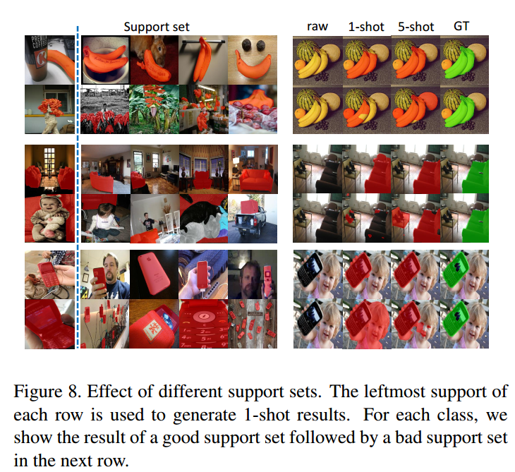
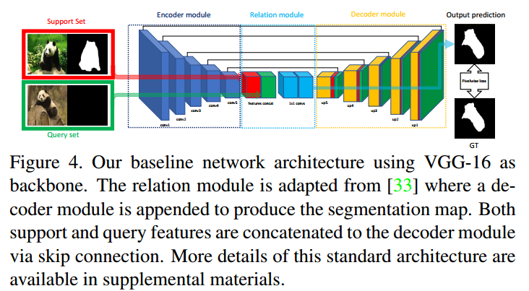
Baseline

