Slide 1
ACL 2019

Slide 2
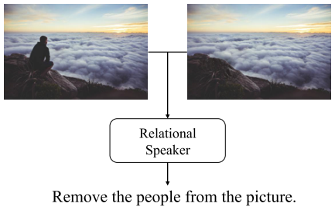
Motivation
Fundamental problem in vision-language research: Describing images with text
Existing task: single image captioning
Propose a new task: describing the visual relationship between two images

Slide 3
Contributions
Propose a novel language-guided image editing dataset
Design relational-speaker models

Slide 4
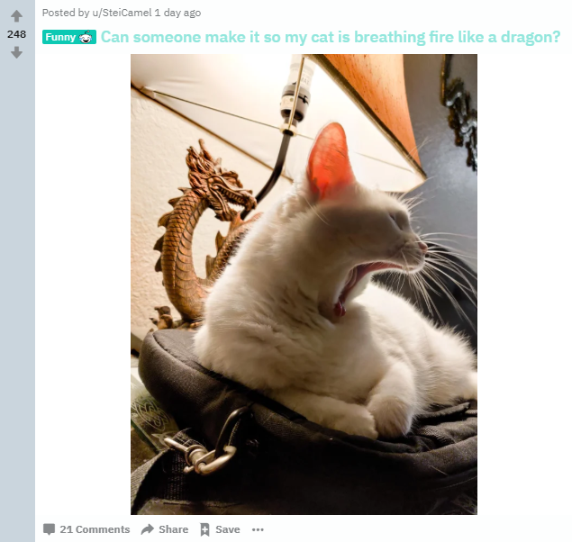
Dataset - Image Editing Request Dataset
Image pairs collection
Editing instructions annotation
Post-processing by experts

Slide 5
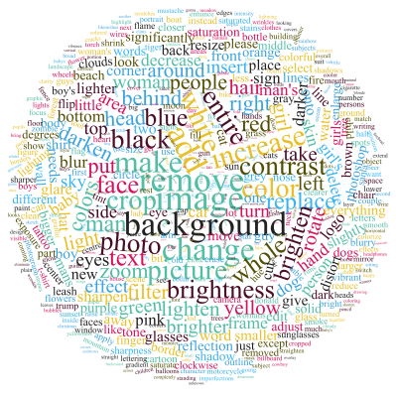
Datasets

Slide 6
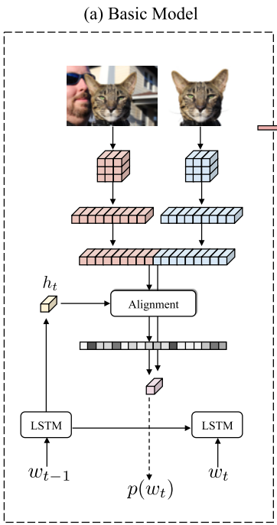
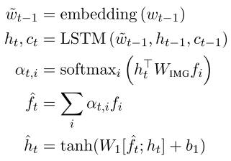
Model

Slide 7
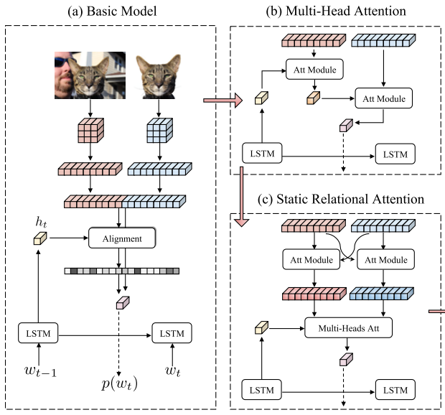
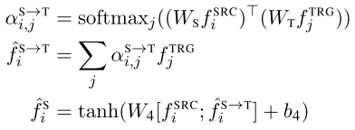
Model

Slide 8
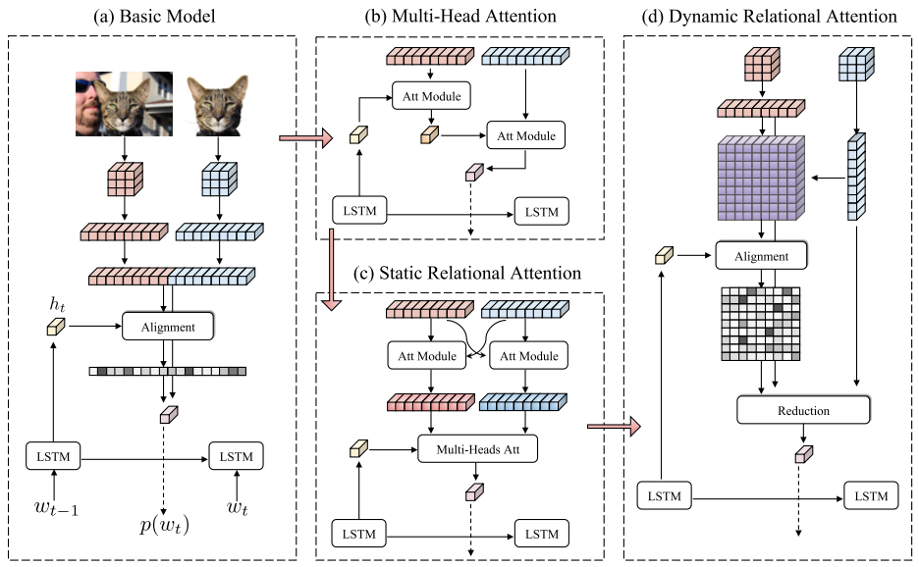
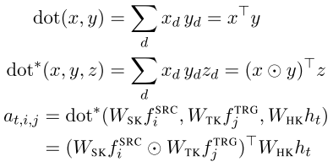
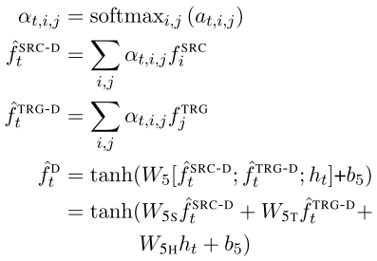
Model

Slide 9
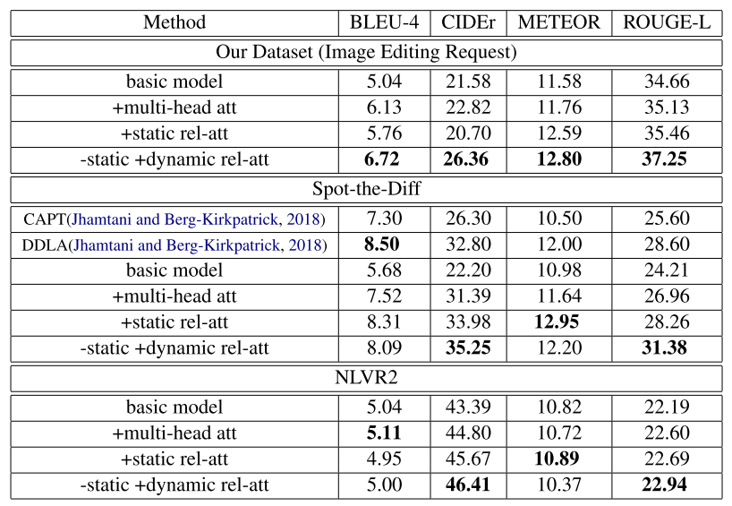
Experiments

Slide 10
Experiments

