Slide 1
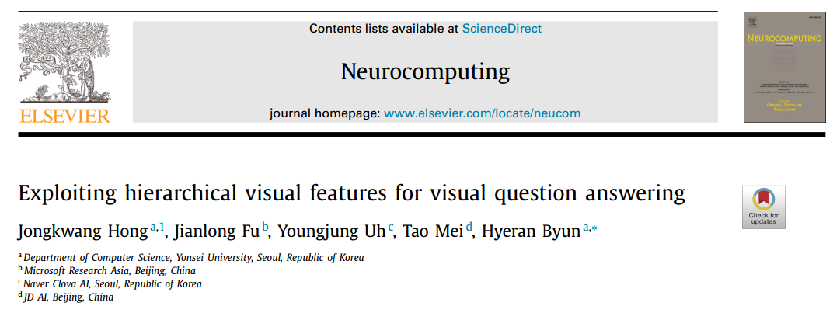

Slide 2
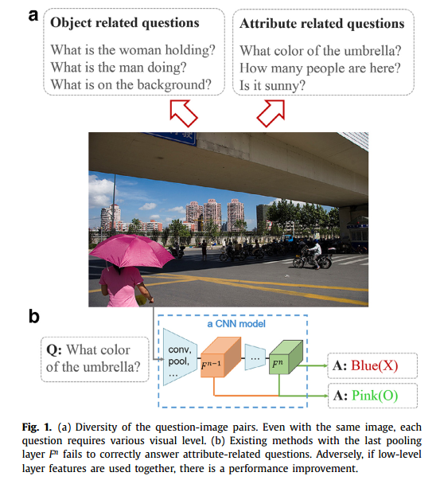
Motivation
Low-level semantic information such as color, texture, and quantity can be derived from low-level CNN layers to improve VQA performance.
Object-categorization oriented features lose low-level semantics (attribute related questions).

Slide 3
Contribution
The role of low-level features is confirmed.
Propose HFnet to exploit both low and high-level features from a CNN for encoding visual semantics
High performance.

Slide 4
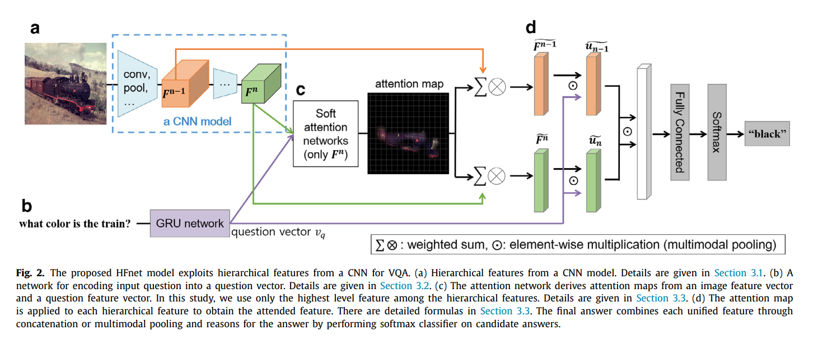
Framework
Only uses the last layer feature for attention network
Because visual attention for VQA is supposed to focus on the region of objects.

Slide 5
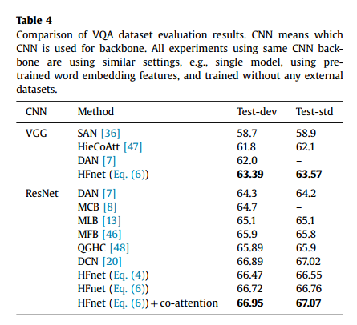
Experiments

