Slide 2
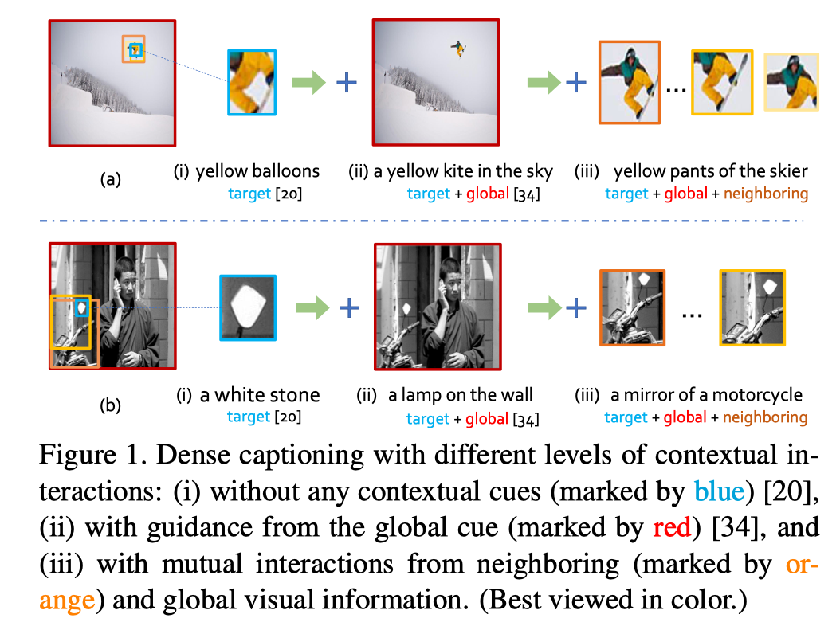
Motivation
Caption generated by one RoI lacks contextual coherence with its surrounding context

Slide 3
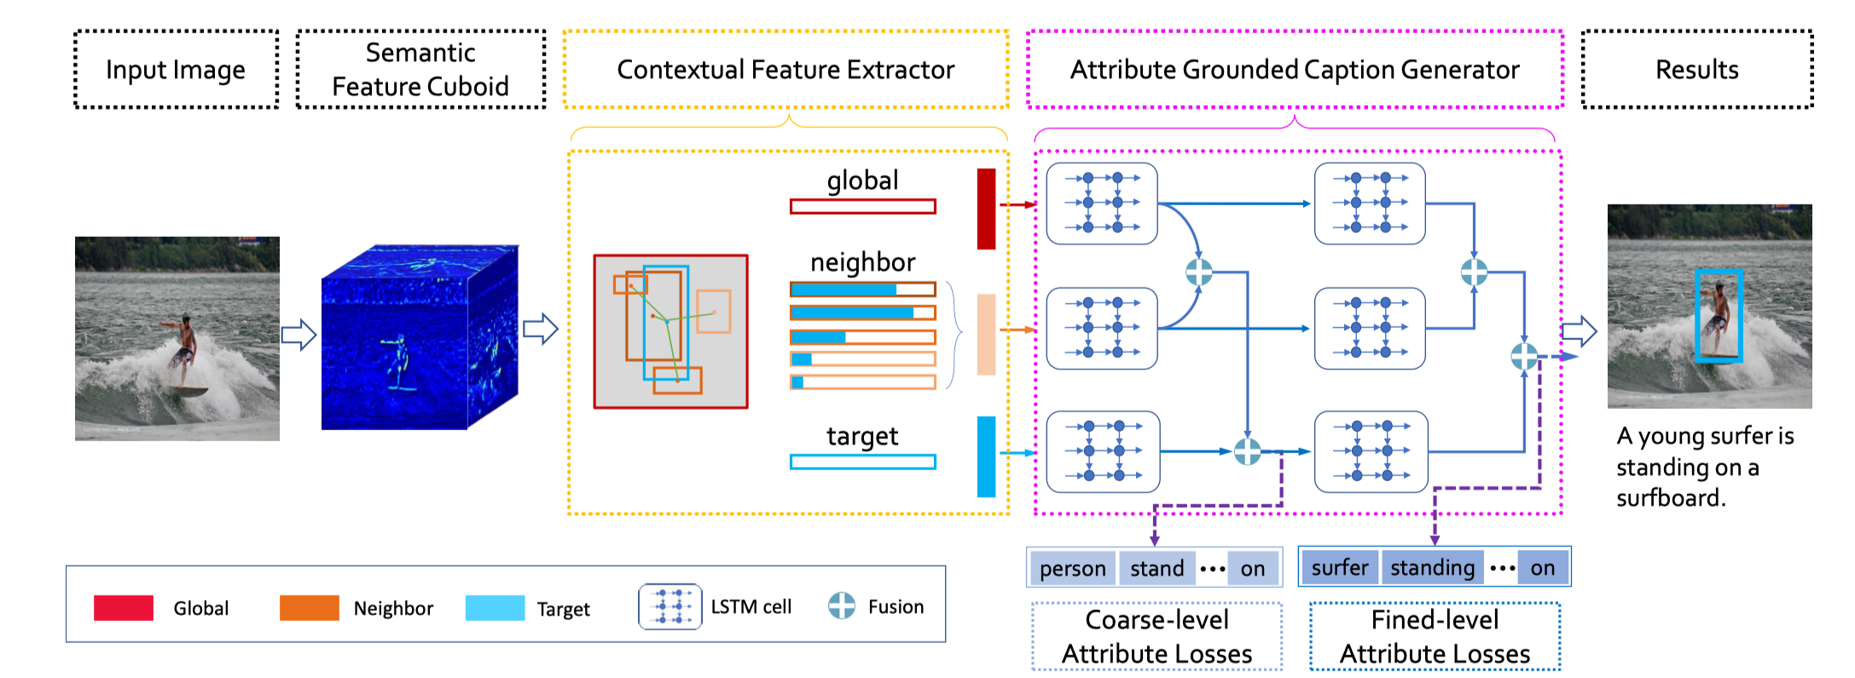
Pipeline

Slide 4
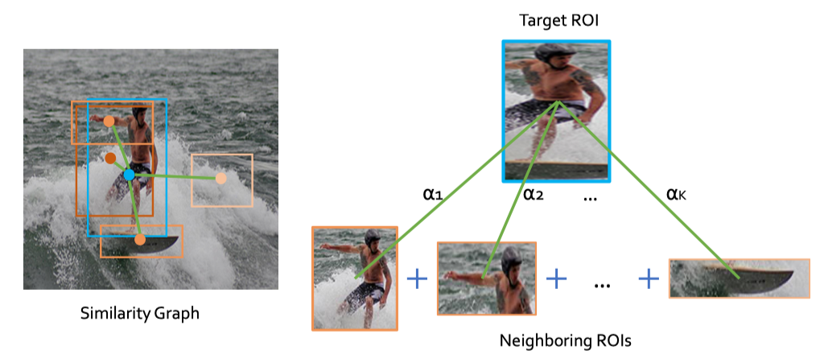
Neighboring RoIs

Slide 5
Neighboring RoIs
Fusion:
Choice of k in ‘nearest-k’
#Input RoI

Slide 6
Context Usage

Slide 7
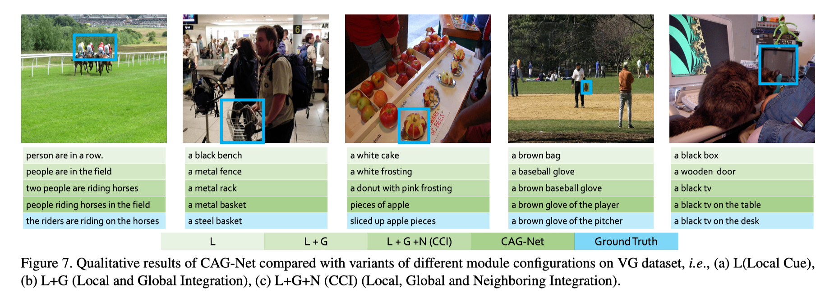
Result

Slide 9
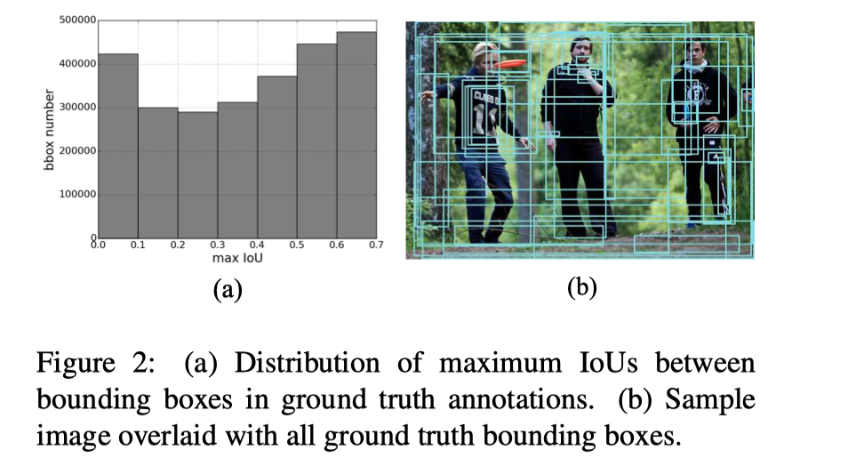
Motivation
Dense visual concept annotations in each image are associated with highly overlapping target regions
The large amount of visual concepts makes it hard to recognize each of them by appearance alone. such as “horse” and “donkey”

Slide 10
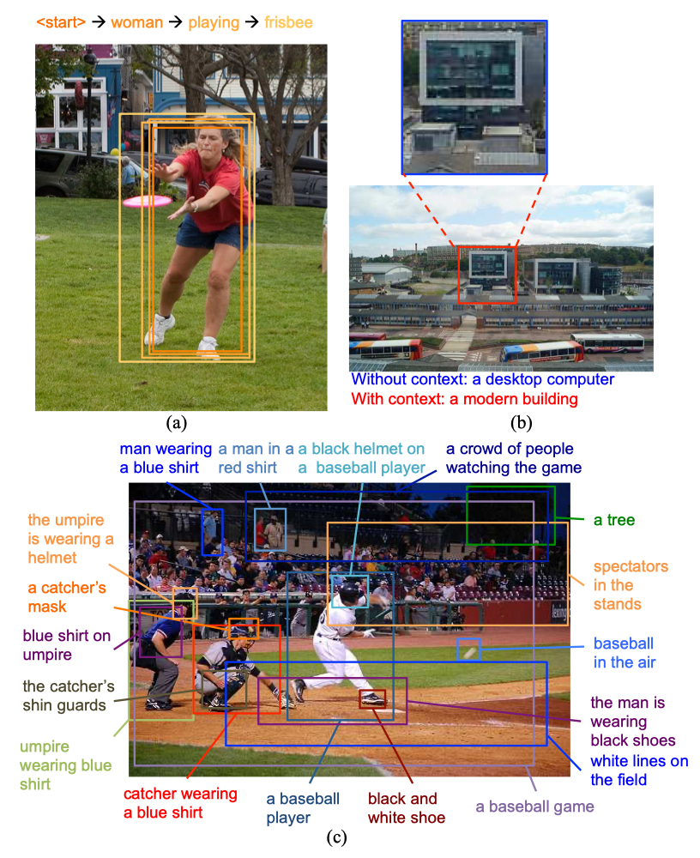

Slide 11
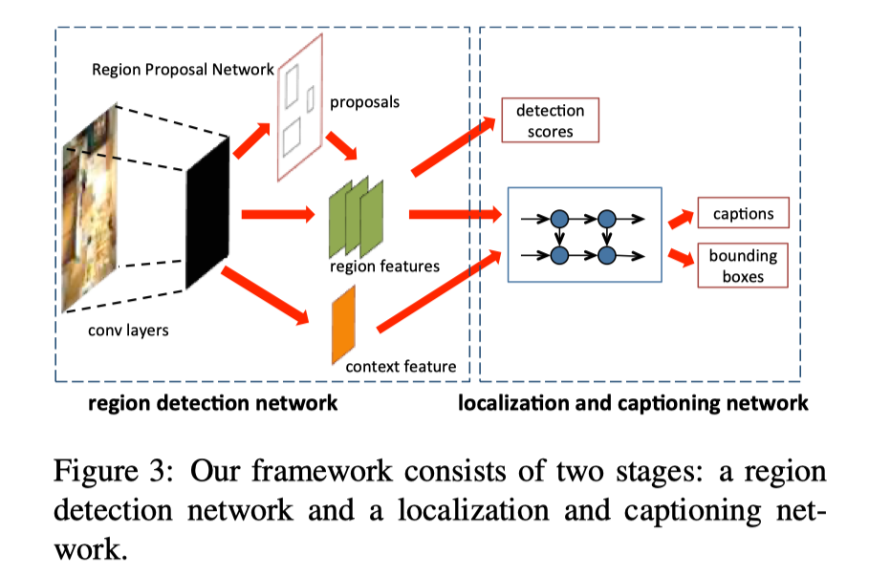
Pipeline

Slide 12
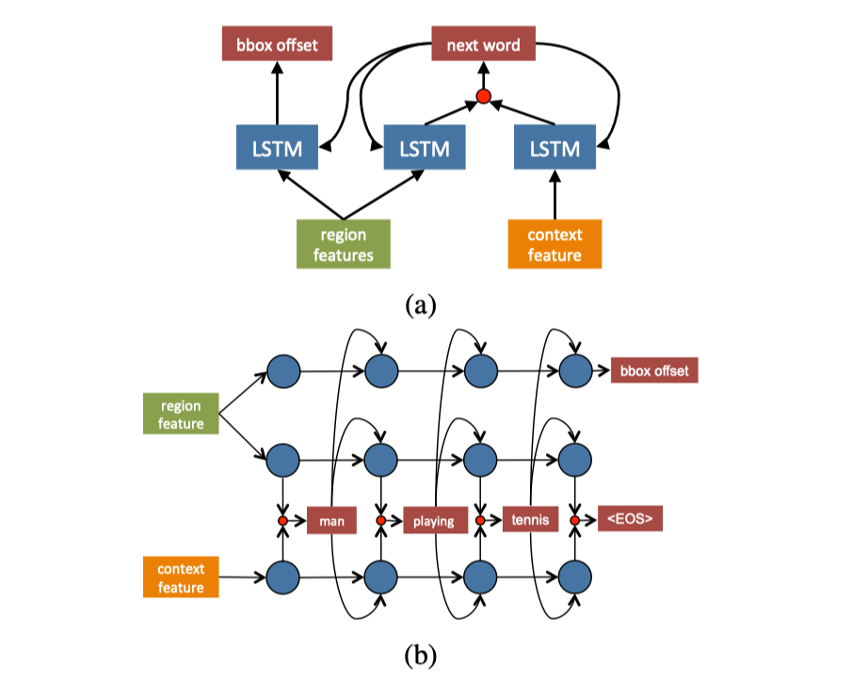

Slide 13
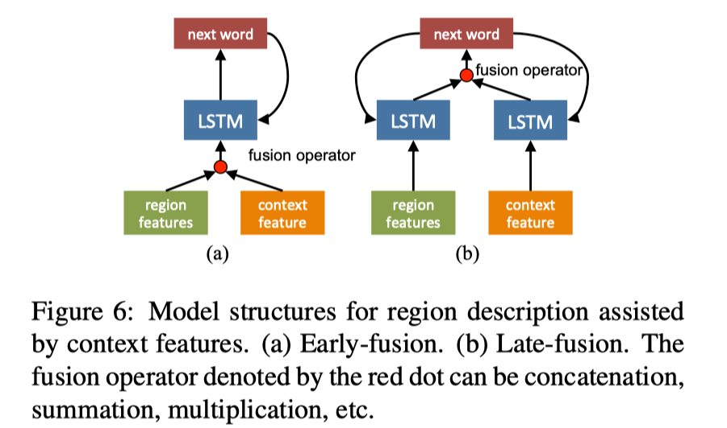
Context fusion

Slide 14
Caption generation

