Slide 1
CVPR 22

Slide 2
Contribution：
1、framework
2、systematic study

Slide 3
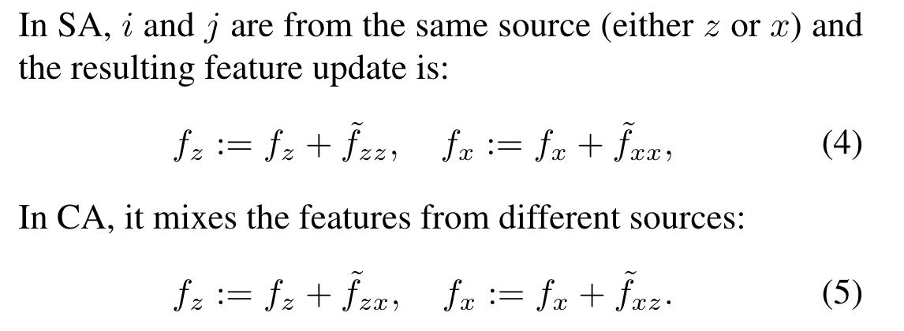
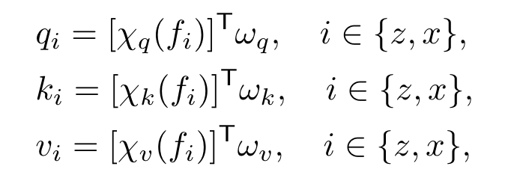

Slide 4
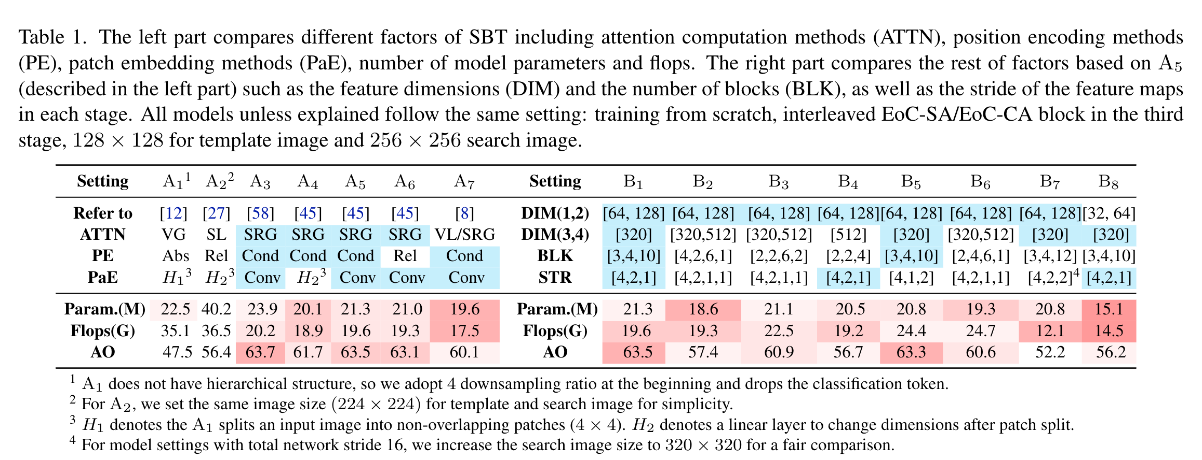

Slide 5
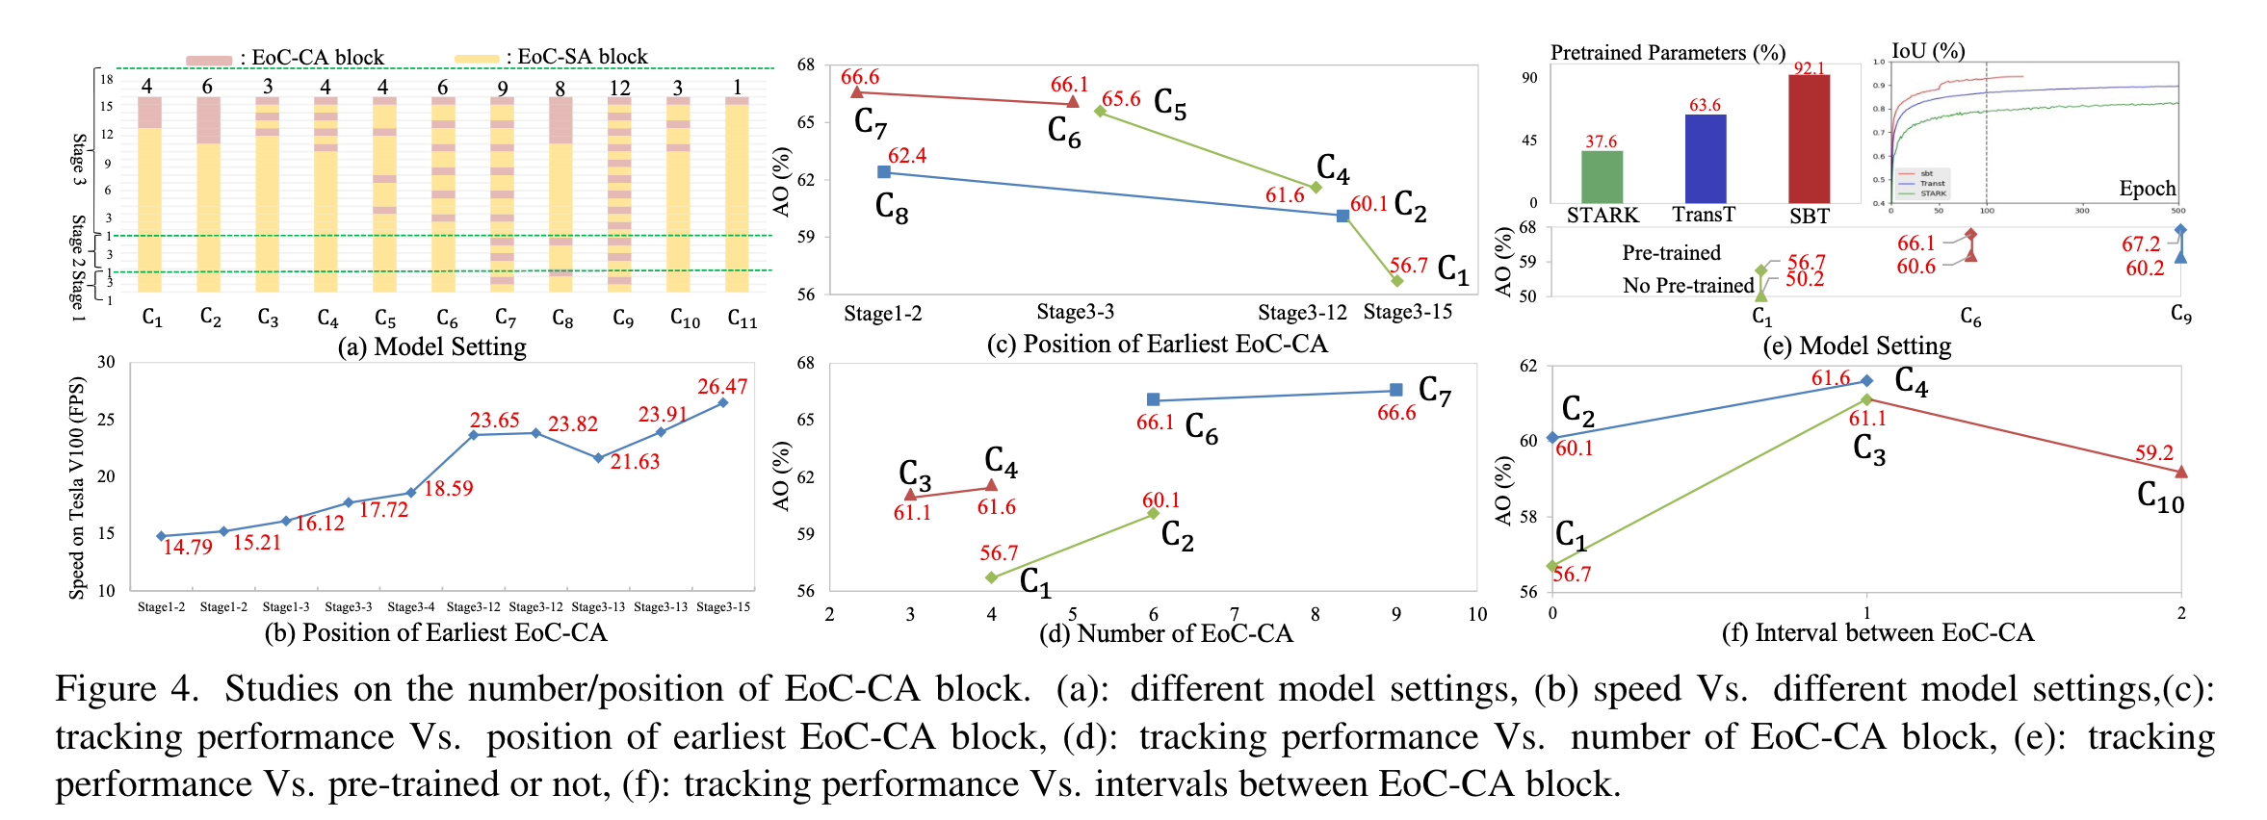
Which attention computation is better for SBT tracker?
Does flexible design of EoC-SA/EoC-CA bring negative/positive effects?
Do earlier and more EoC-CA blocks help to tracking better?
Is tracking performance related to the placement pattern of EoC-CA blocks?
What is the optimal network variants for tracking model?

Slide 6
