Slide 2
Motivation
There are two ways to model the interaction and its context
Treat the combination of interaction and its context as a single class
Suffers from poor scalability and generalization ability
Fails to generalize to an unseen combination even if both its interaction type and context are seen in the training set
The interaction is classiﬁed independently of its context
Difficult of associating the interaction with certain visual appearance in the absence of context information
This paper:
Separate the classification of the interaction and the context into two stages
the interaction classifier in our method is designed to be adaptive to its context

Slide 3
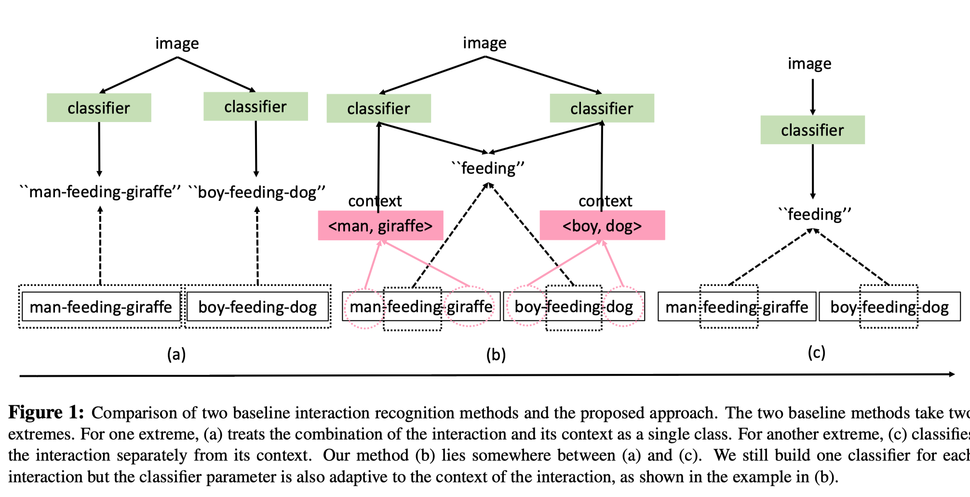

Slide 4
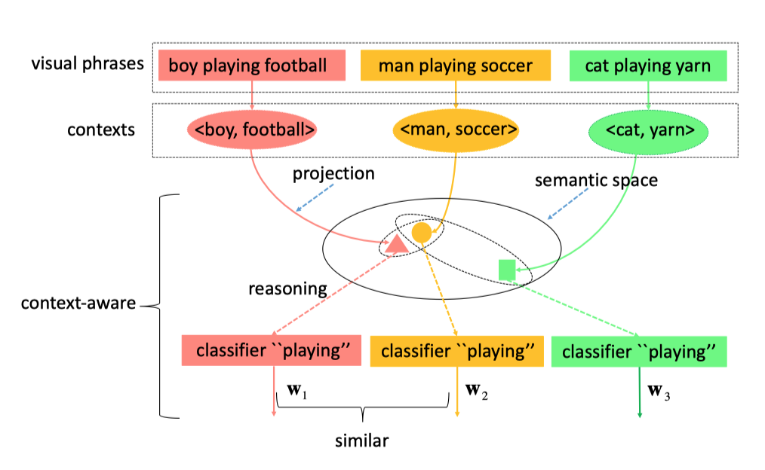
Context-aware interaction classiﬁcation framework
Triplet: $<O_{1},P, O_{2}>$
Classifier for the p_th interaction: $y_{p}=w_{p}^{T}φ\left(I\right)$

Slide 5
Feature representations for interactions recognition
Spatial feature representation
$\left(x, y, w, h\right), \left(x^{′}, y^{′}, w^{′}, h^{′}\right):$ the bounding box coordinates of the subject and object
Spatial feature:
Appearance feature representation
VGG16 Conv5_3 layer + mean pooling

Slide 6
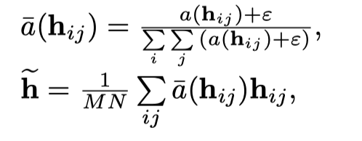
Improving appearance representation with attention and context-aware attention
The discriminative visual cues for interaction recognition may only appear in a small region of the input image or the image region
Direct Attention:
Context-Aware Attention

Slide 7
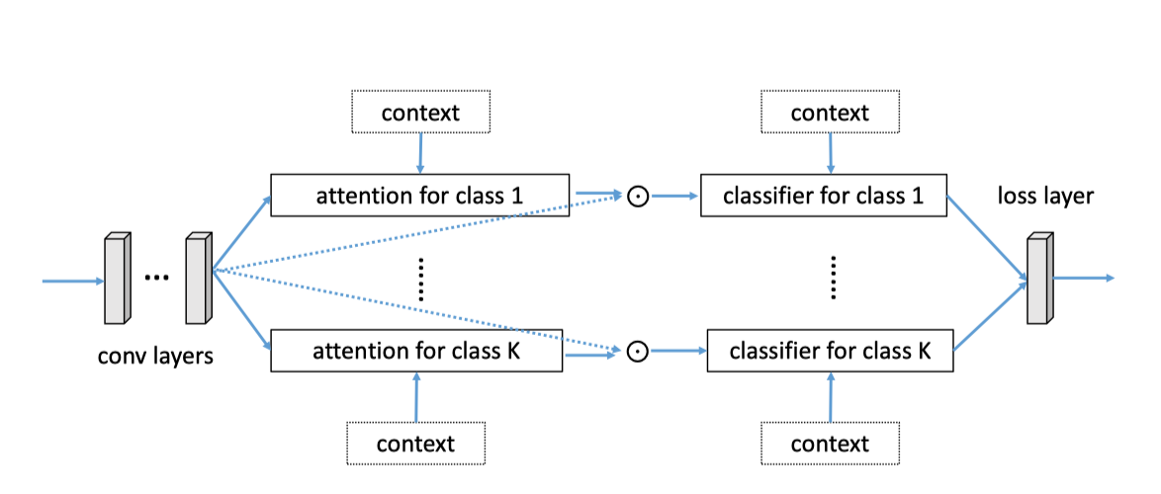
Architecture

Slide 8
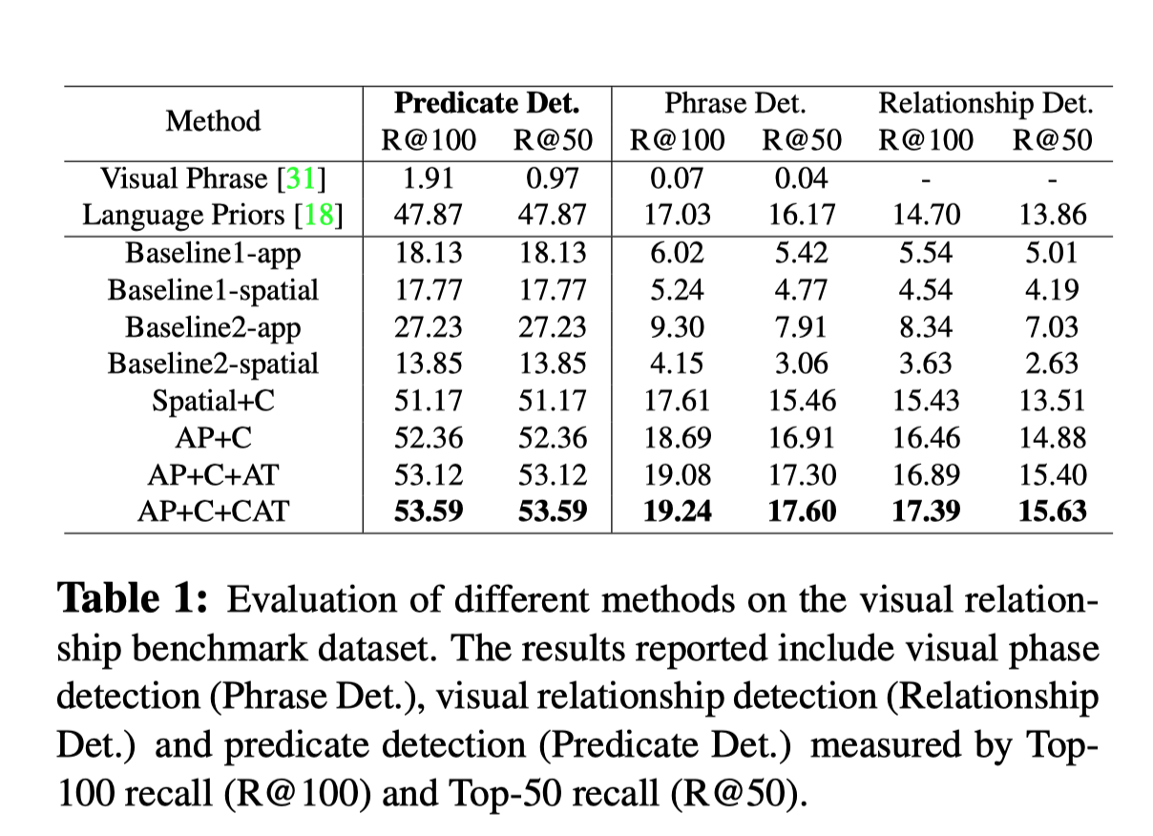
Experiment
Dataset: VRD

Slide 10
