Slide 1
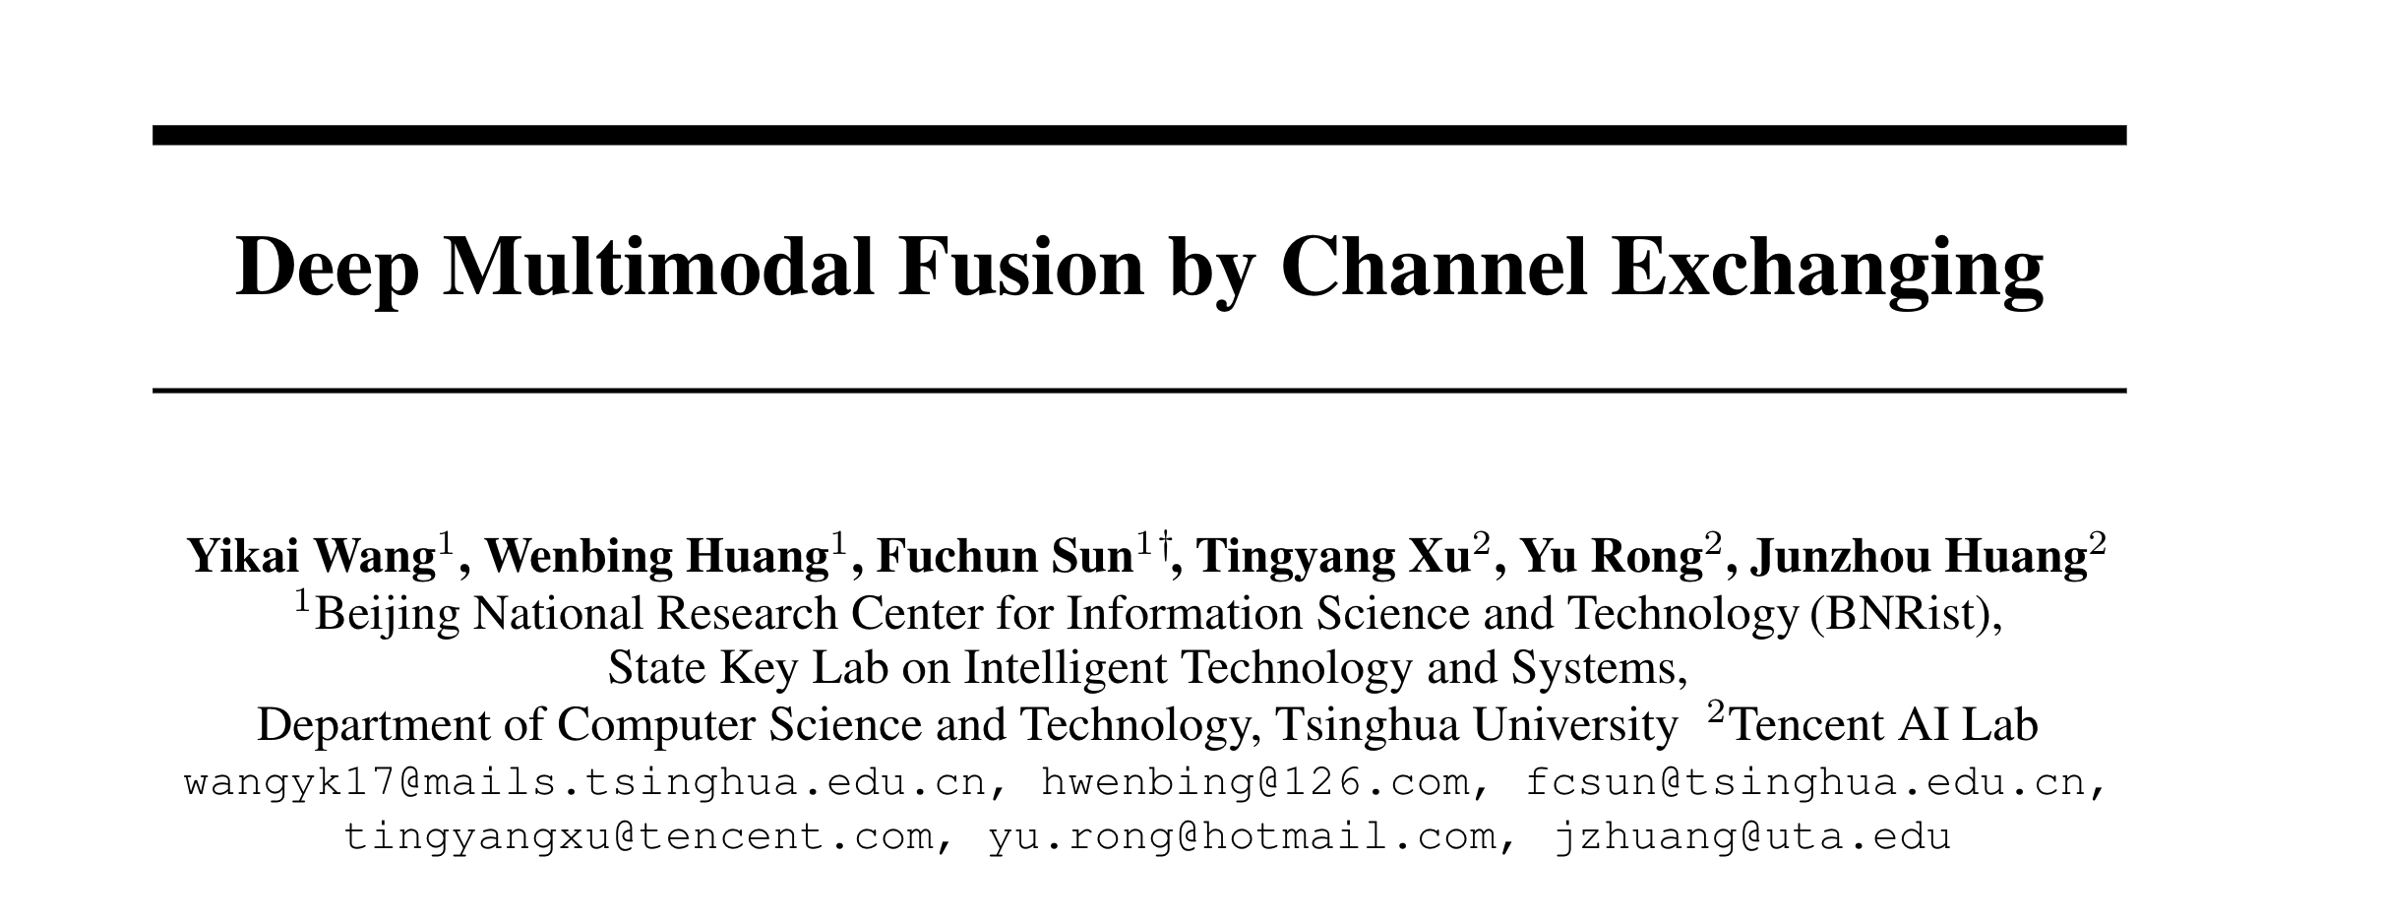
NeurIPS 2020

Slide 2
Motivation
Key to multimodal fusion: the trade-off between inter-modal fusion and intra-modal processing
Fusing modality-common information and preserving modality-specific patterns
The aggregation-based fusion is prone to underestimating the intra-modal propagation once the multi-modal sub-networks have been aggregated
The alignment-based fusion maintains the intra-modal propagation, but it always delivers ineffective inter-modal fusion owing to the weak message exchanging by solely training the alignment loss
The proposed CEN dynamically exchanges the channels between sub-networks for fusion based on the smaller-norm-less-informative assumption inspired from network pruning

Slide 3
Method
General loss
Aggregation-based fusion
global network $h$
Alignment-based fusion
The whole optimization objective of proposed method
L1 norm on BN parameters to find less informative channels

Slide 4
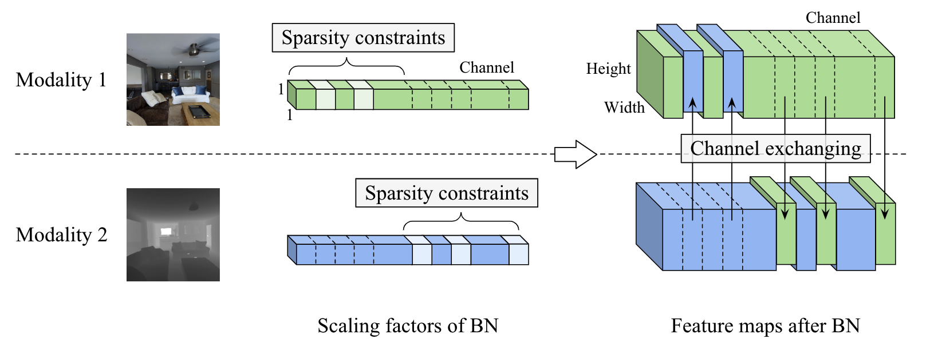
Method
BN operation
Exchange channels with small $γ$
if one channel of one modality has little impact to the final prediction,
then we replace it with the mean of other modalities

Slide 5
Experiments

Slide 6
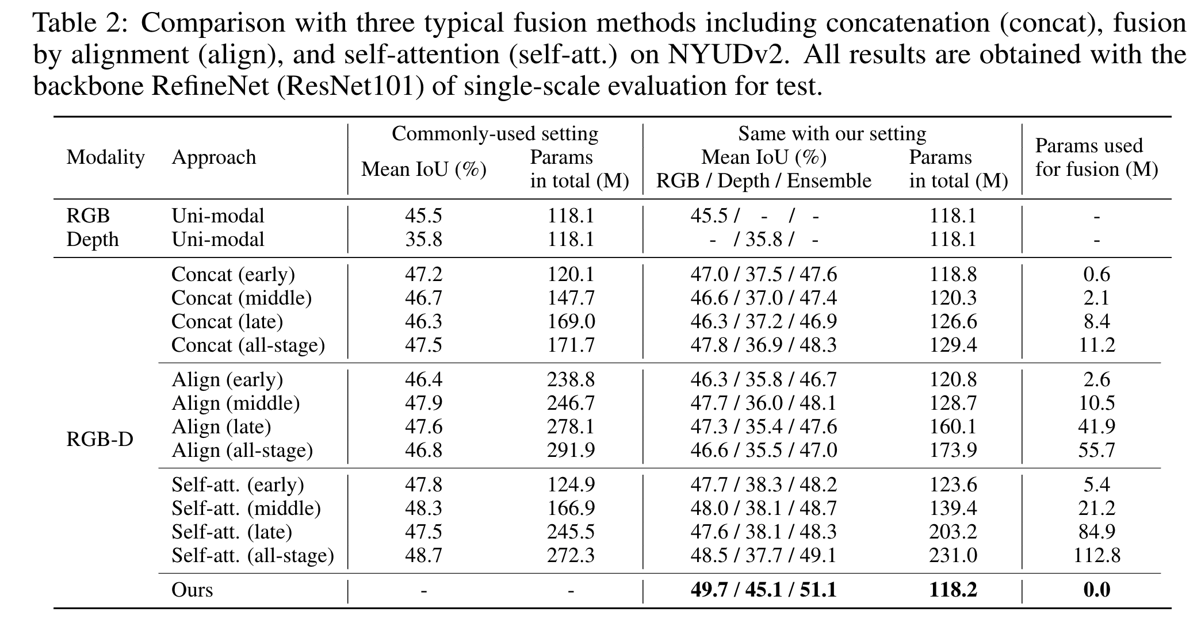
Experiments

Slide 7
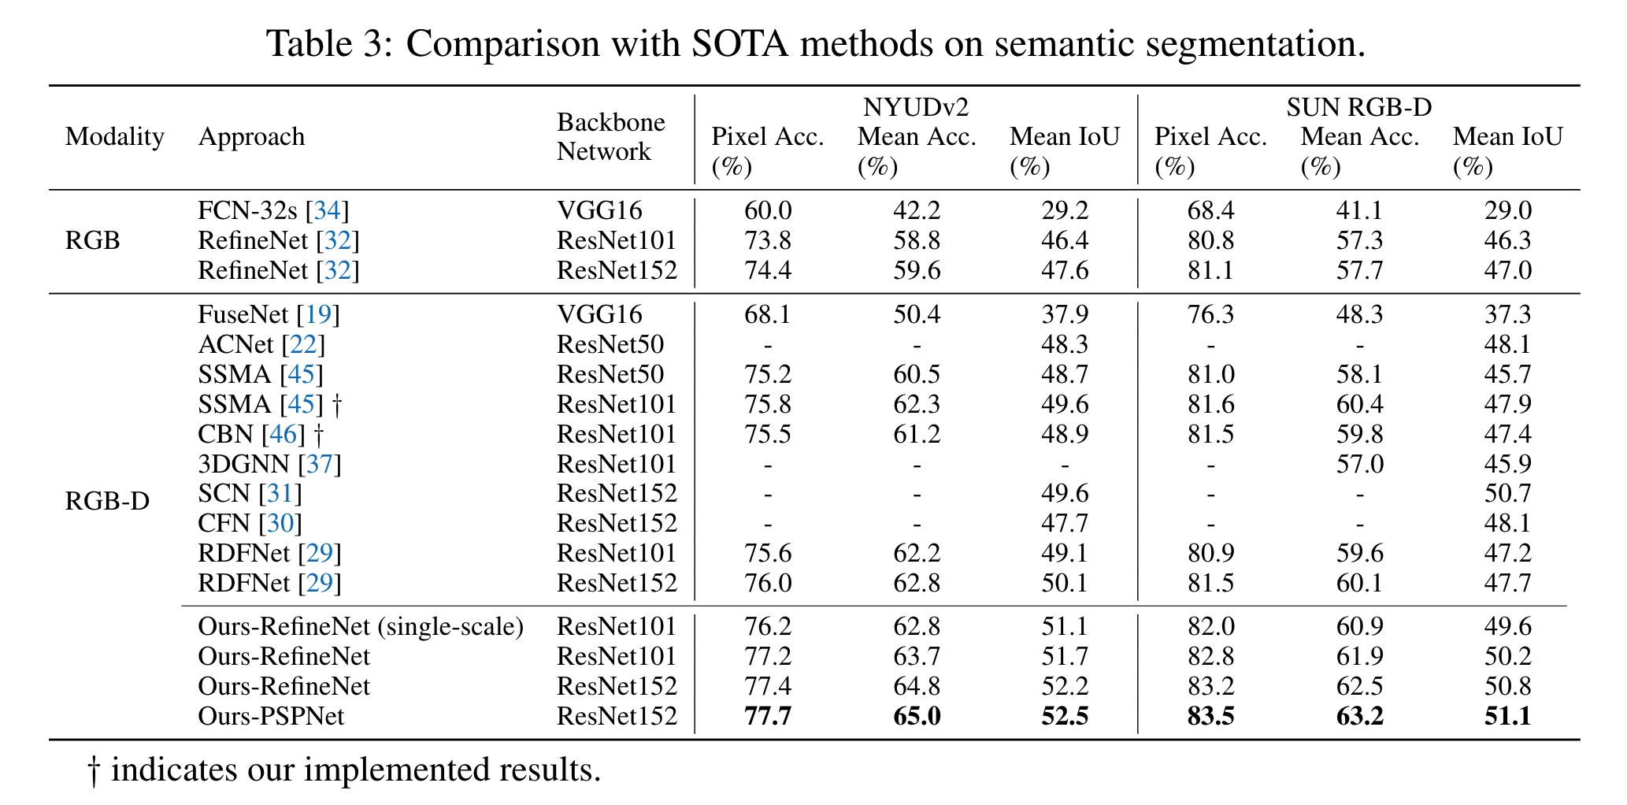
Experiments

Slide 8
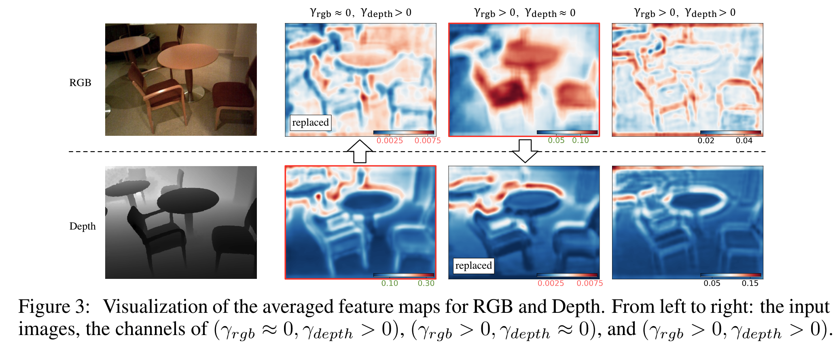
Experiments

