Slide 2
Motivation
The pre-training of generic feature or structure for video understanding is seldom explored and remains challenging
The simplicity of current video-sentence benchmarks, which mostly focus on specific fine-grained domains with limited videos (cooking, movie)
the human annotations (e.g., video-sentence pairs) are resourcefully expensive and thus cannot be scaled up
Present the Auto-captions on GIF dataset
An automatic pipeline is devised to extract, filter, and refine the raw video-sentence pairs
Large-scale benchmark with 164,378 video-sentence pairs
A Transformer-based approach for pretraining

Slide 3
Contribution
Build to-date the first automatically generated video-sentence dataset with diverse video content
Design a Transformer-based encoder-decoder structure for vision-language pre-training in video domain
Demonstrate the effectiveness of exploiting vision-language pre-training over our Auto-captions on GIF dataset, that facilitates video captioning downstream task

Slide 4
Auto-captions on GIF Dataset

Slide 5
Auto-captions on GIF Dataset
Collection of Comprehensive GIF Videos
Most of existing video-sentence datasets mainly focus on specific fine-grained domains
First extract the objects, actions, and SVO (subject-verb-object) triplets from all the sentences in several existing image/video benchmarks
All the massive extracted items (∼ 1,200,000) are taken as the search queries
Crawl the GIF videos on web pages via several commercial GIF video search engines for each query
Filtering of Sentences
Harvest the raw sentence from the Alt-text HTML attribute for each video
Discard the ones with no determiner, no noun, or no preposition
……

Slide 6
Auto-captions on GIF Dataset
Filtering of Video-sentence Pairs
Assume each crawled GIF video is semantically correlated to the search query,
Discard the sentence that has no overlap with the search query of the corresponding GIF video
This filtering stage discards the semantically mismatched video-sentence pairs
Selection of Human-like Sentences
Train two binary classifiers
Depending on the whole sentence or the parsed SVO triplet
All the human-written sentences in existing image/video captioning benchmarks as positive samples
All the discarded raw sentences at the filtering of sentences stage as negative samples

Slide 7
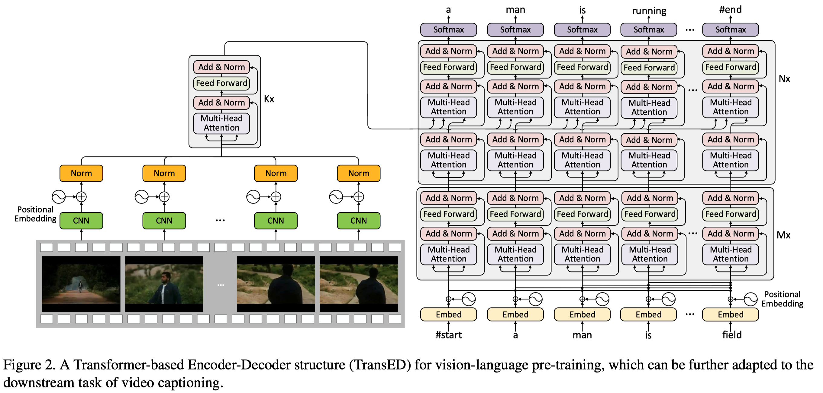
Vision-language Pre-training

Slide 8
Proxy Tasks for Vision-language Pre-training
Masked language modeling
Masked frame-feature regression
Video-sentence matching (in analogy to image-sentence matching)
Sequence to sequence generation

Slide 9
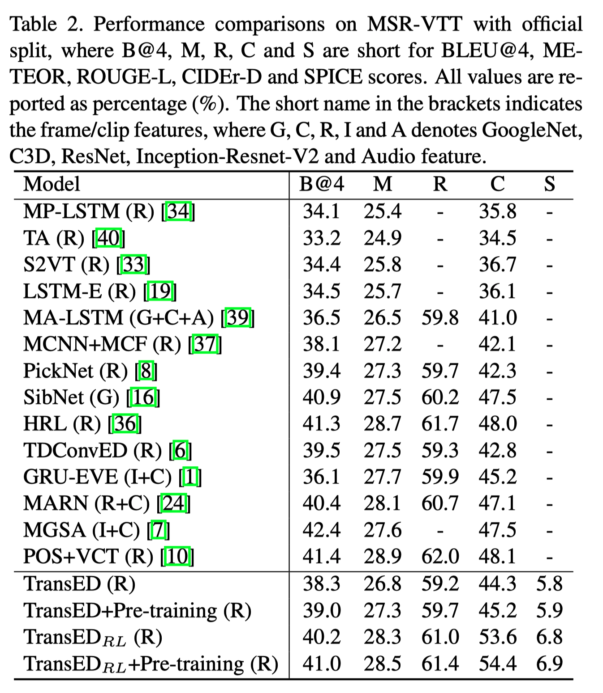
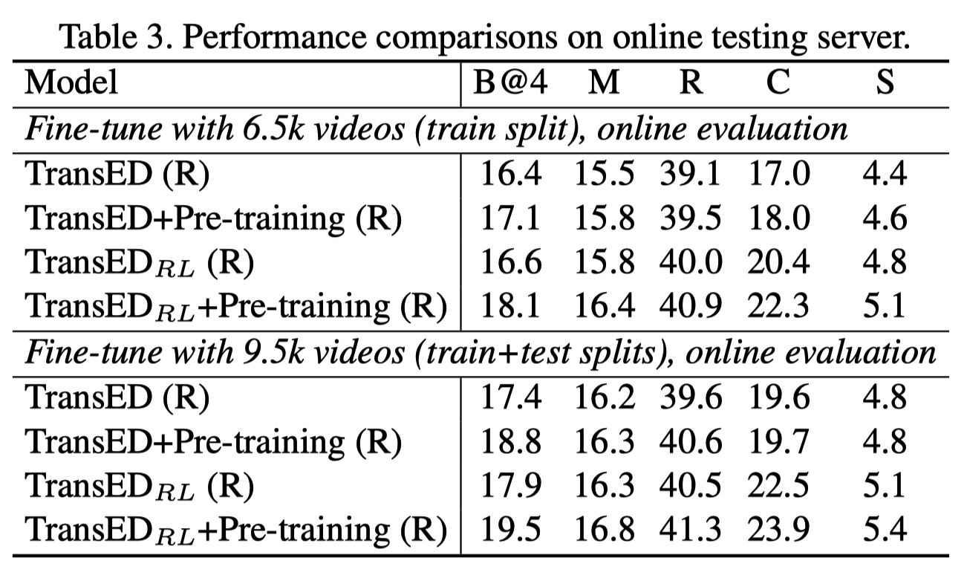
Experiments

