Slide 2
Motivation
Pixel-level fusion
Lose the dense patterns in the image domain due to the sparsity of the fusion points
Breaking the semantic consistency in the image features
Instance-level fusion
Coarse feature aggregation
The absence of 2D information at the initial proposal generation phase

Slide 3
Contribution
A learnable multi-modal feature fusion framework, called AutoAlign, which enhances the fusion process at both pixel level and instance level
A joint training paradigm for 2D-3D detection to regularize the features extracted from the image branch and improve the detection accuracy
Validate the effectiveness of the proposed AutoAlign on various 3D detectors and achieve competitive performance on both KITTI and nuScenes dataseta

Slide 4
Method

Slide 5
Method (Cont.)

Slide 6
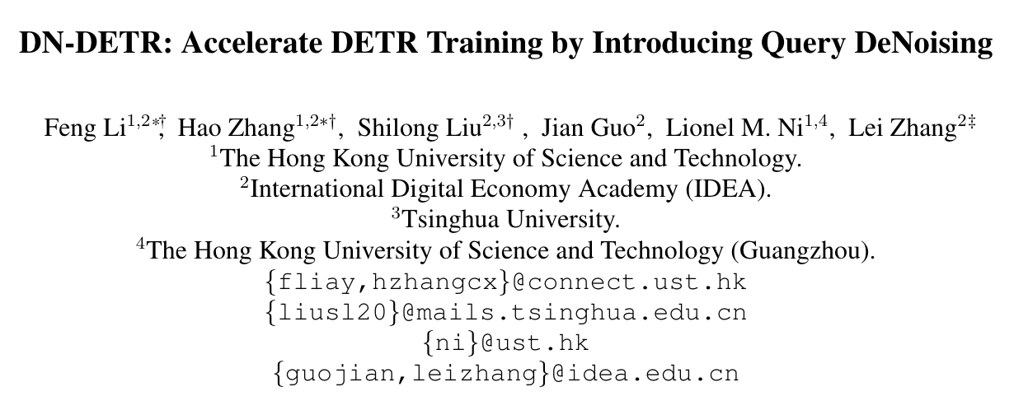

Slide 7
Motivation
DETR suffers from prohibitively slow training convergence
Few work pays attention to the bipartite graph matching part for more efficient training
The bipartite graph matching is unstable especially in the early stages of training due to the nature of stochastic optimization
As a consequence, for the same image, a query is often matched with different objects in different epochs, which makes optimization ambiguous and inconstant

Slide 8
Contribution
A novel training method to speed up DETR training (Also leads to a remarkably better training result)
Analysis on the slow convergence of DETR from a novel viewpoint and a deeper understanding of DETR training. A metric to evaluate the instability of bipartite matching and veryfying that our method can effectively lower the instability
A series of ablation studies to analyze the effectiveness of different components of our model such as noise, label embedding, and attention mask

Slide 9
Why Denoising accelerates DETR training?
A small change of the cost matrix may cause an enormous change in the matching result
Two stages of training DETR-like models: learning “good anchors” and learning relative offsets
The inconsistent update of anchors can make it difficult to learn relative offsets. Therefore, in our method, we leverage a denoising task as a training shortcut to make relative offset learning easier, as the denoising task bypasses bipartite matching

Slide 10
Method

Slide 11
Method (Cont.)

Slide 12
Denoising
Center shifting
Box scaling
Label noising: random flipping

