Slide 1
CVPR2016

Slide 2
Motivation
Most approaches learn a mapping directly from input images and questions to answers.
VQA is a complex problem because it requires accessing information not present in the image.
Common sense, or specific knowledge about the image subject.

Slide 3
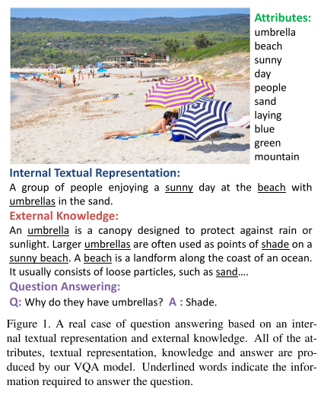
Contribution
Combines image features with external knowledge.
Allows questions to be asked about the contents of an image, even when the image itself does not contain the whole answer.

Slide 4
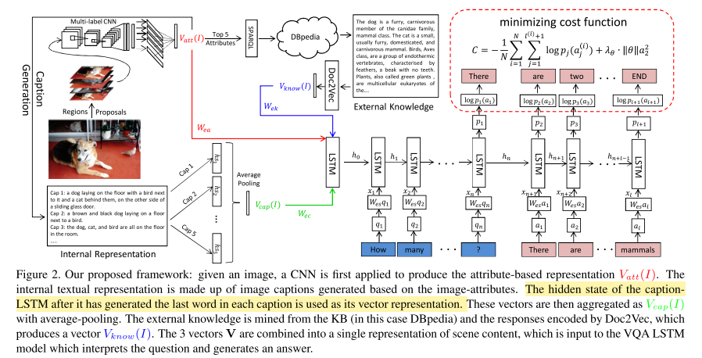
Method
Construct a textual representation.
Attributes and captions.
Merge representation with textual knowledge from a KB.
Feed the merged information to an LSTM.
Generate words.

Slide 5
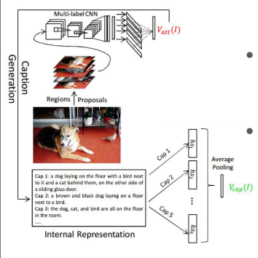
Image Representation
Attribute-based
Vocabulary derived from words in COCO captions.
256 attributes: Objects (nouns), actions (verbs), or properties (adjectives).
Region-based multi-label classification
Max-pool -> Vatt.
Caption-based
Generate 5 captions based on Vatt(I) using beam search.
Average-pooling over the caption-LSTM -> Vcap(I)

Slide 6
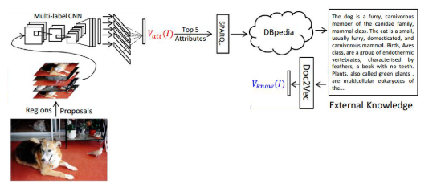
Relating to the Knowledge Base
Pre-emptively fetch information related to the top 5 attributes
Issue a SPARQL query to retrieve the textual “comment” field for each attribute.
A comment field contains a paragraph description of an entity.
Concatenate the 5 paragraphs -> Doc2Vec -> Vknow(I)

Slide 7
Full Architecture
Concatanate [Vatt(I), Vcap(I), Vknow(I)] as the initial input to an LSTM.
Predict the sequence of words in the answer.

Slide 8
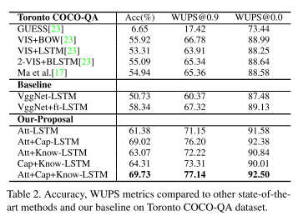
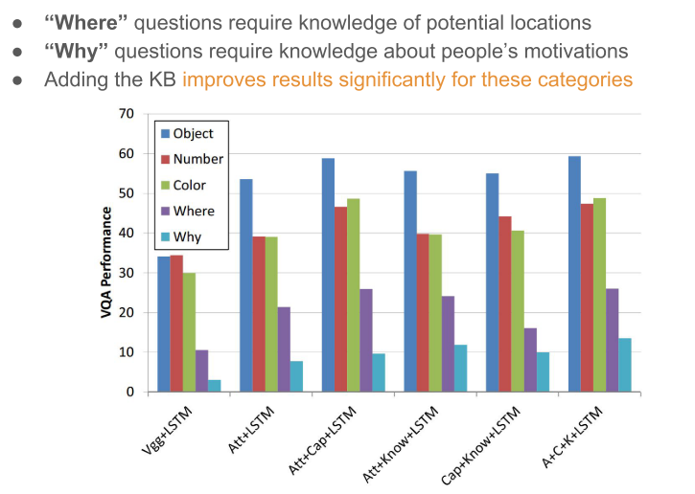
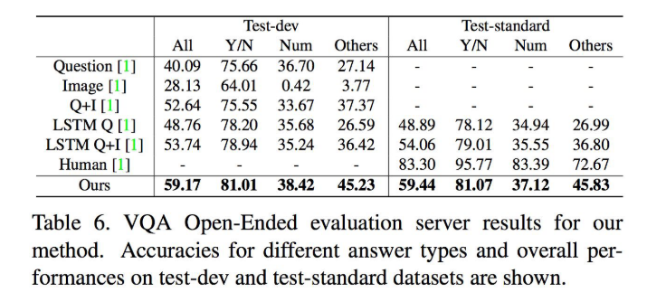
Experiment
Notes:
Weaknses
Only extracts discrete pieces of text from the KB: ignores the structured representation
No explicit reasoning: cannot provide explanations for how it arrived at an answer

Slide 9
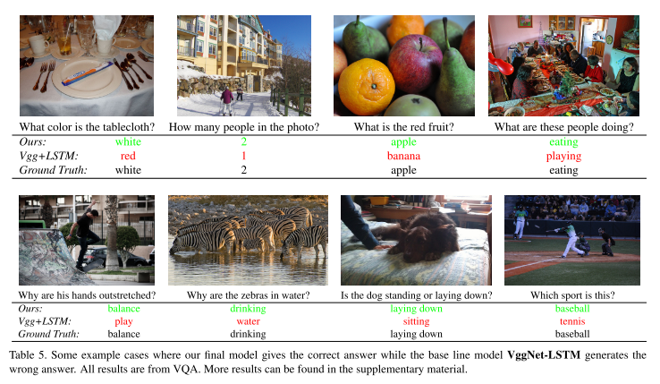
Experiment

