Slide 1
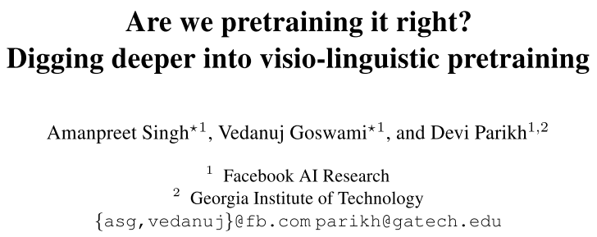

Slide 2
Motivation & Contributions
﻿The choice of pretraining datasets (arch, objective) has received little attention
﻿Question some of the default choices
﻿The finer nuances and details of the pretrain-finetune regime have not been carefully investigated
E.g., ﻿Conceptual Captions (large size)
﻿Deeper dive into the intricacies of pretraining visio-linguistic
﻿Deeper dive
Propose some questions
Conduct Exps to answer

Slide 3
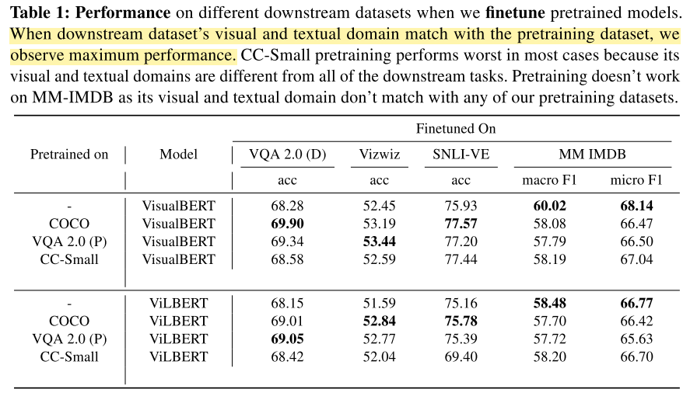
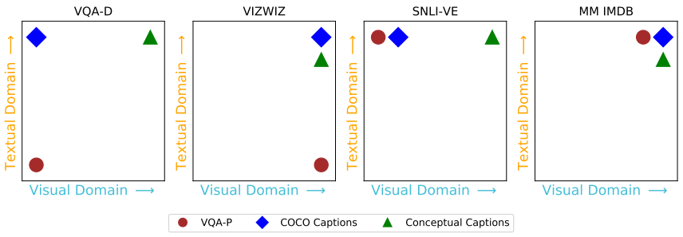
﻿How should one choose the pretraining dataset?
Domain similarity
﻿Using in-domain pretraining dataset is better

Slide 4
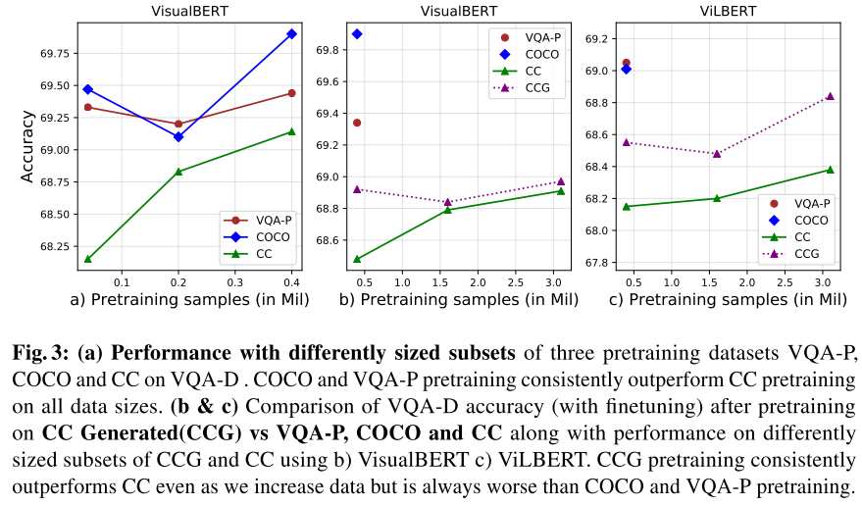
﻿How should one choose the pretraining dataset?
Size
﻿Increasing trend and fluctuation
﻿in-domain > ﻿out-of-domain
﻿size is not the most important factor
﻿pretraining on even a smaller dataset can easily outperform pretraining on a larger dataset

Slide 5
﻿Does pretraining always help?
﻿Low-resource downstream tasks
﻿large dataset: masks the actual transferability and contribution of pretrained visio-linguistic representations.
﻿achieve best performance when no pretraining is used
﻿one should be mindful of characteristics of the downstream task

Slide 6
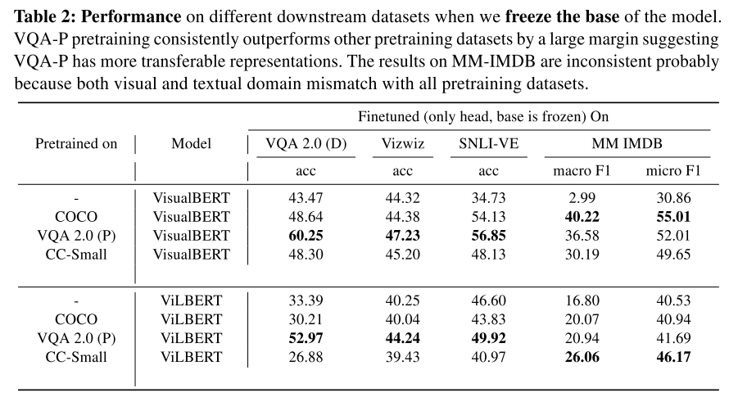
﻿Does pretraining always help?
﻿Transferability.
﻿freeze the base of the model and only finetune the classifier head
﻿﻿ViLBERT applied to all downstream tasks doesn’t benefit from pretraining (coco, cc)

Slide 7
﻿Does pretraining always help?
﻿Transferability.
﻿freeze the base of the model and only finetune the classifier head
﻿﻿ViLBERT applied to all downstream tasks doesn’t benefit from pretraining (coco, cc)
best pre-trained model may lead to best downstream model if finetuned but it may not be the most transferable pretrained model.

Slide 8
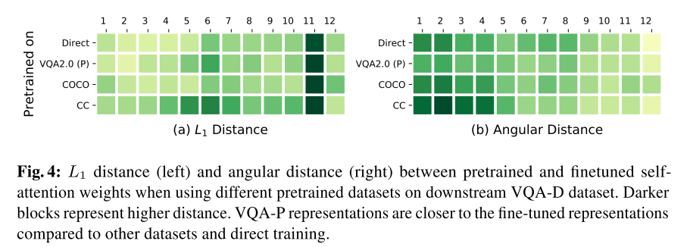
﻿Which pretrained representations are more transferable?
﻿Transferability.
﻿representations trained from VQA-P are more close to fine-tuned representations compared to other pretraining dataset and hence, have greater transferability.

Slide 9
﻿Pretraining Scalability
generated data that is close to the domain of the downstream task can serve as a better pretraining dataset than a natural but out-of-domain dataset
﻿train a captioning model on a visually in-domain dataset (COCO). then generate captions on an out-of-domain dataset (CC). ﻿generated dataset is now closer in domain to the downstream dataset (VQA-D) than CC
﻿increasing the generated dataset
further improves performance

