Slide 1
Arxiv

Slide 2
Task
Noise to image

Slide 3
Motivation
Directly controlling the strength of image features at different scales
Disentangle global (pose, identity) and stochasticity (细节随机)

Slide 4
Contributions
Propose an alternative generator architecture
unsupervised separation of high-level attributes and stochastic variation
scale-specific control of the synthesis
Quality metrics -> improve
Dataset: FlickrFaces-HQ

Slide 5
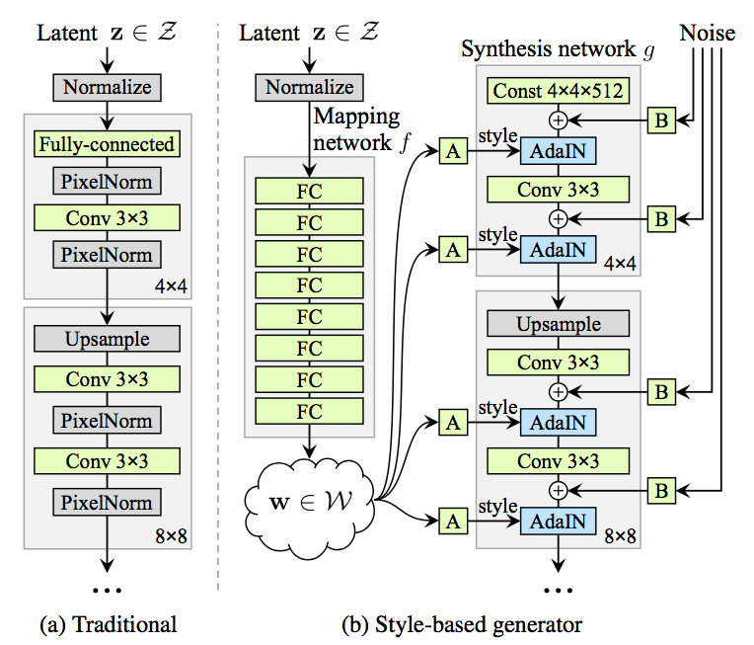
Framework
Noise: pixel-wise
Style: channel-wise
解耦：Noise变不了pose和身份等。因为是逐像素作用的，D将网络将惩罚其空间不一致性。
生成器的三种特性：
解耦
细节随机变化
风格混合

Slide 6
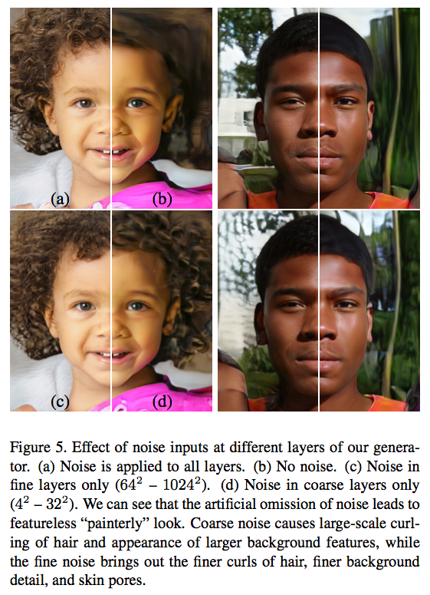
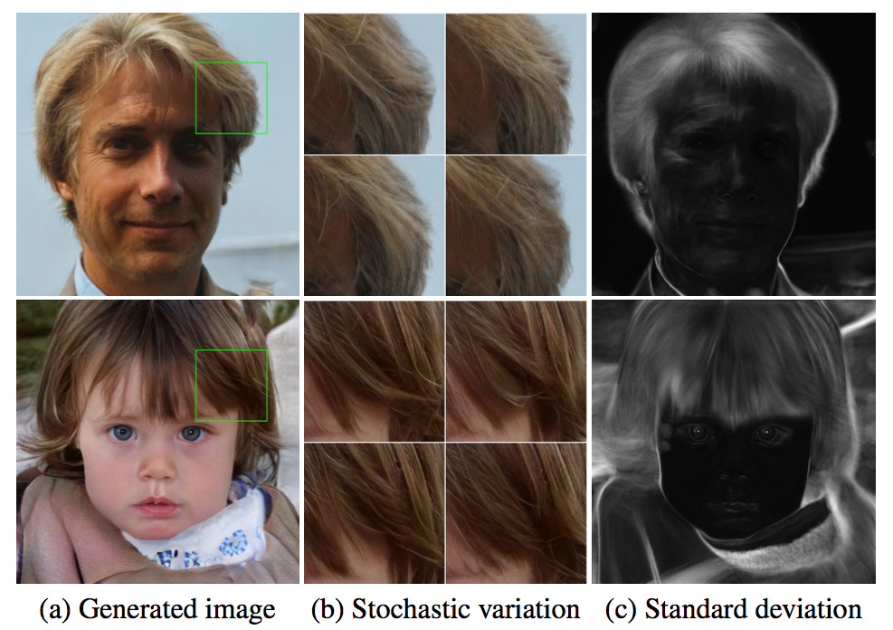
Stochastic variation

Slide 7
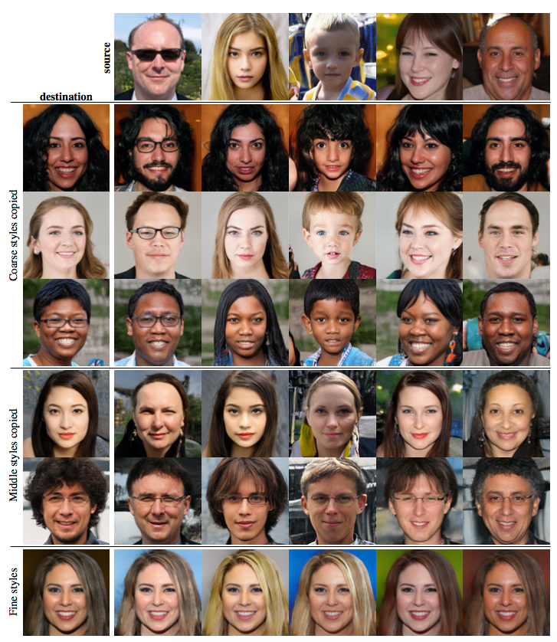
Style mixing
high-level aspects
(4 – 8)
low-level aspects
64 – 1024

