Slide 2
Motivation
Training competitive deep video models is an order of magnitude slower than training their counterpart image models.
Fixed mini-batch shape: a specific number of clips, frames, and spatial size -> what is the optimal shape?
Solution: variable mini-batch shapes with different spatial-temporal resolutions

Slide 3
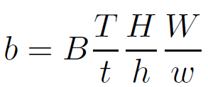
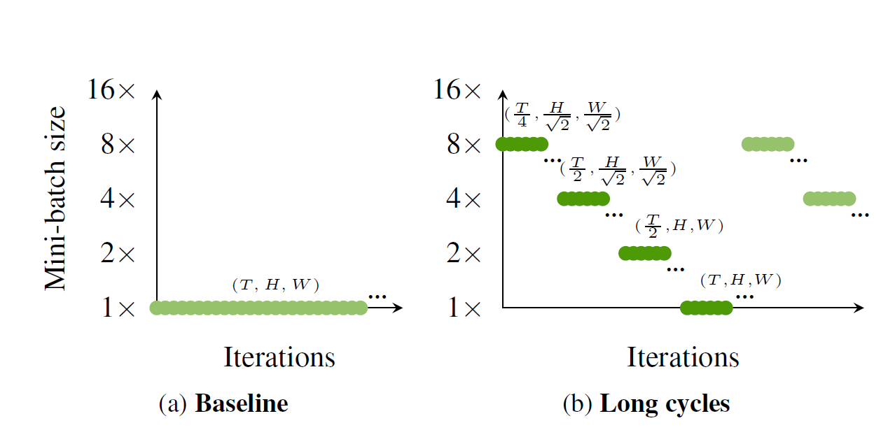
Multigrid Training
B*T*H*W -> b*t*h*w,
b·t·h·w = B·T·H·W
Coarse to fine

Slide 4
Multigrid Training
baseline training sample strategy：
Spatial:random crop at a short edge in [256,240], resize the crop to H*W
Temporal: randomly sample a clip with T frames at a stride of 2
Multigrid training sample strategy：
Spatial:random crop at a short edge in [256*h/H,240], resize the crop to h*w
Temporal: randomly sample a clip with T frames at a random stride of [2,2*T/t]

Slide 5
Multigrid Training
Fine-Tuning Phase
Multigrid training may introduce a mismatch between the training distribution and test distribution
Solution: fine tune at the last learning rate stage.
Fisrt half: use lr of the L-1 learning rate stage
Second half: use lr of the L learning rate stage
Only use short cycle(as data augmentation)

Slide 6
Experiments

Slide 7
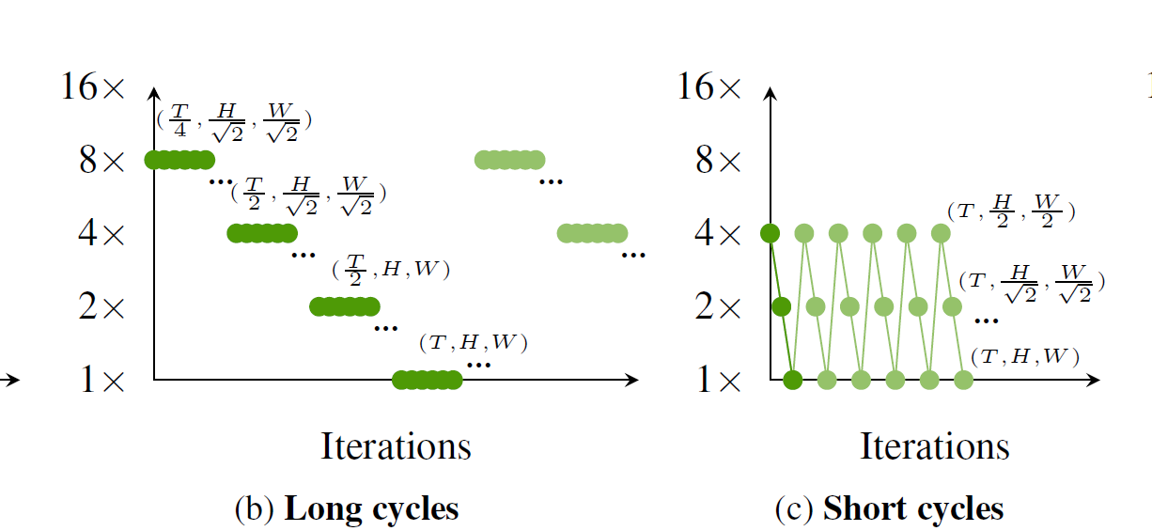
Experiments

Slide 8
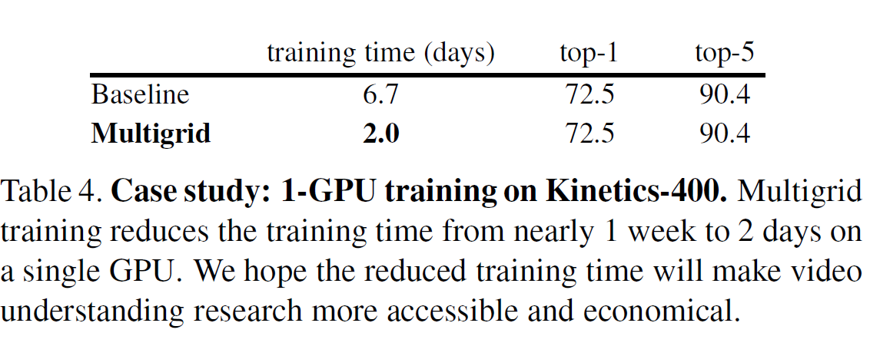
Experiments

Slide 9
Contributions
This paper proposes a multigrid method for fast training of video models
The proposed method varies the sampling grid and the minibatch size during training, and can process the same number of epochs using a small fraction of the computation of the baseline trainer.
With a single out-of-the-box setting, it works on multiple datasets and models, and consistently brings a ∼3-6× speedup with comparable or higher accuracy

