Slide 1
rgh

Slide 2
Motivation
The group activity is formed by individual actions of the people and their interactions.
Another important factor in recognizing the group activity recognition is the temporal development of the individual actions and group activity.
Incorporating additional information other than the appearance features has positive effect on the performance of the activity recognition models.

Slide 3
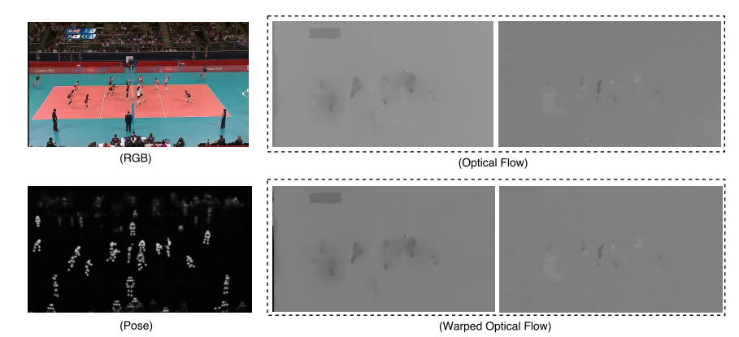
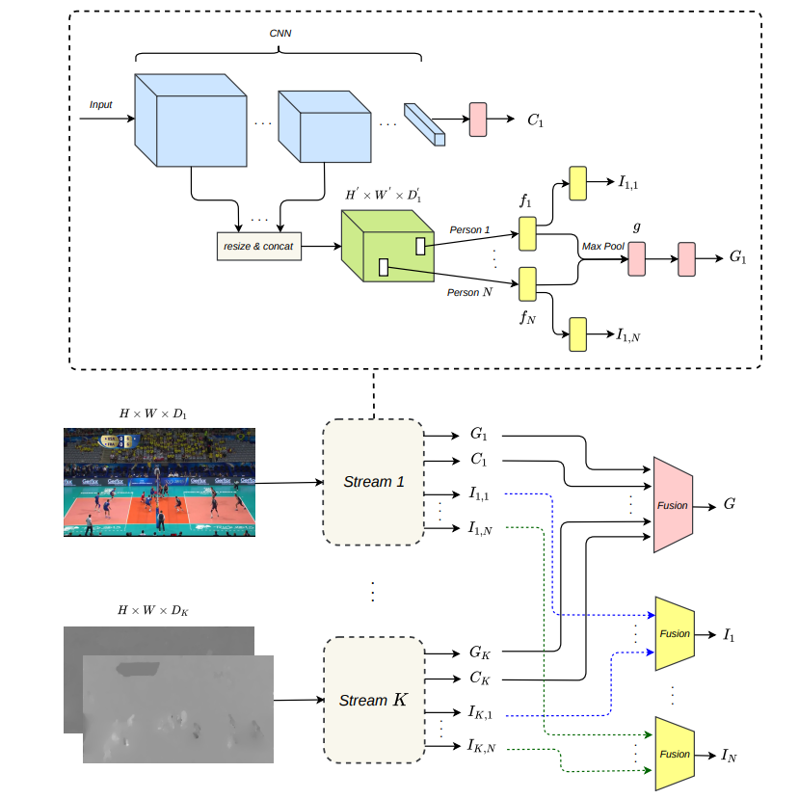
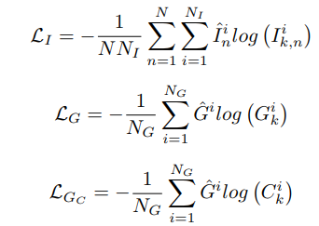
Framework

Slide 4
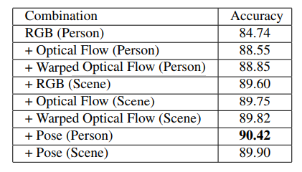
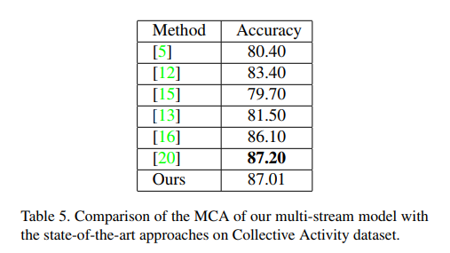
Experiment

Slide 5
一点看法
写Related work时感觉他做得和前人一样，没有一句提自己的不同点，比如考虑单个人的动作识别有文章，用光流捕捉时空变化也有TSN(林达华)的动作，有个库的精度比别人低也没有解释why
由于以上没有叙述好，所以完全get不到他的贡献点

