Slide 2
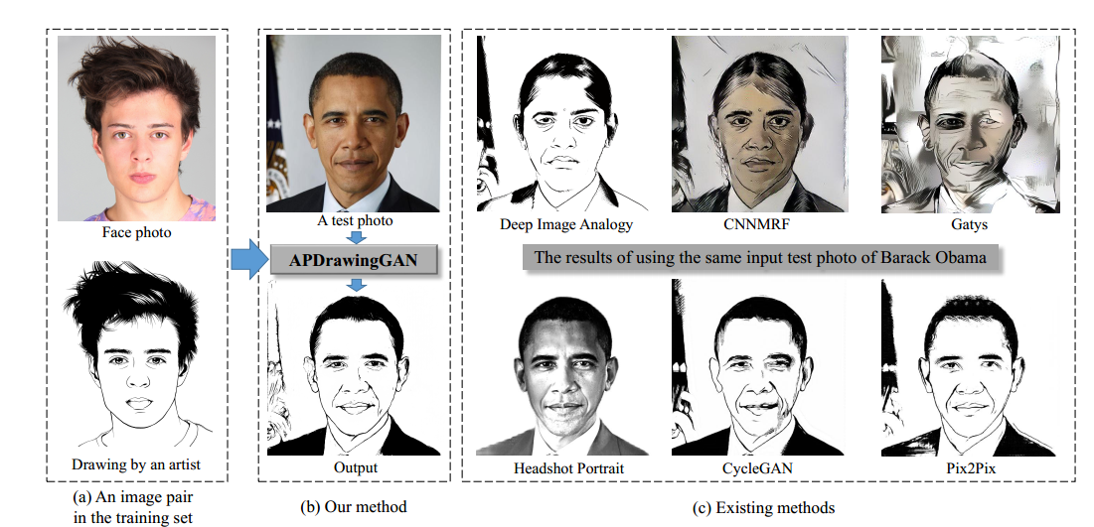
Task
Produce artistic portrait drawings.

Slide 3
Challenge
Such drawings have a highly abstract style.
Small artifacts are more exposed than for painting styles.
Artists use different strategies to draw different facial features.
Lines drawn are only loosely related to obvious image features.

Slide 4
Contribution
A Hierarchical GAN architecture.
A novel DT loss (to promote line-stroke based style).
Pre-train on 6,655 frontal face photos and construct an APDrawing dataset.
140 high-resolution face photos and corresponding portrait drawings by a professional artist

Slide 5
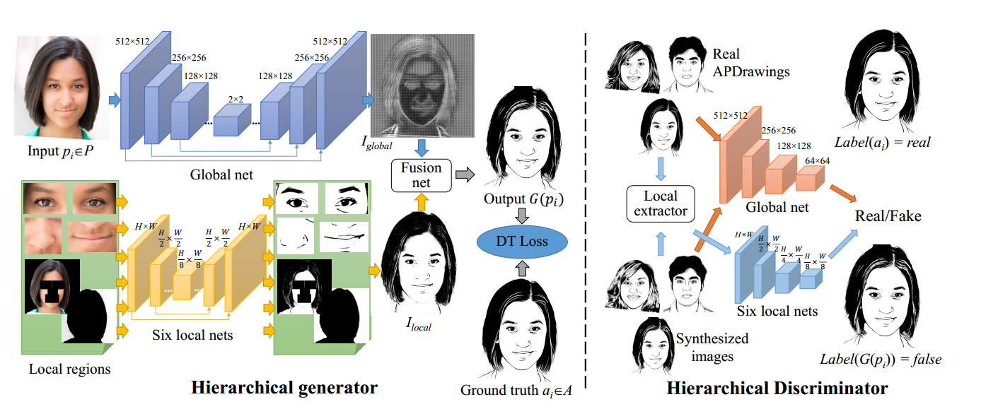
Framework
Paired data (512x512) / Similar to Pix2Pix / Unet & PatchGAN.
Hierarchical architecture.
Global& local adv loss / Global& local L1 Loss / DT Loss

Slide 6
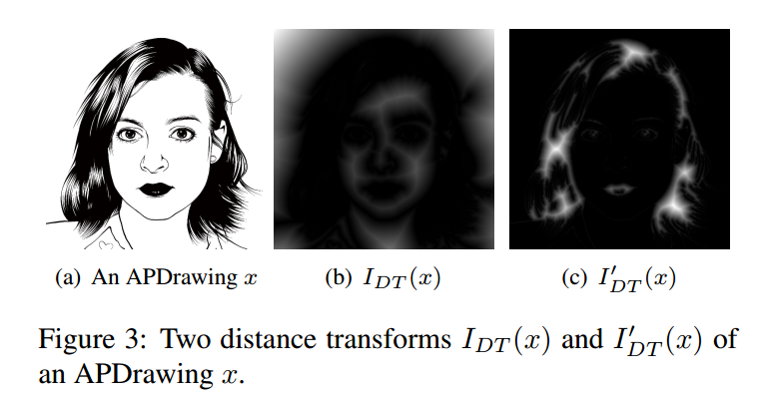
DT Loss
Designed for promoting line strokes.
IDT (x) stores the distance value to its nearest black pixel.
IDT ‘ (x) stores the distance value to its nearest white pixel.

Slide 7
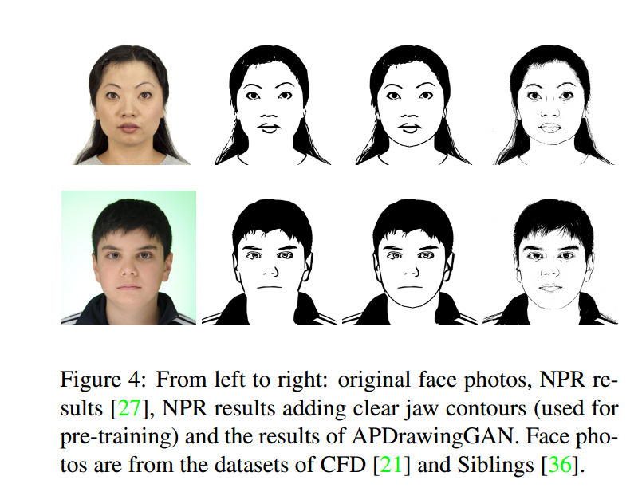
Training
We collect 6,655 frontal face photos, and generate synthetic drawings by NPR algorithm for pre-training.
APDrawing dataset: 70 image pairs for training and 70 for testing.

Slide 8
Result

Slide 9
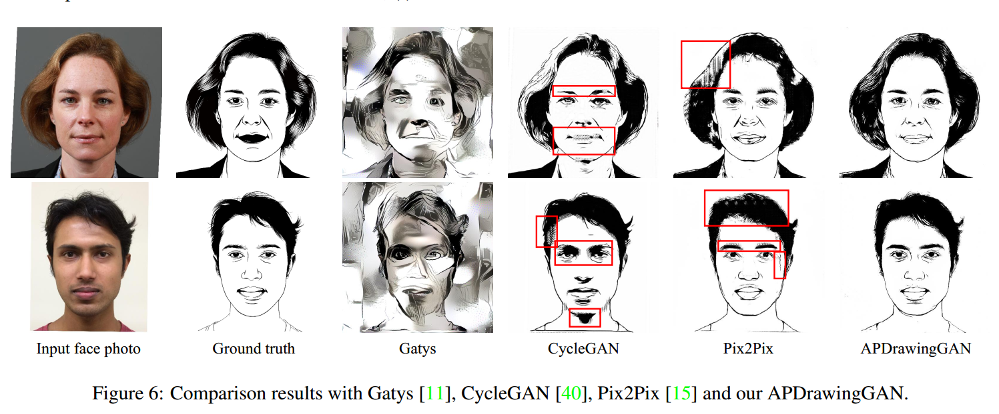
Result

