Slide 2
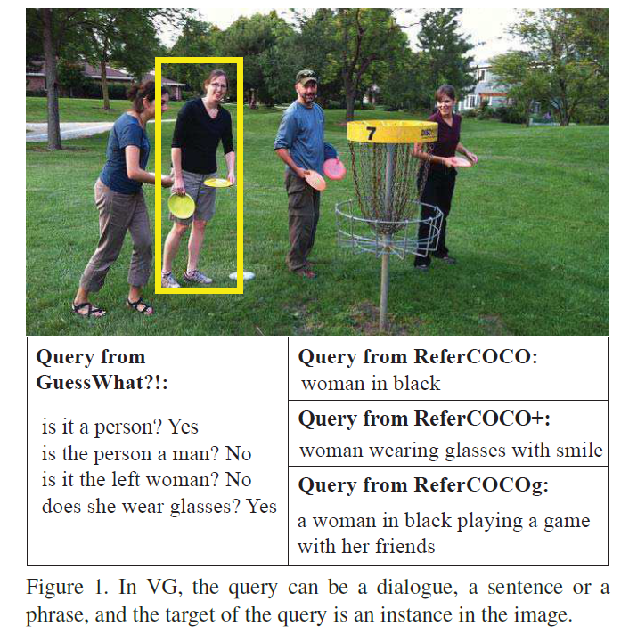
Task

Slide 3
Motivation
It is difficult for a machine to effectively grasp the key point in the natural language and the visual content
Visual grounding problem
which words to focus on in a query
where to look in an image
which object to locate.
Previous works solve three sub-problems separately
Propose Accumulated Attention (A-ATT) to solve these three sub-problems in a circular way

Slide 4
Attentions
which words to focus on in a query
Query features:
Attention weight for query $i$:
where to look in an image
Visual features:
Attention weight for region $i$
which object to locate
Object candidate (spatial feature + local feature)
Attention weight for object $i:$
$H_{i}$: joint features

Slide 5
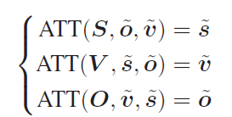
Accumulated attention (A-ATT)
$X:$ feature sequence
$g_{1},g_{2}:$ other two features;
One round

Slide 6
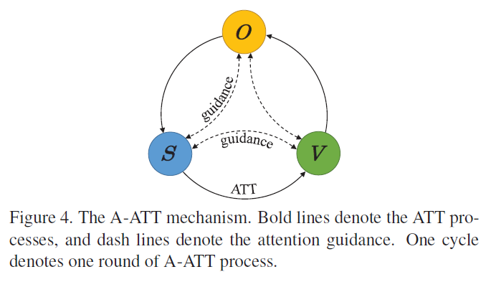
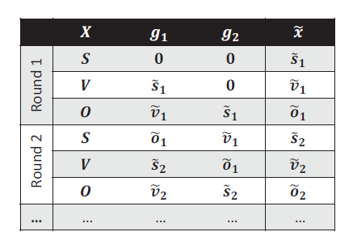
Accumulated attention (A-ATT)

Slide 7
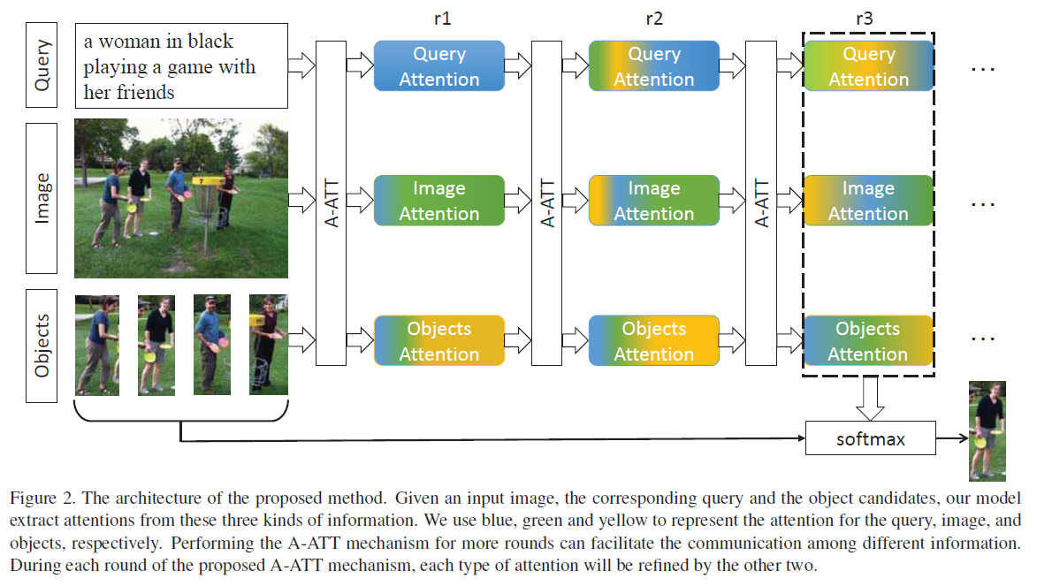
Pipeline

Slide 8
Grounding the query
Joint representation:
Probability for object $o_{i}$ being the target object

Slide 9
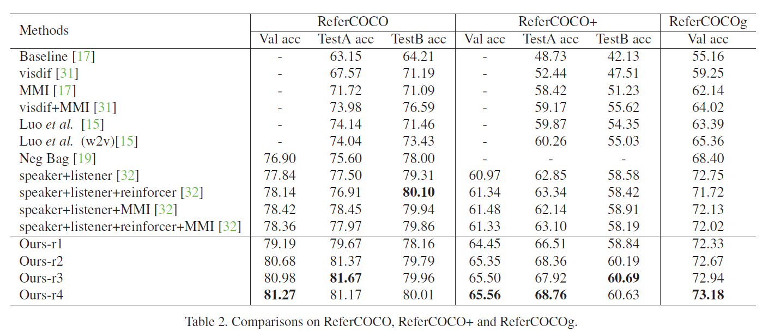
Experiment

Slide 10
