Slide 2
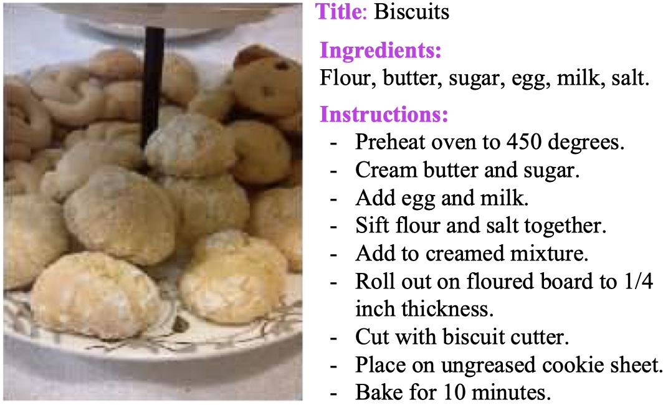
Task
Predicts ingredients as sets, modeling their dependencies without imposing any order, and then generates cooking instructions by attending to both image and its inferred ingredients simultaneously.

Slide 3
Problem
Traditionally, the image-to-recipe problem has been formulated as a retrieval task, where recipes are retrieved from a fixed dataset based on the similarity score in an embedding space.
Food and its components have high intra-class variability and present heavy deformations that occurring the cooking process. Visual ingredient detection requires high level reasoning and prior knowledge.
Previous efforts on food understanding have mainly focused on food and ingredient categorization, not its preparation process.
Food image-to-ingredient prediction is a hard task even for humans.

Slide 4
Pipeline

Slide 5
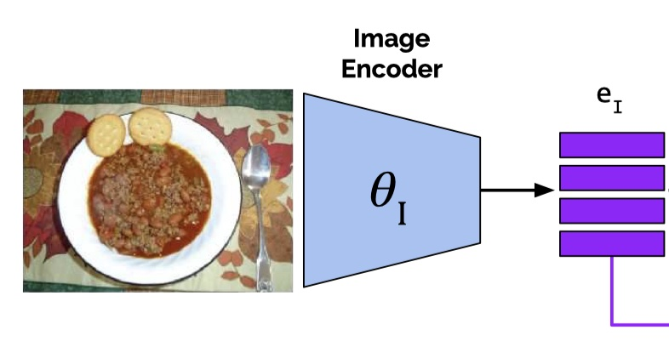
Image Encoder
Image representation is extracted with a ResNet-50 using the last convolutional layer.

Slide 6
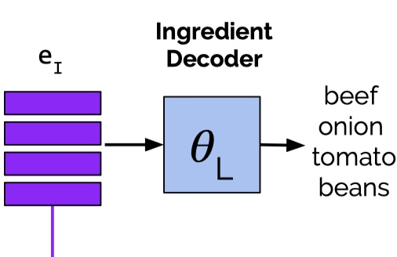
Ingredient Decoder
Ingredients are generated either in list or set

Slide 7
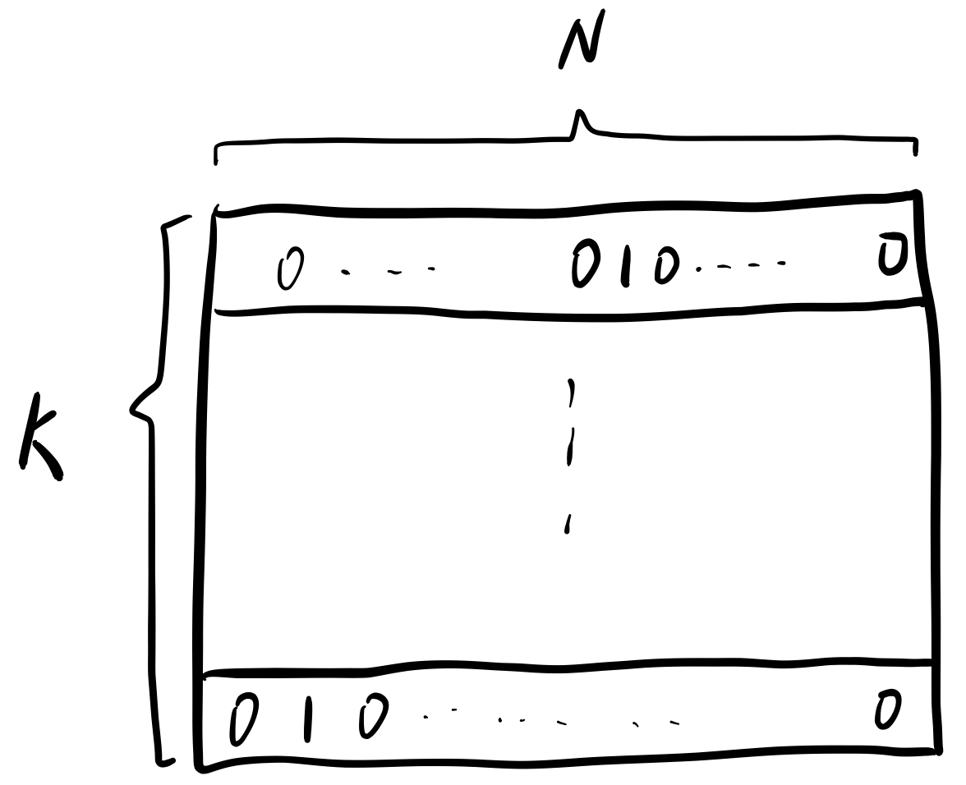
Variable sized list of ingredients
L：
Ordered
Factorize probability using conditional probabilities

Slide 8
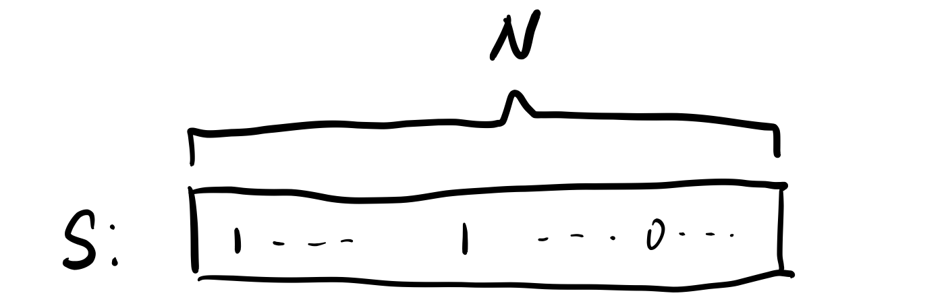
Variable sized set of ingredients
Element dependencies within the set
Unordered

Slide 9
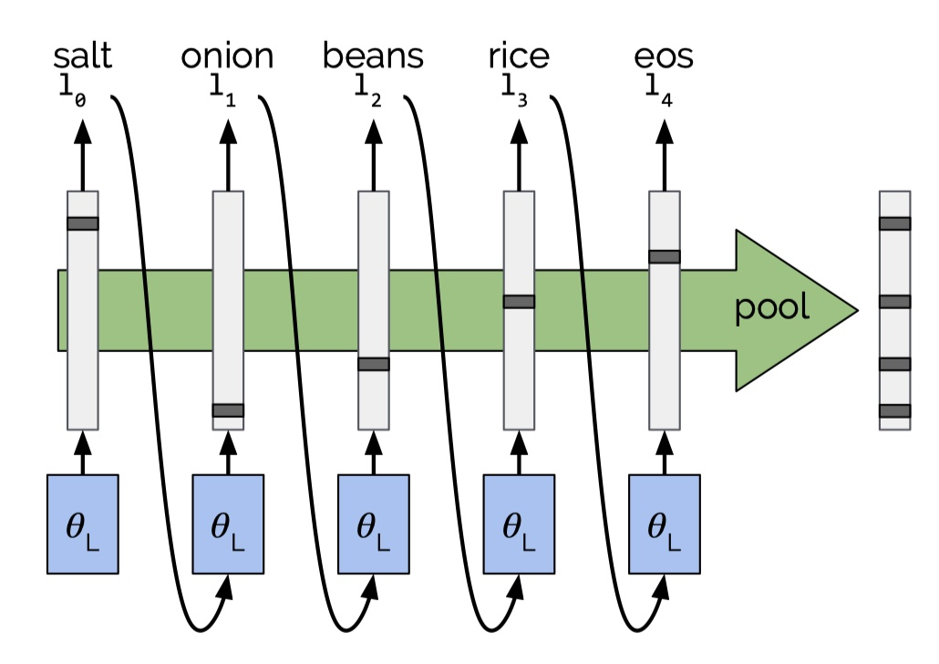
Variable sized set of ingredients: 1
Remove the order:

Slide 10
Variable sized set of ingredients: 2
Using target distribution to model the joint distribution of set elements and train a model by minimizing the cross-entropy loss between the ground-truth distribution and the model’s output distribution

Slide 11
Instruction Decoder

Slide 12
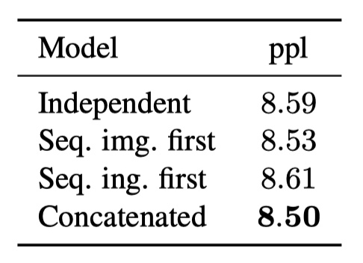
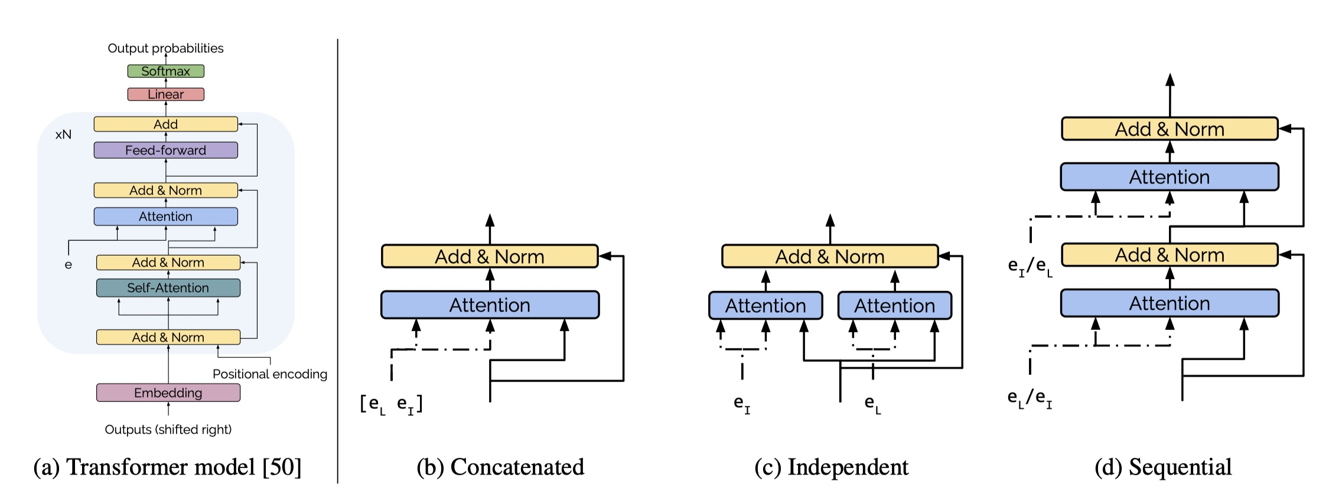
Transformer blocks in instruction decoder AND
Fusion strategy

Slide 13
I2R: From image-to-sequence of instructions without predicting ingredients
L2R:Removing visual features and predicting instructions directly from ingredients

Slide 15
