Slide 1
BMVC 2019 Oral

Slide 2
Problem:
have not not seen a notable improvement or comprehensive analysis in exploiting the structured scene graph for Visual QA
Hedi Ben-Younes, Rémi Cadene, Nicolas Thome, and Matthieu Cord. Block: Bilinear superdiagonal fusion for visual question answering and visual relationship detection. arXiv preprint arXiv:1902.00038, 2019.
Remi Cadene, Hedi Ben-younes, Matthieu Cord, and Nicolas Thome. MUREL: Multimodal relational reasoning for visual question answering. In CVPR, 2019.
Linjie Li, Zhe Gan, Yu Cheng, and Jingjing Liu. Relation-aware graph attention network for visual question answering. arXiv preprint arXiv:1903.12314, 2019
Yuanzhi Liang, Yalong Bai,Wei Zhang,Xueming Qian, LiZhu, and TaoMei. Rethinking visual relationships for high-level image understanding. arXiv preprint arXiv:1902.00313, 2019
Jiaxin Shi, Hanwang Zhang, and Juanzi Li. Explainable and explicit visual reasoning over scene graphs. In CVPR, 2019
Zhuoqian Yang, Jing Yu, Chenghao Yang, Zengchang Qin, and Yue Hu. Multi-modal learning with prior visual relation reasoning. arXiv preprint arXiv:1812.09681, 2018
multiple possible reasons:
not yet have algorithms to construct high-quality scene graphs
not yet have algorithms to effectively leverage scene graphs
do not explicitly need scene graphs for VQA

Slide 3
Contributions:
scene graphs have already captured essential information for VQA
apply GNN without complicated attention and fusion mechanisms show promising results
easy to interpret the reasoning process
质疑：
只在VG上测试VQA性能，缺少说服力
VG上有许多问题是根据scene graph而提的简单问题，能显示地在scene graph上找到答案
文中所提方法难处理较复杂的推理问题

Slide 4
Related Work
Visual question answering (Visual QA)
the performance gain between a simple MLP baseline and a complicated attention model is merely within 5 ∼ 7%. The improvement brought by newly proposed models usually lies within 0.5% .
QA with knowledge bases
exploiting knowledge bases (KBs) to store complex structured and unstructured information so as to support combinatorial reasoning has been widely investigated
Curated KBs, such as Freebase and YAGO2 , extract < entity − relationship − entity > triples from knowledge sources like Wikipedia and WordNet. Extracted KBs, on the other hand, extract knowledge in the form of natural language from millions of web pages
The scene graph examined in our work could be seen as a form of curated KBs that extracts triplets from images.
Scene Graphs
they usually integrate multiple techniques (e.g., scene graph generation, attention, multi-modal fusion) into one hybrid model to obtain state-of-the-art performance. It is thus hard to conclude if scene graphs truly contribute to the improvement
in an early study of the Visual Genome dataset, only 40% of the questions could be answered exactly with the human annotated scene graphs. This ratio is surprisingly low considering the detailed knowledge encoded by scene graphs and the existing Visual QA models’ performance.

Slide 5
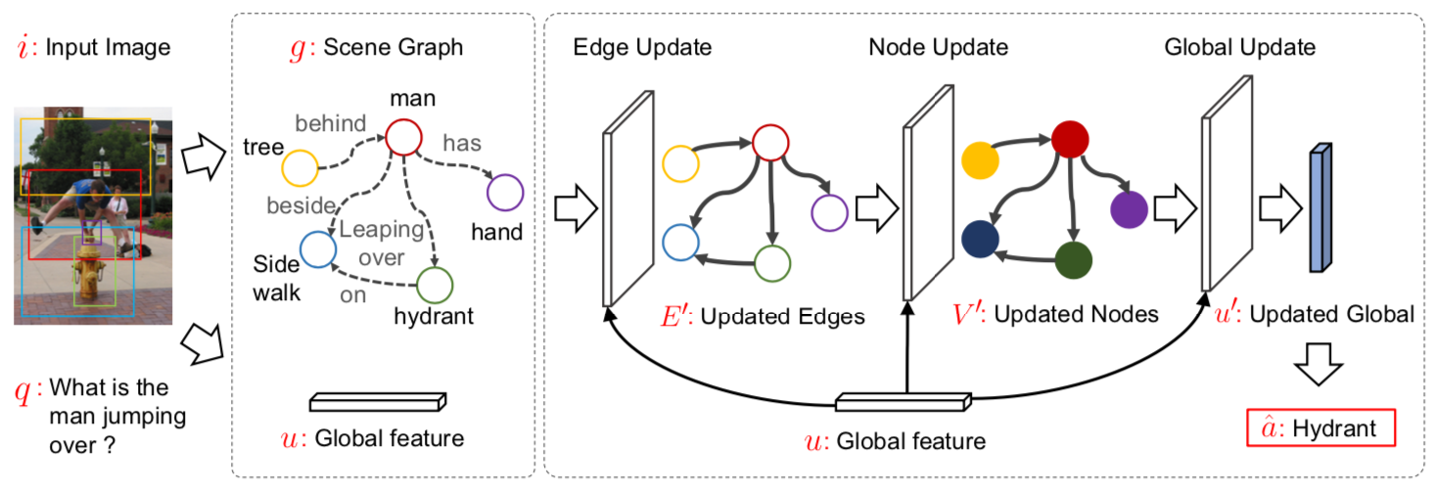
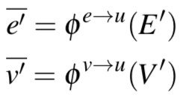
Edge updates:
Global updates:
unfactorized models:
Node updates:
factorized models:

Slide 6
Learning unfactorized Visual QA models
Learning factorized Visual QA models

Slide 7
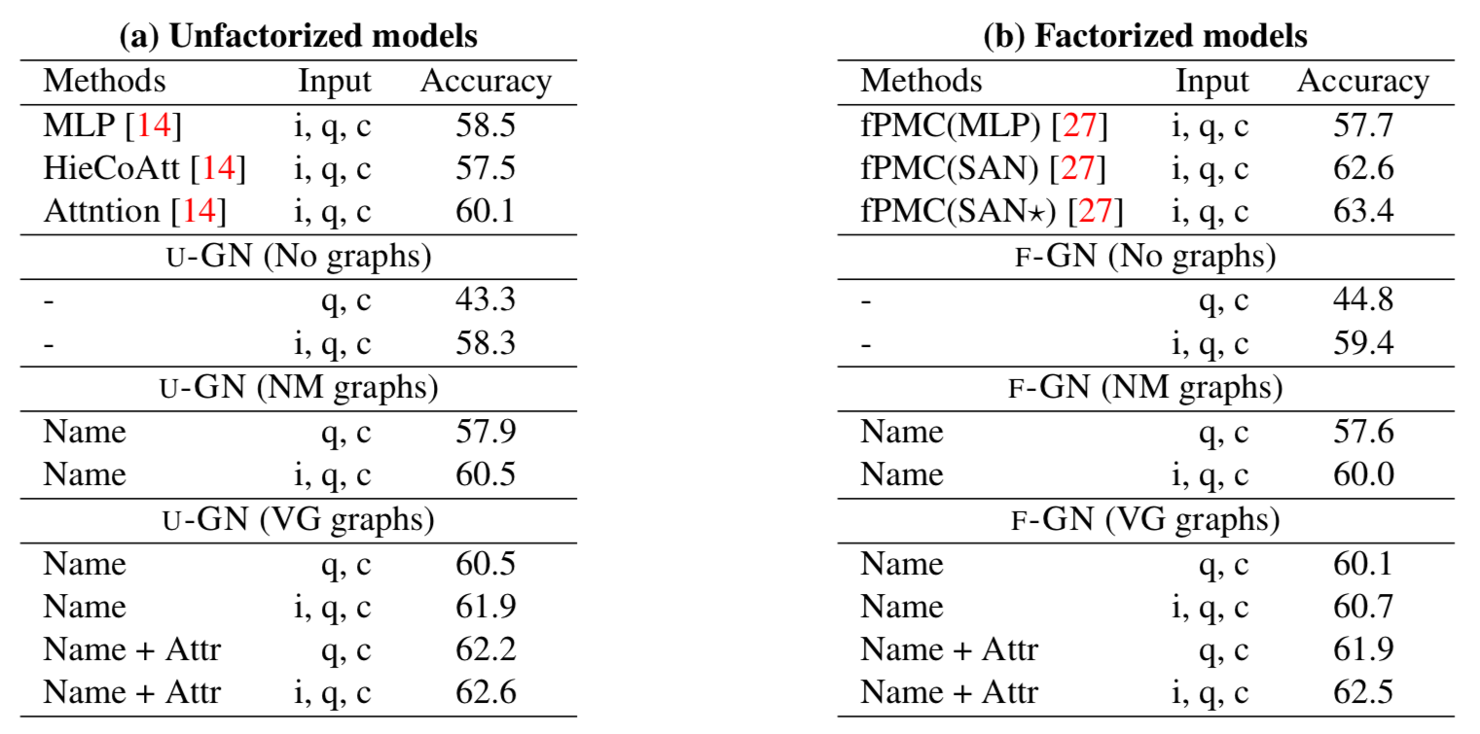
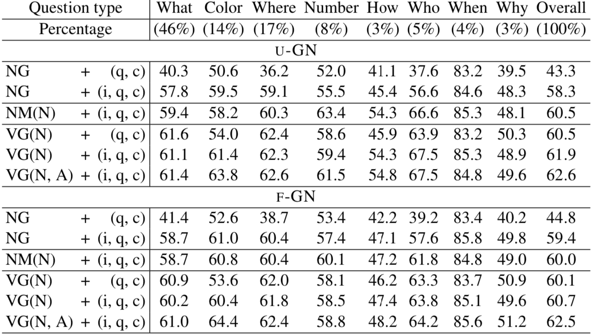

Slide 8
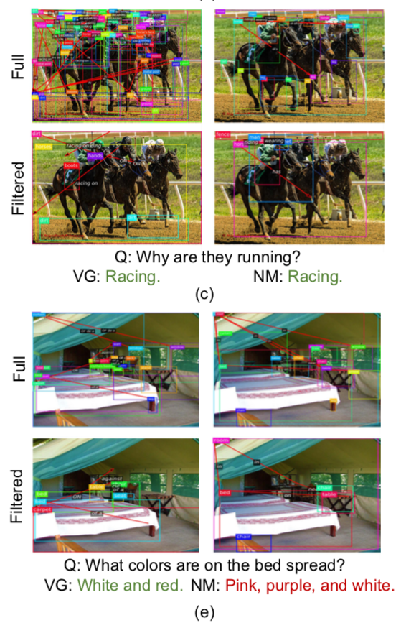
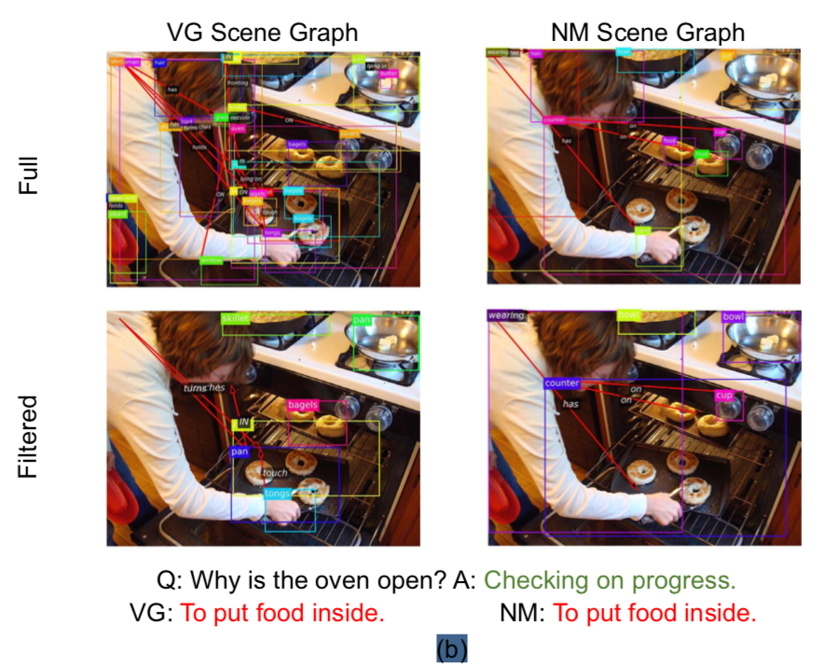

Slide 9
ACM MM17

Slide 10
ImageNet-VidVRD 2017
The dataset contains 1,000 videos selected from ILVSRC2016-VID dataset based on whether the video contains clear visual relations. It is split into 800 training set and 200 test set, and covers common subject/objects of 35 categories and predicates of 132 categories.
VidOR 2019
VidOR (Video Object Relation) dataset contains 10,000 videos (98.6 hours) from YFCC100M collection together with a large amount of fine-grained annotations for relation understanding. In particular, 80 categories of objects are annotated with bounding-box trajectory to indicate their spatio-temporal location in the videos; and 50 categories of relation predicates are annotated among all pairs of annotated objects with starting and ending frame index. In total, there are around 50,000 object and 380,000 relation instances annotated. To use the dataset for model development, we split the dataset into 7,000 videos for training, 835 videos for validation, and 2,165 videos for testing.

Slide 11
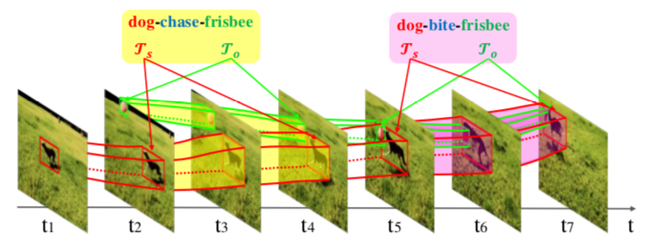
Strength
disambiguate similar predicates
dynamic relations → more general and feasible
Challenge
require to localize objects with bounding box trajectories
needs to temporally localize the visual relations within maximal duration
needs to predict more types of visual relations than ImgVRD because some visual relations can only be detected in videos, such as “A-towards-B” and “A-faster than-B”.

Slide 12
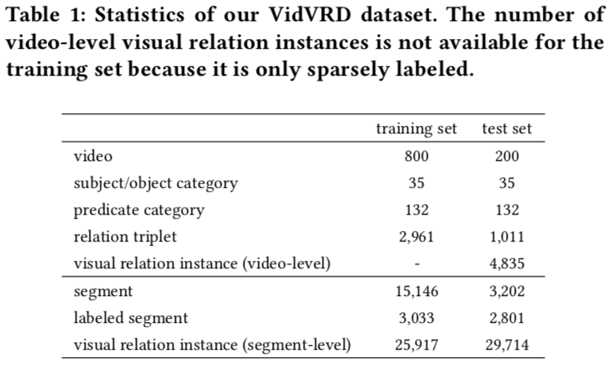
Dataset
Transitive verb: bite, chase, drive, fall (off), feed, fight, follow, hold, kick, play, pull, ride, touch, watch;
Comparative: faster, larger, taller;
Spatial: above, away, behind, beneath, inside, in front of, next to, on the left of, on the right of, past, towards;
Intransitive verb: creep, fly, jump, lie, move, run, sit, stand, stop, swim, walk
segment level annotation
3219 relation triplets (258 never appear in training)
4835 visual relation instances (432 instances are unseen)

Slide 13
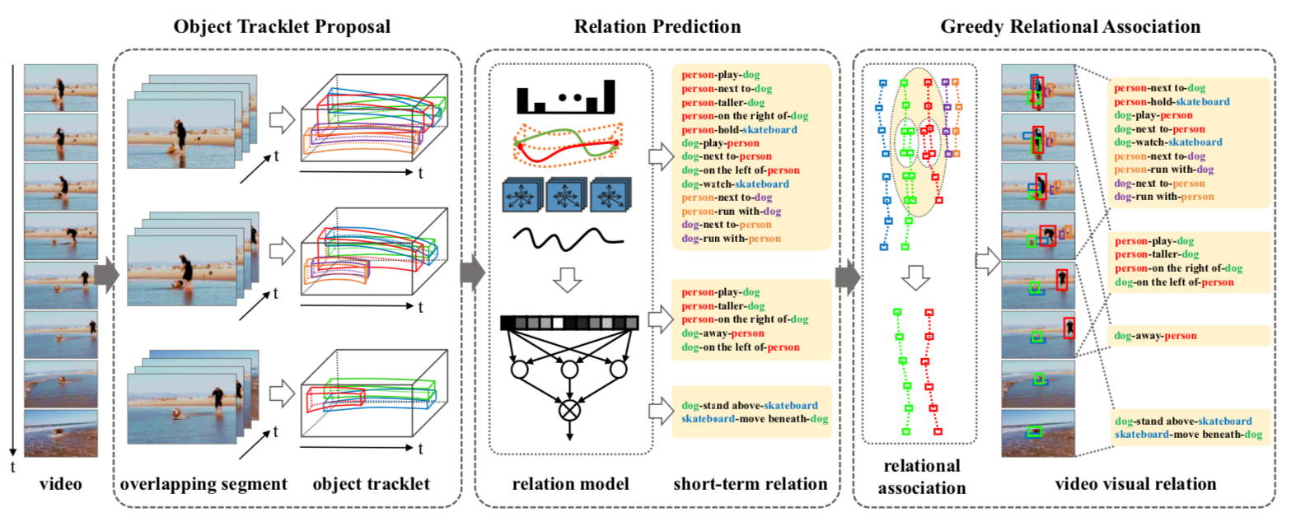
Pipeline

Slide 14
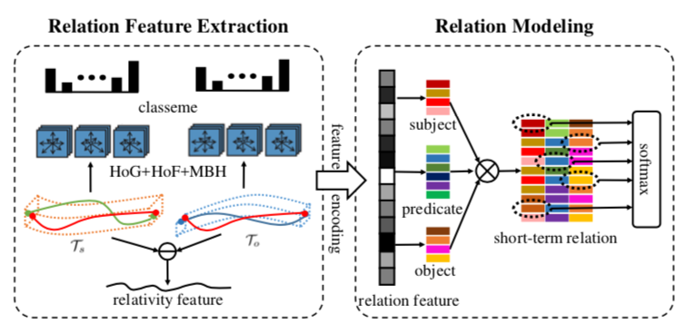
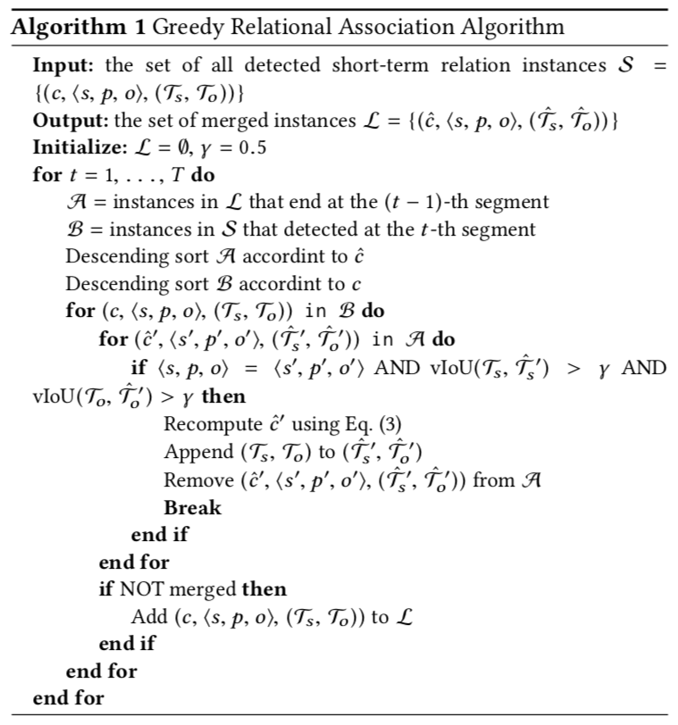

Slide 15
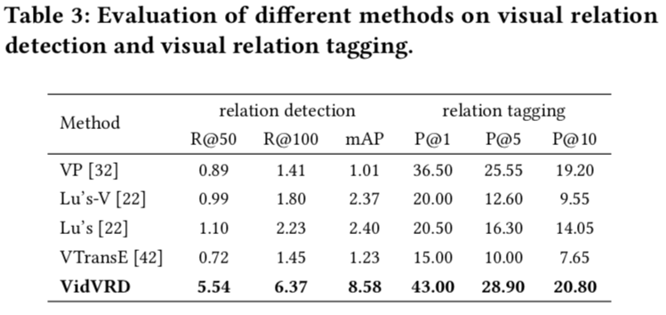
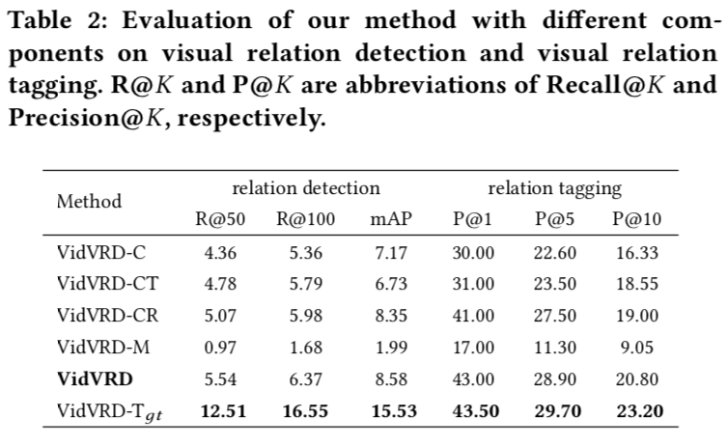
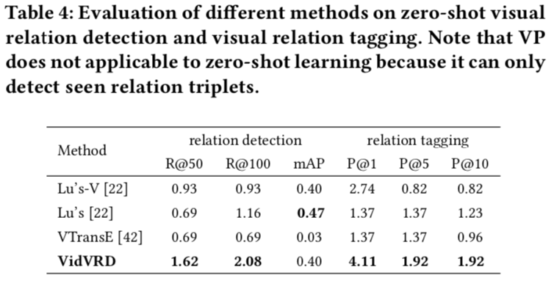

Slide 16
