Slide 1
ICML2019

Slide 2
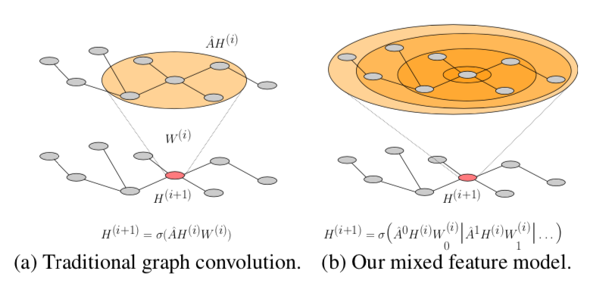
Gabor filters are fundamental to the human visual cognitive system
Realizing Gabor-like filters in Graph domains ought to yield a general advantage

Slide 3
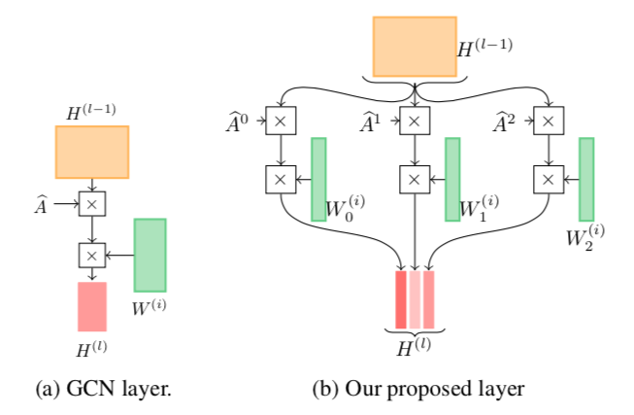

Slide 4
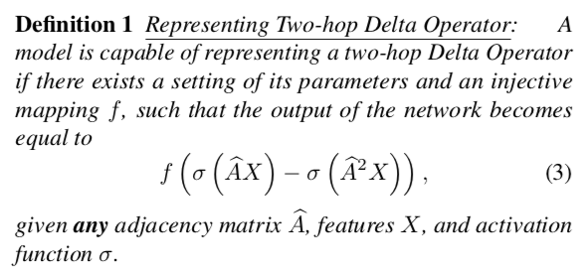
Notes:
更远的，更具有反差的信息会被更好地利用

Slide 5
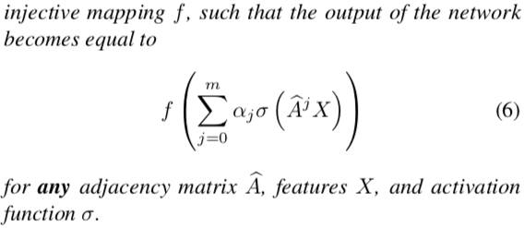

Slide 6
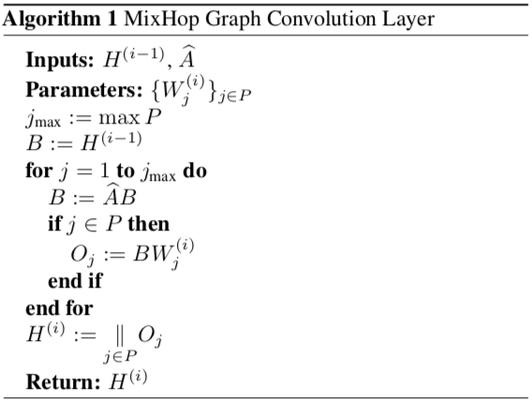
Computational Complexity

Slide 7
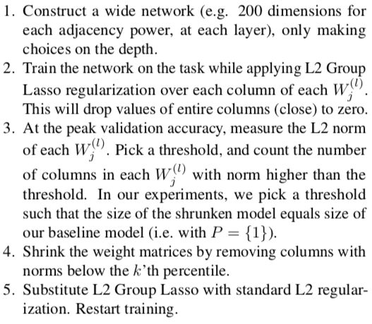
Output Layer
Learning Adjacency Power Architectures

Slide 8
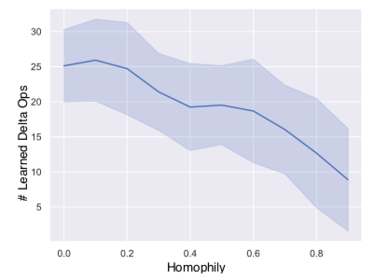
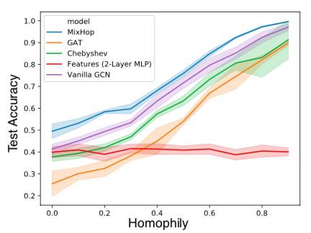
Experiments
The MixHop model learns delta operators.
Higher order graph convolutions using neighborhood mixing can outperform existing approaches on real semi-supervised learning tasks.
When learning a model architecture for MixHop the best performing architectures differ for each graph

Slide 9
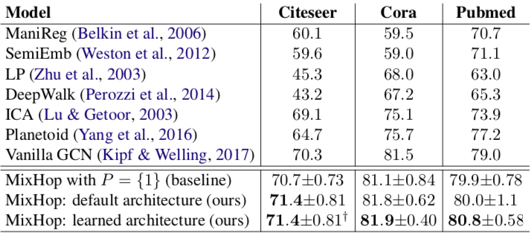
Experiments

Slide 10
Conclusion
Graph Neural Networks cannot learn general neighborhood mixing functions.
Proposing a graph convolutional layer that utilizes multiple powers of the adjacency matrix
To learn general mixing of neighborhood information, including averaging and delta operators in the feature space, without additional memory or computational complexity
To learn a unique architecture that is optimized for each dataset

Slide 11
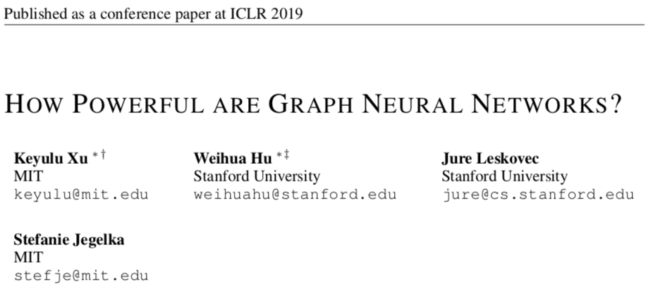

Slide 12
Contributions
There is limited understanding of GNNs representational properties and limitations
We show that GNNs are at most as powerful as the WL test in distinguishing graph structures.
We establish conditions on the neighbor aggregation and graph pooling functions under which the resulting GNN is as powerful as the WL test.
We identify graph structures that cannot be distinguished by popular GNN variants, such as GCN and GraphSAGE, and we precisely characterize the kinds of graph structures such GNN-based models can capture.
We develop a simple neural architecture, Graph Isomorphism Network (GIN), and show that its discriminative/representational power is equal to the power of the WL test.

Slide 13
Weisfeiler-Lehman test
The graph isomorphism problem:
ask whether two graphs are topologically identical .
WL subtree kernel:
measures the similarity between graphs .
essentially counts of different rooted subtrees in the graph .
(is analogous to neighbor aggregation in GNNs)

Slide 14
The Representational power of a GNN
Intuitively:
A maximally powerful GNN maps two nodes to the same location
only if :
they have identical subtree structures with identical features on the corresponding nodes.
A maximally powerful GNN would never map two different neighborhoods to the same representation.

Slide 15
Building Powerful Graph Neural Networks
Beyond WL test:
GNNs not only discriminate different structures , but also learn to map similar graph structures to similar embeddings and capture dependencies between graph structures.

Slide 16
Graph Isomorphism network(GIN)
GIN is one such example among many maximally powerful GNNs, while being simple.
Readout: sum all node features from the same iterations.

Slide 17
Less Powerful But Still Interesting GNNs
1. 1-Layer perceptrons are not sufficient
With the bias term and sufficiently large output dimensionality, 1-layer perceptrons might be able to distinguish different multisets .
Weakness:
not adequately capture structural similarity; sometimes severely underfit training data.

Slide 18
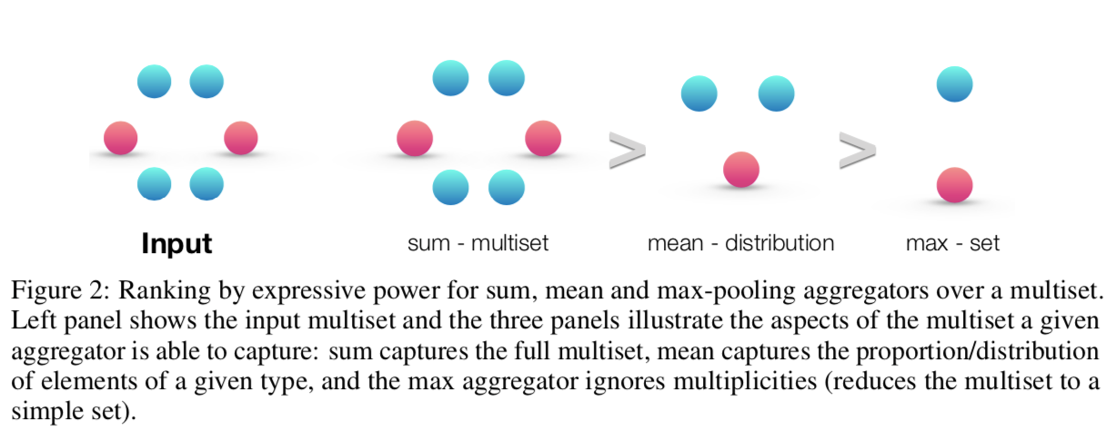
2. Structures that Confuse Mean and Max-Pooling
个人小结：
mean捕捉的是邻居节点特征的分布信息。
最大池化更有效是识别重要的节点或“skeleton”。
GCN更有效的情形：
graph中的统计信息和分布信息比结构信息更为重要时；
节点的特征更为多样化且很少重复时。
GIN的方法更适合于让模型去学习Graph的结构特点，而不是去更多依赖于输入的节点特征
3. Mean learns distributions
4. Max-pooling learns sets with distinct elements

Slide 19
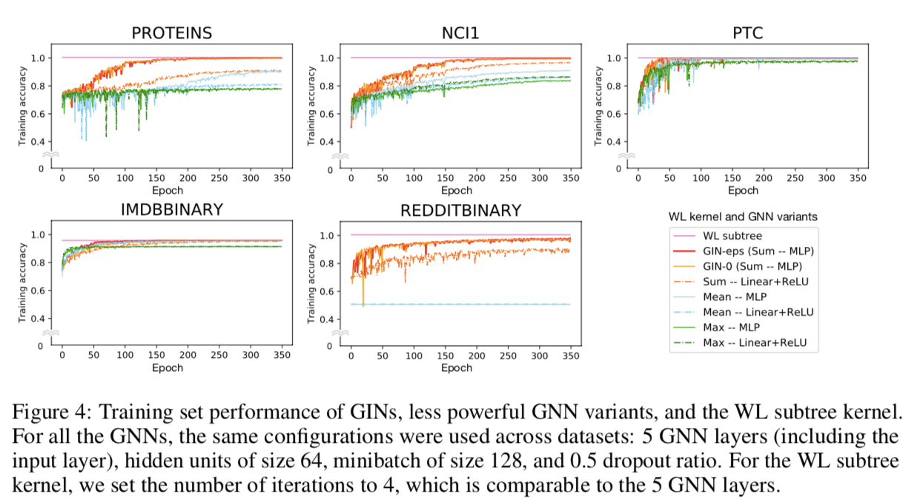
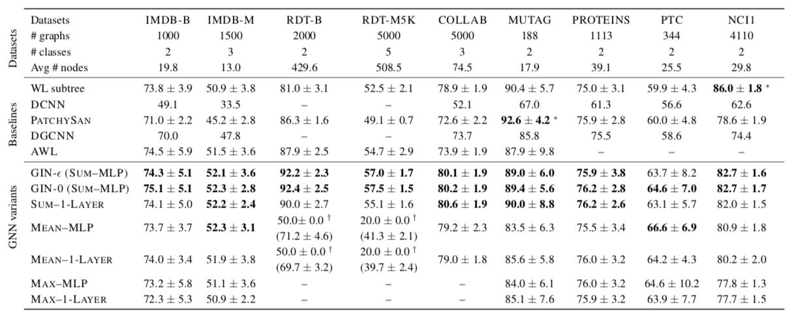

Slide 20
Conclusion
Developed theoretical foundations for reasoning about expressive power of GNNs
proved tight bounds on the representational capacity of GNN variants
designed a provably maximally powerful GNN under the neighborhood aggregation framework
Go beyond neighborhood aggregation

Slide 21
Open Review
Q: According to the current paper, can one say that all the graph Laplacian normalizations in previous GCN are not essential? Or redundant in some sense?
A: Note that the graph Laplacian normalization can decrease the representational power of GNNs, but it can also induce useful inductive bias for the applications of interest, e.g, semi-supervised learning. Therefore, we can not draw a decisive conclusion about the normalization only from the perspective of representational power. It is our future work to investigate generalization, inductive bias and optimization of different GNN variants.

Slide 22
Open Review
A: As a final remark, as R1 nicely commented, instead of Eq. (**), a node and neighbors can be concatenated, rather than summed, to achieve the same power as the WL test. Interestingly, as R1 cleverly predicted, in our preliminary experiments, we found such concatenation was harder to train compared to our simple GINs (both GIN-0 and GIN-eps) and achieved lower test accuracy. We leave the extensive investigation and comparison to our future work.
R: I do feel however that the authors should make it clear that discriminative power is not the only thing we care, and in most applications we are not doing graph isomorphism tests. The ability to tell, for example, how far two inputs are, when they are not the same is also very (and maybe more) important, which such isomorphism / injective map based analysis does not capture at all.

Slide 23
CVPR2019

Slide 24
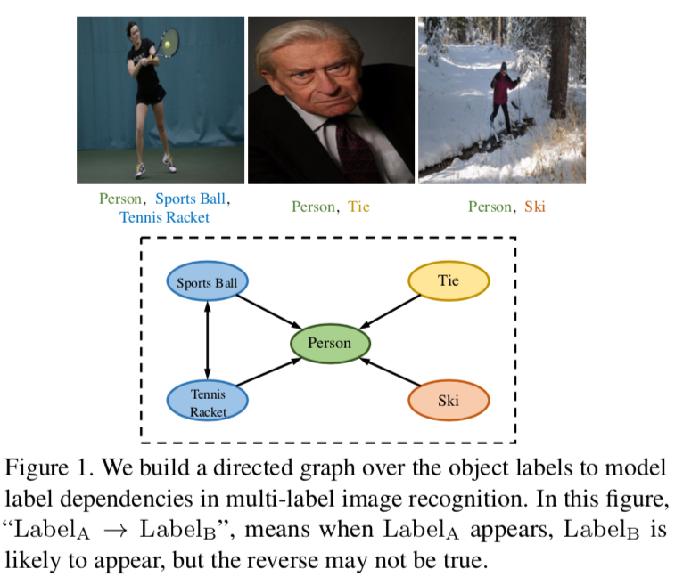

Slide 25
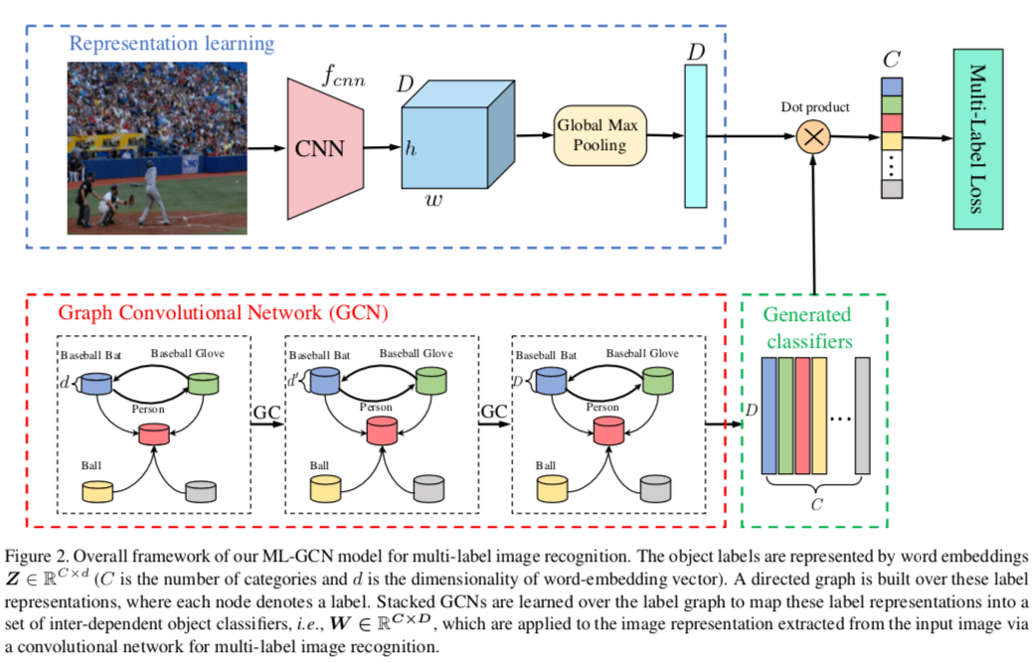

Slide 26
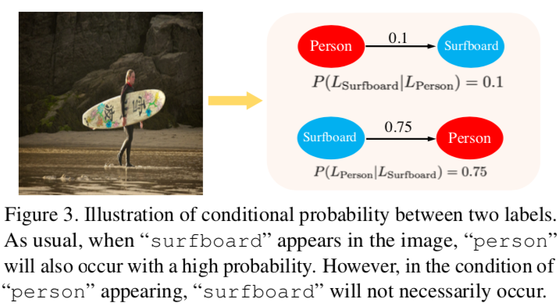
Correlation Matrix of ML-GCN
Two drawbacks:
may exhibit a long-tail distribution, where some rare co-occurrences may be noise
the number of co-occurrences from training and test may not be completely consistent. (hurt generalization capacity)
binary correlation matrix
asymmetrical correlation network
Over-smoothing problem:
the node feature s may be over-smoothed such that nodes from different clusters may become indistinguishable.
reweighted scheme

Slide 28
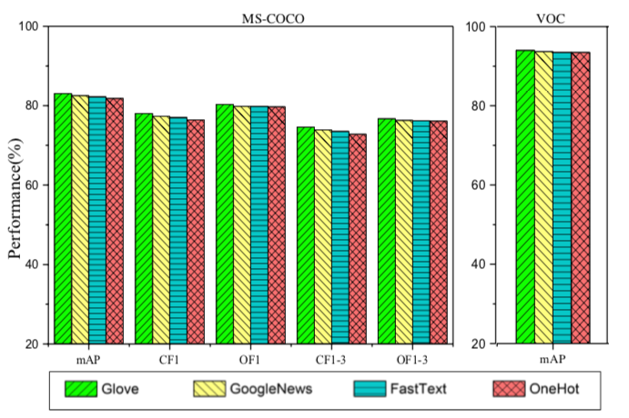
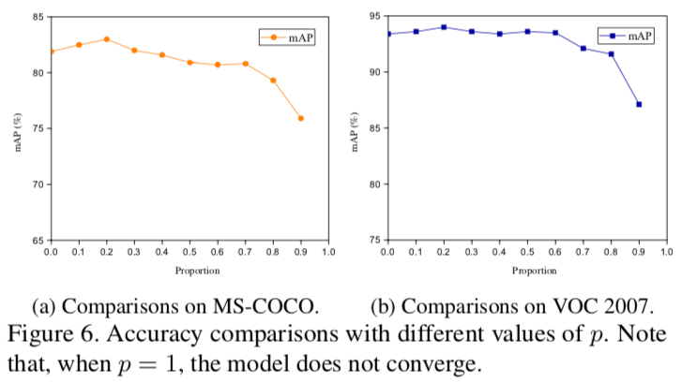
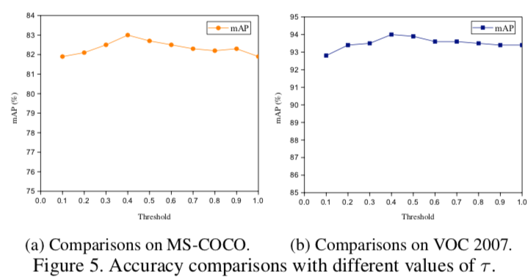

Slide 29
