Slide 1
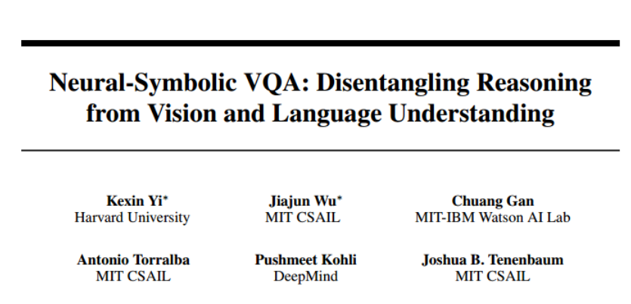

Slide 2
Motivation
Combine:
Deep representation learning for visual recognition & language understanding.
Symbolic program execution for reasoning.
Method
Recover a structural scene representation from the image
Recover a program trace from the question
Executes the program on the scene representation to obtain an answer

Slide 3
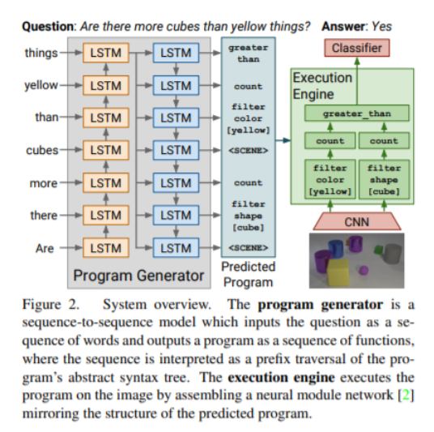
Inferring and Executing Programs for Visual Reasoning (IEP)

Slide 4
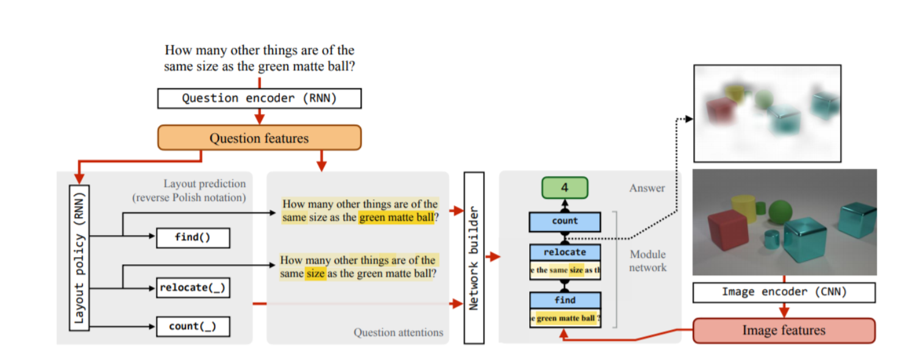
N2NMN

Slide 5
Contribution
Executing programs on a symbolic space is more robust to long program traces.
More data- and memory-efficient.
Symbolic program execution offers full transparency to the reasoning process.
We are thus able to interpret and diagnose each execution step.

Slide 6
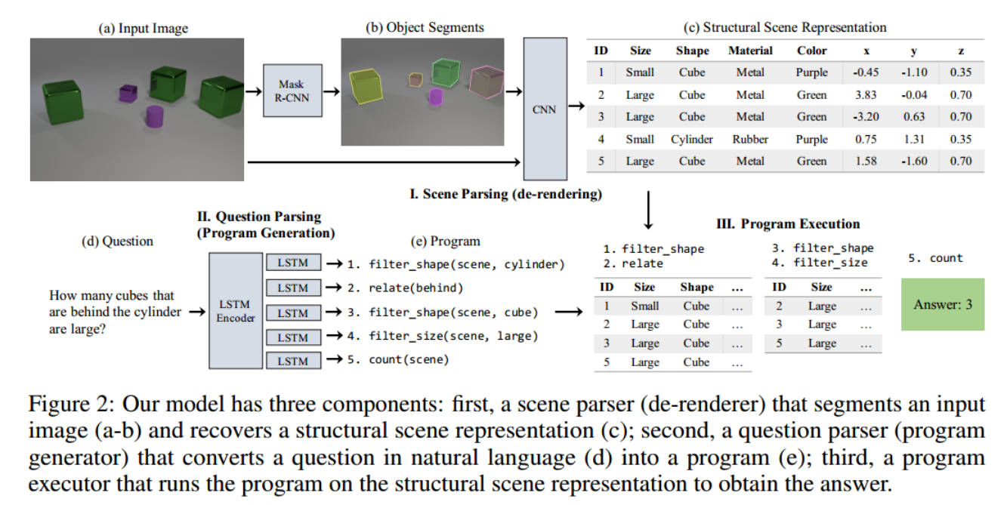
Approach
Scene Parsing (Mask rcnn)
Mask + Attributes + Pose & 3D coordinates
Question Parsing (LSTM)
Program Execution

Slide 7
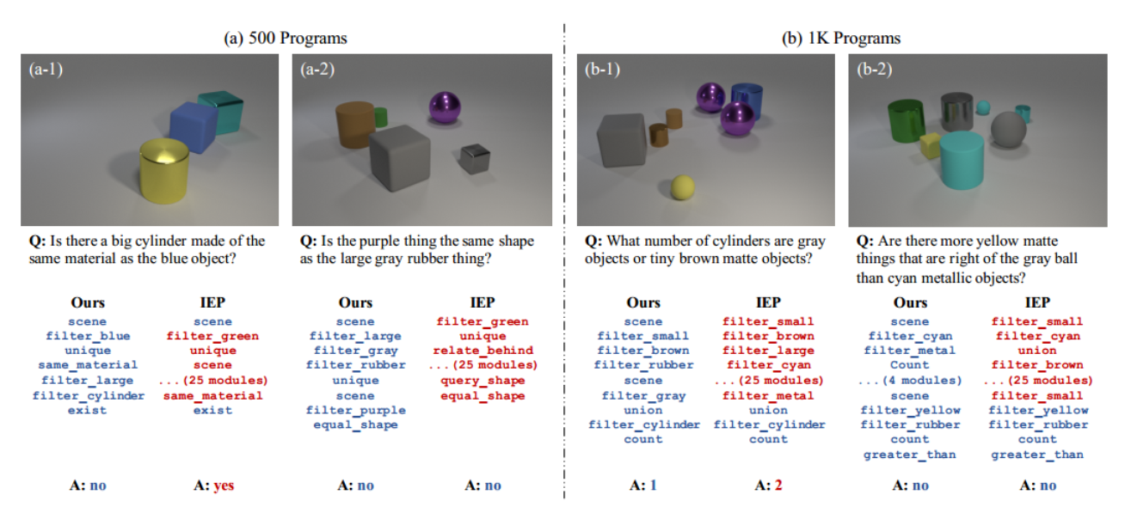
Approach
Question Parsing (LSTM)

Slide 8
Approach
Program Execution

Slide 9
Other details
Question parser training
2-step procedure to train the mapping from a question to a program
Select a small number of ground truth question program pairs to pretrain the model with direct supervision.
Pair it with our deterministic program executor, and use REINFORCE to fine-tune the parser on a larger set of question-answer pairs
Using only the correctness of the execution result as the reward signal.

