Slide 2
Current VQA
Predicting the correct answer from a multi-modal representation.
Weakness
图片只体现了静态信息，忽视了temporal coherence
视觉内容有时不能提供答案所需的全部信息->需要额外知识
所以出现了video question answering (VideoQA) 和 knowledge-based visual question answering (KBVQA)
However, a common framework for addressing multi-question types in VQA is still missing.

Slide 3
Contributions
Introducing a general framework: both video understanding and knowledge-based reasoning are required to answer questions.
Create KnowIT VQA - a dataset for KBVQA in videos.
A two-piece model
Acquires, processes, and maps specific knowledge into a continuous representation inferring the motivation behind each question
Fuses video and language content together with the acquired knowledge in a multi-modal fashion to predict the answer.

Slide 4
KnowIT VQA Dataset
视频来自生活大爆炸，同时包含了字幕和文字记录(transcripts)
每句话对应了时间点和说话人
通过transcripts划分场景clips，每段20s， 12264个clips

Slide 5
KnowIT VQA Dataset
AMT标注内容
QA：每个问题对应1个正确答案、3个错误答案
Knowledge：每个QA pair注释，不包含在clips中，回答问题需要的信息
QUESTION TYPE
visual-based (22%), 即依靠 video frames即可找到答案
textual-based (12%), 依靠字幕可以找到答案
temporalbased (4%), the answer is predictable from the current video clip at a specific time
knowledge-based (62%)，无法从当前clip找到答案，但在剧中其它地方可以找到

Slide 6
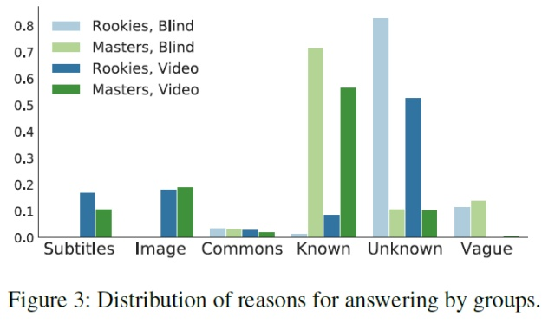
Human Evaluation
Evaluation on the questions
视频片段是否与回答问题相关
问题是否需要知识来回答
知识注释对于回答数据集中的问题是否有用
human baseline
Evaluation on the knowledge
rookies组看过相关知识后再次回答，准确率从0.683升到了0.823。

Slide 7
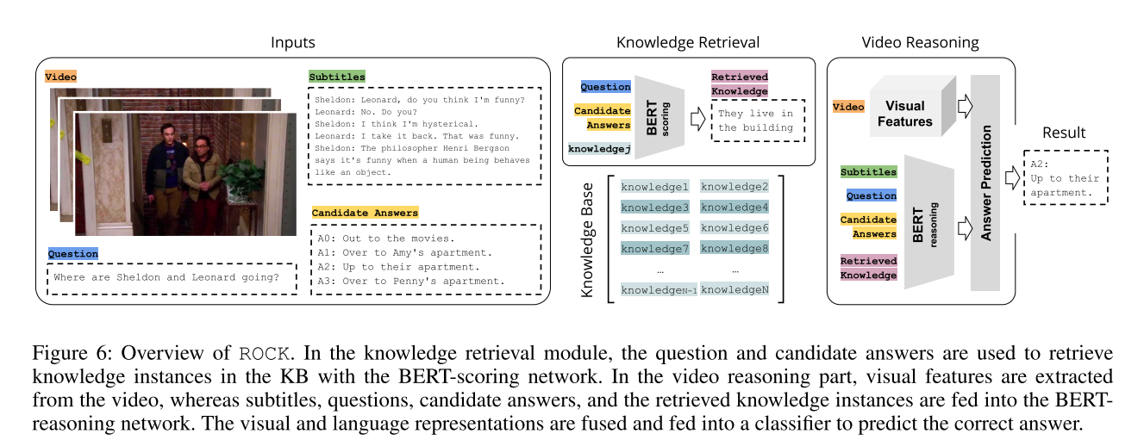
Method
ROCK (Retrieval Over Collected Knowledge) Model
生成Knowledge Base
Knowledge Retrieval Module
Video Reasoning Module

Slide 8
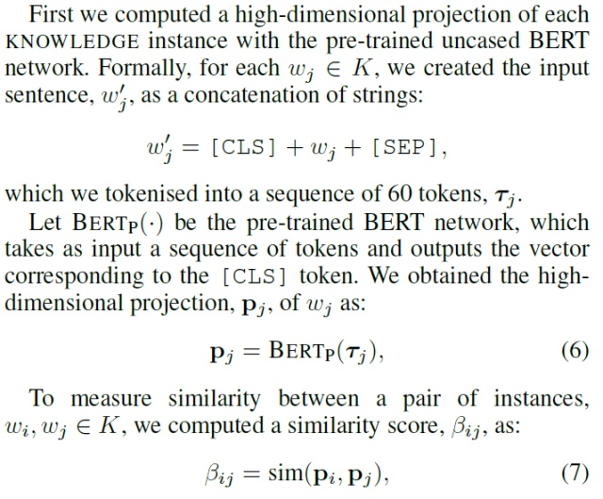
Knowledge Base
Specific information instead of generic knowledge graphs.
Rely on AMT workers annotated knowledge.
Knowledge Base Cleaning
构建无向图
保存余弦相似度>0.998的边
每个连通分量随机保存一个顶点

Slide 9
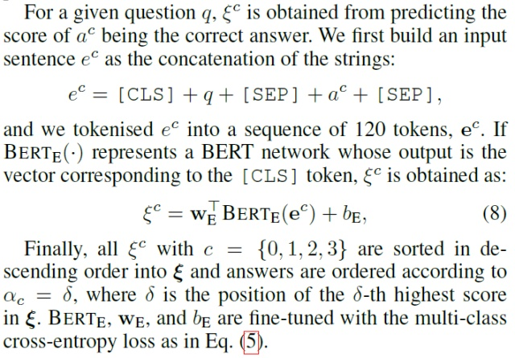
Knowledge Retrieval Module
Prior Score Computation
训练：
使用：选择分数最高的k个知识提取

Slide 10
Video Reasoning Module
Visual Representation: sample nf frames from each clip
Image features
ResNet50->拼接所有帧feat->fc->512ch
Concepts features
detector->C-dimensional bag-of-concept representation -> fc -> 512ch
Facial features
F-dimensional bag-of-faces representation-> fc -> 512ch
Caption features
Generate nf caption to describe its visual content. -> send to language model

Slide 11
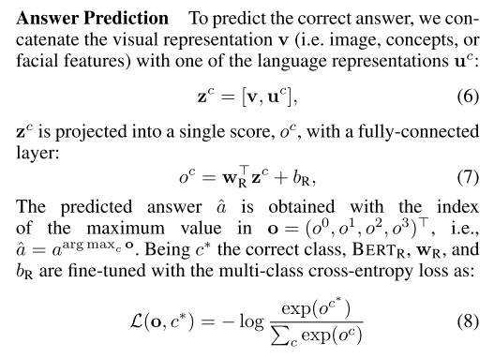
Language Representation
一个Q分别拼4个A，生成4个u

Slide 12
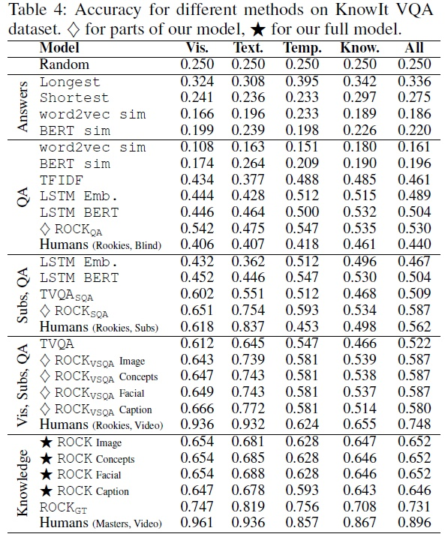
Experiments

